Slide 1
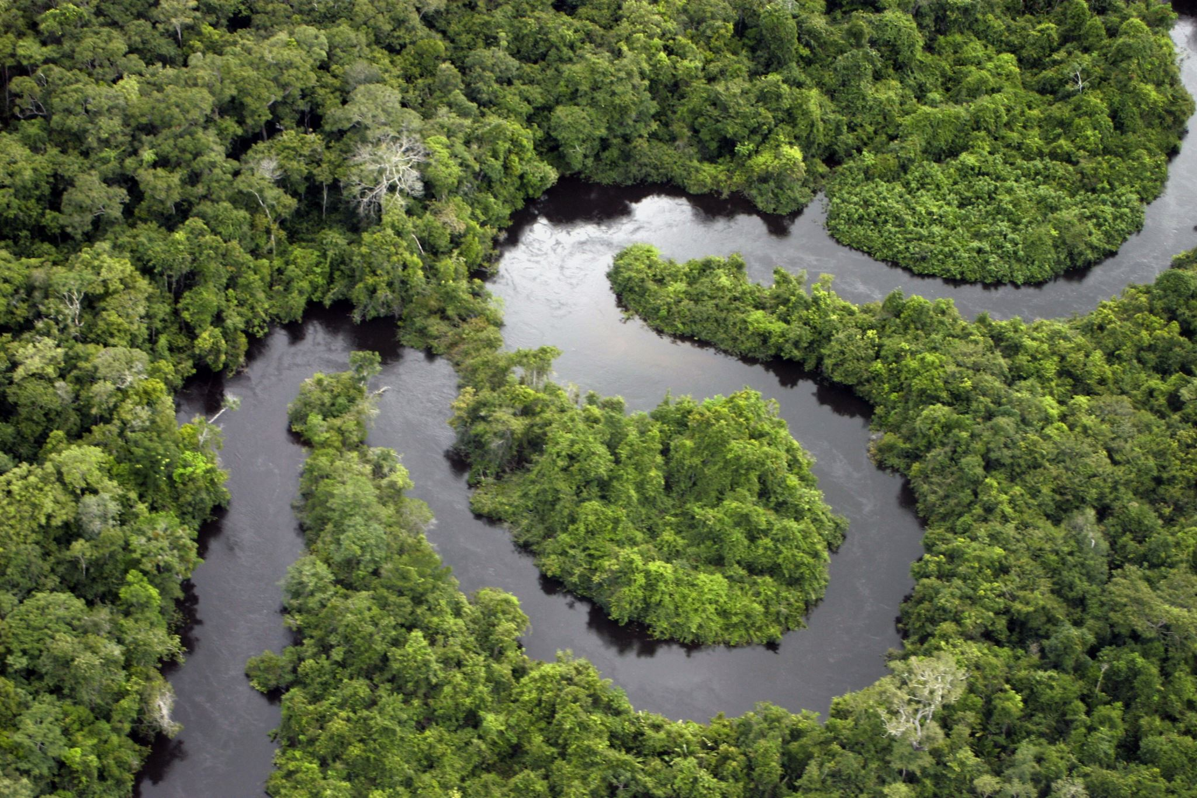
Rivers and streams
Group 1
Lara, Carmen, Karen, Selina, Valeria, Yvonne

Slide 2
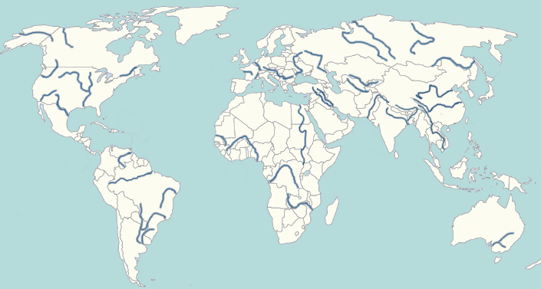
What are rivers and streams?
River drains most of the landscape of the world
Classified by where rivers occur in drainage network
Essential for economies and human histories
Remove waste
Deliver food
Renew oxygen
Strongly affects size, shape and behavior of river organisms

Slide 3
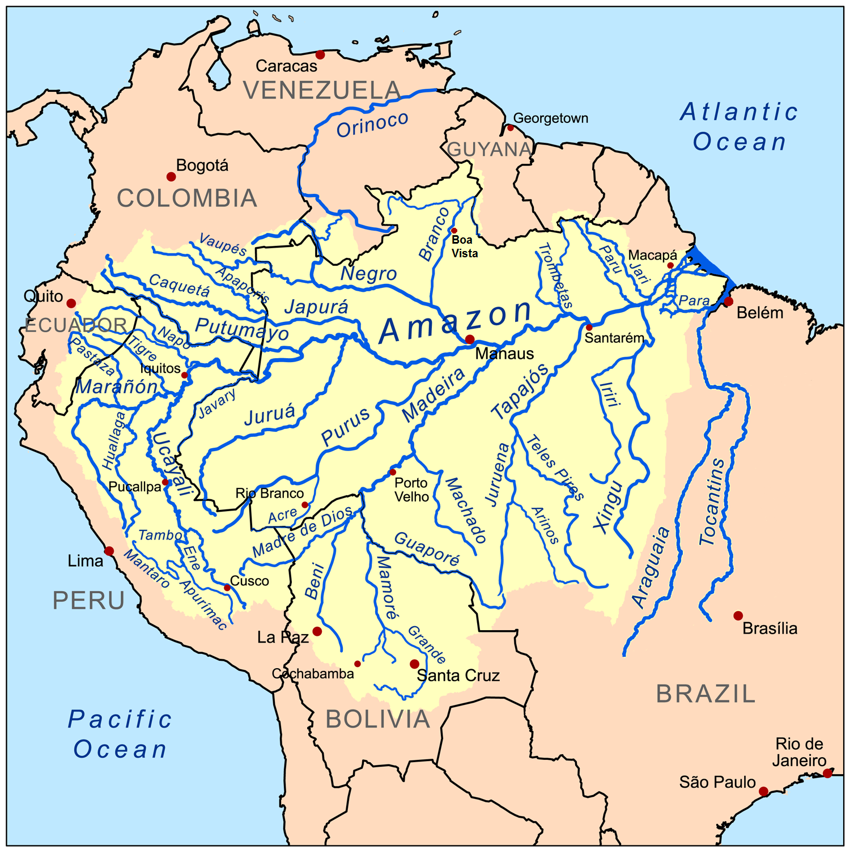
Structure
Length: pools, runs, riffles
Widths: variation of flow
Vertically: into the water surface, water column, bottom

Slide 4
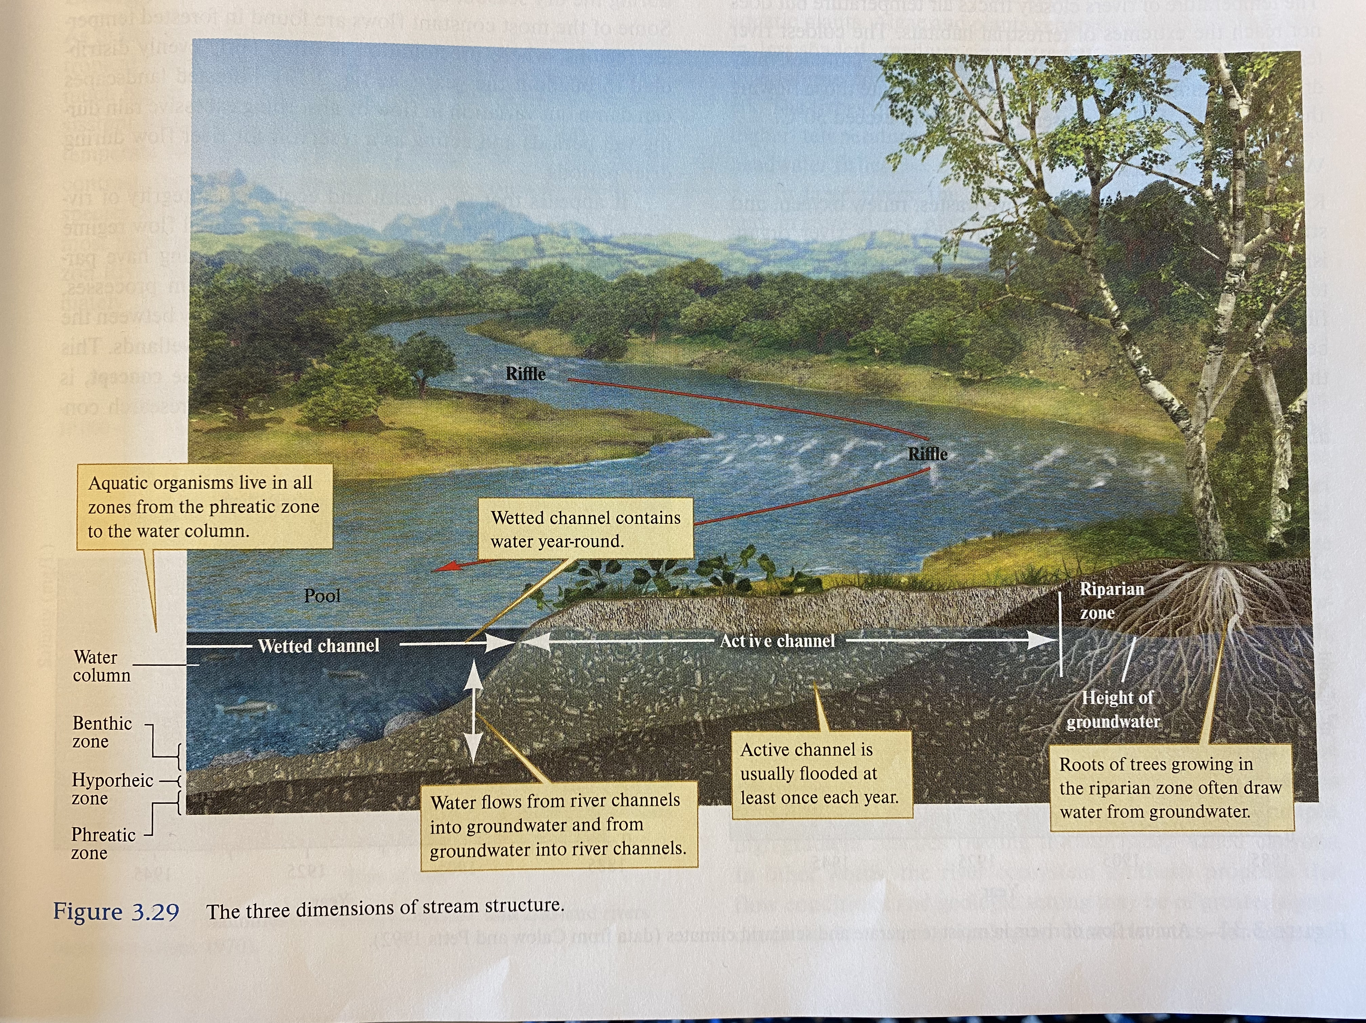

Slide 5
Physical conditions
Light
photosyntetic
Temperature
0-30°C
Water movements
More water = higher movement
different life occur in different movements

Slide 6
Chemical conditions
Salinity
Desert rivers generlly have the highest salinity. Tropical rivers have low sailiny.
Oxygen
Highest oxygen in cold rivers
Biology
# of fish is higher in tropical than temperate rivers;
Temperate Mississippi river has over 300 fish species vs. Tropical congo river has over 669 fish species

Slide 7
Why are rivers and streams important?
Habitat for many animals and plants.
Rivers transport a huge amount of life important minerals.
Important to human population for comerce and transportation, irrigation and waste disposal.
These are points why we have to protect the river. ☺

