Slide 1
Tropical Savanna
Ryan, Mercy, Pauline

Slide 2
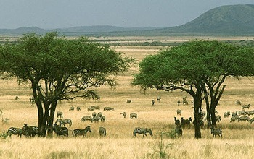
Savanna
Birthplace of humankind
From the Savanna we eventually moved out into every biome

Slide 3
Geography
Most tropical savannas occur north and south of tropical dry forests within 10° to 20° of the equator
Africa: tropical savanna extend from the west to East African Highlands to south-central Africa
South America: south-central Brazil, Venezuela, Colombia
Natural vegetation of northern Australia and southern Asia

Slide 4
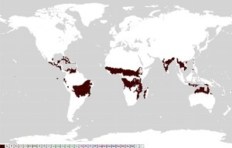

Slide 5
Climate
Life on the savanna cycles to the rhythms of alternating dry and wet seasons
Seasonal droughts combines with another important physical factor: fire
Rains come in summer, accompanied by intense lightning→ often starts fires at the beginning of wet season
Fires kill young trees while the grasses survive and quickly resprout
Fires help maintain the tropical savanna as a lanscape of grasslan and scattered trees

Slide 6
Climate
Generally drier than that of tropical dry forest
Venezuela receives as much rainfall as a tropical dry forest
Other savannas occur in areas that are as dry as deserts
How can savannas persist under desertlike conditions?

Slide 7
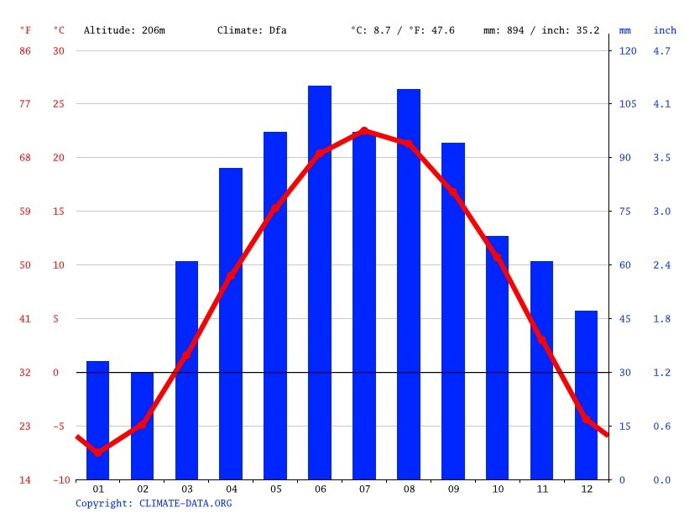

Slide 8
Soils
Soil layers with low permeability to water play a key role in maintaining many tropical savannas
savannas occur in areas of southwestern Africa that would otherwise support only dessert
Impermeable soils help savannas persist in wet areas (South America)
Scattered trees occur only where soils are well drained

Slide 9
Biology
Total primary production across the globe is second only to tropical rain forest
Biological activity on the savanna takes place near ground level, in grasses
The few tree species on the savanna resist fire well enough to be unaffected by low-intensity fires
Populated by wandering animals→ move in response to seasonal and year-to-year variations in rainfall and food availability
Kangaroos, large flocks of birds, humans
Mobile consumers: elephants, wildebeest, giraffes, zebras, lions

Slide 10
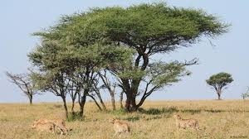

Slide 11
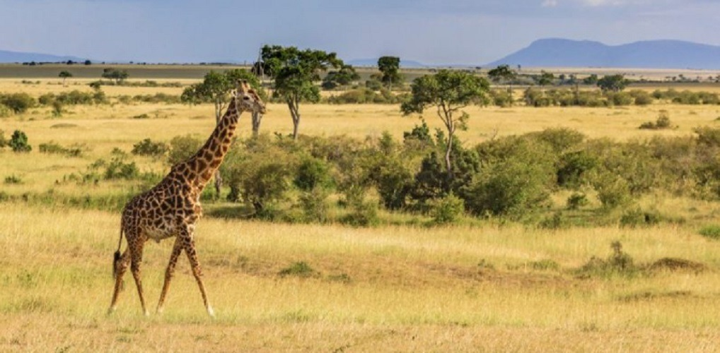

Slide 12
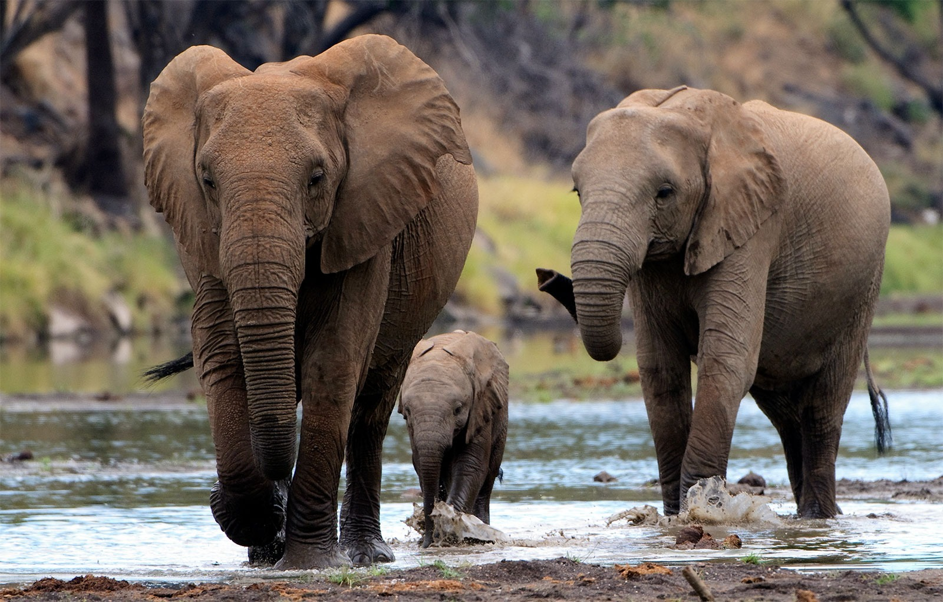

Slide 13
Human Influences
Product of the savanna
Savanna has been influenced by human activity
Indelible link between us and this biome: fire
Savanna as classroom where early humans observed and learned to use, control, and make fire
Humans set fire to the savanna, which in turn helped to maintain and spread the savanna itself
Manipulation of nature on a large scale

Slide 14
Human Influences
Humans subsisted on the savanna by hunting and gathering
They shifted from hunting to pastoralism
Today: livestock ranching is the main source of livelihood in the savanna regions
In modern-day sub-Sahran Africa high density of livestock and drought has devasteted much of the region

Slide 15
