Slide 1
Water week - Ecology
P14-16 / p 48-49

Slide 2
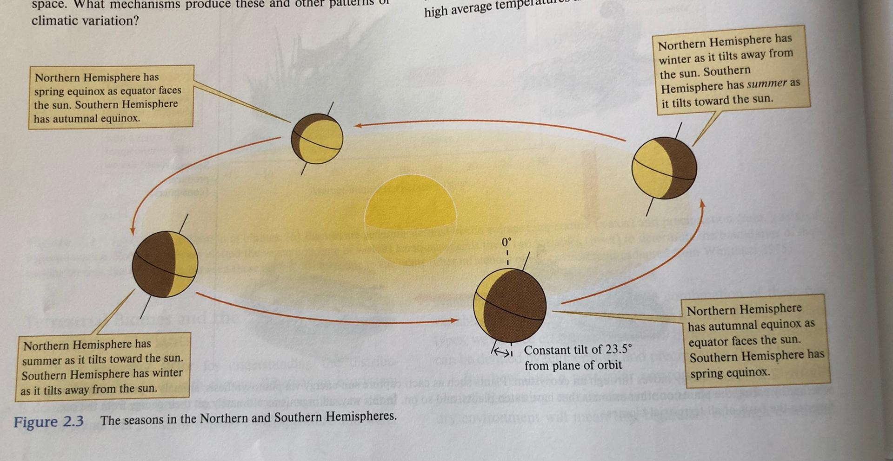

Slide 3
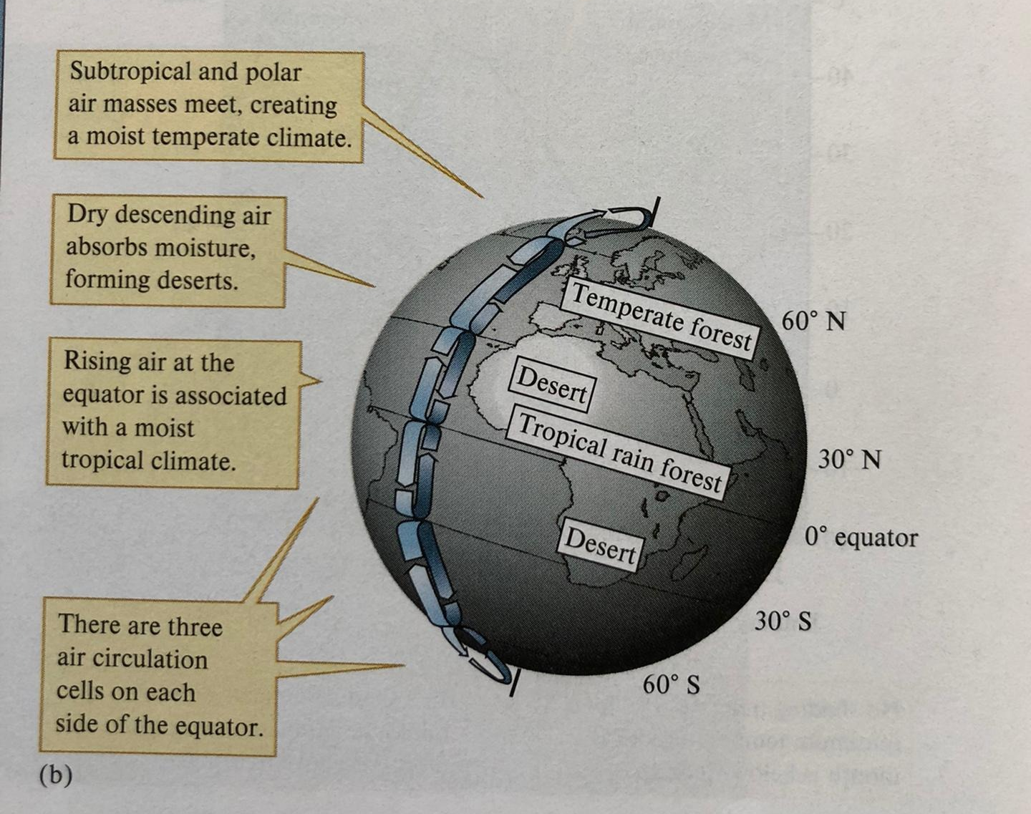

Slide 6
