Slide 1
Lea Zeller, Miriam Grauf, Lena Steiner
The Tropical Rain Forest

Slide 2
The Tropical Rain Forest

Slide 3
Tropical Rainforests of the World
Geography

Slide 4
Abiotic Factors

Slide 5
Abiotic Factors
Climate
Temperature
Rain
Soil
Sun
Wind
Water sources

Slide 6
Climate
Temperatures in tropical rain forests vary and change often
Doesn’t even change between night and day
Is around 25 to 27 degrees.
The rainfall ranges are about 2000 to 4000 mm per year
Dry: If there is a month with less than 100mm of rain
The atmosphere is hot and humid
No seasons: the climate is consistent all year

Slide 7
Rain/Precipitation
Precipitation is substantial
Incredible amount of moisture leads to many unique adaptations in plant species
"Wet season“: monsoons or heavier rainfall become more common
Temperate rainforests: some precipitation falls as snow at higher elevations
Humidity: varies from 77 to 88 percent (allowing the growth of epiphytes or "air plants“)

Slide 8
Soil
Heavy rains leach nutrients from the soil
Low quantity of organic matter due to the rapid decomposition in the warm, moist rain forest climate
Soils in the rain forest are often nutrient-poor, acidic and thin
More nutrients are tied up in living tissue (Leaves, branches, trunks,… ) than in soil
Some nutrients occurs where soils are very fertile (along rivers)

Slide 9
Poor Foundations
Loose, sandy and nutrient-poor soil due to rapid nutrient uptake
Trees use above-ground root systems to capture nutrients
Creates an incredibly nutrient-rich topsoil
large trees receive little nutritional support (deeper soil in the rainforest is so heavily leached) ➔ leads to adaptations like buttress roots

Slide 10
nutrient cycle - Recycling in the rainforest
Ion-poor rainwater removes nutrients from the trees through their leaves ➔ osmosis
Nutrients meet a network on the ground consisting of tree roots and fungi ➔ mycorrhiza community
Nutrients are immediately reabsorbed by roots and not stored in the soil: around 20% of the nutrients are lost to the system
Nutrients circulate constantly in the vegetation for the most part

Slide 11
Biotic Factors

Slide 12
Biotic Factors
flowering plants first appeared in tropical rainforests about 100 million years ago
about 40 million years ago, other types of vegetation evolved across larger areas as these forests expanded
over 50% of the plant and animal species on Earth are found in tropical rainforests

Slide 13
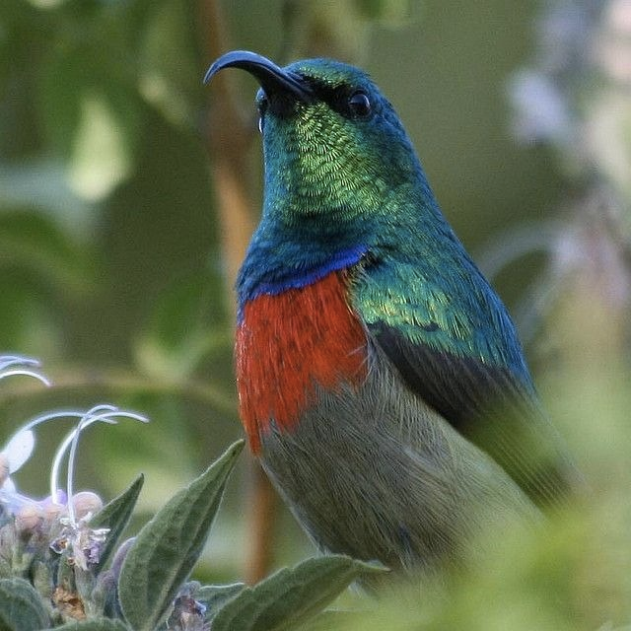
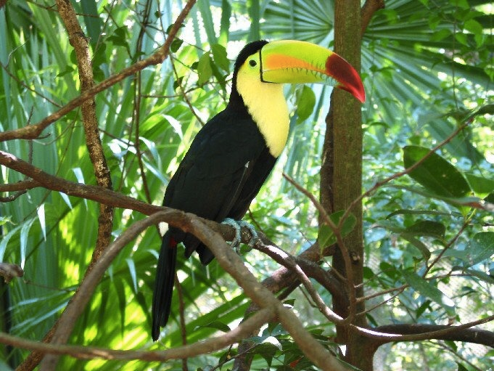
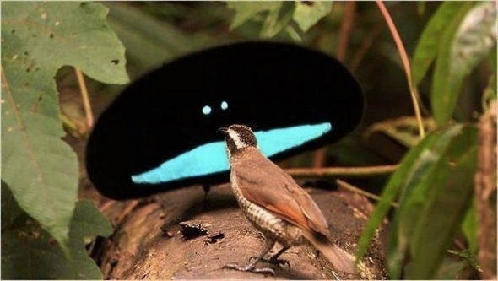
Animals
Birds:
collared sunbird
keel-billed toucan
bird of paradise

Slide 14
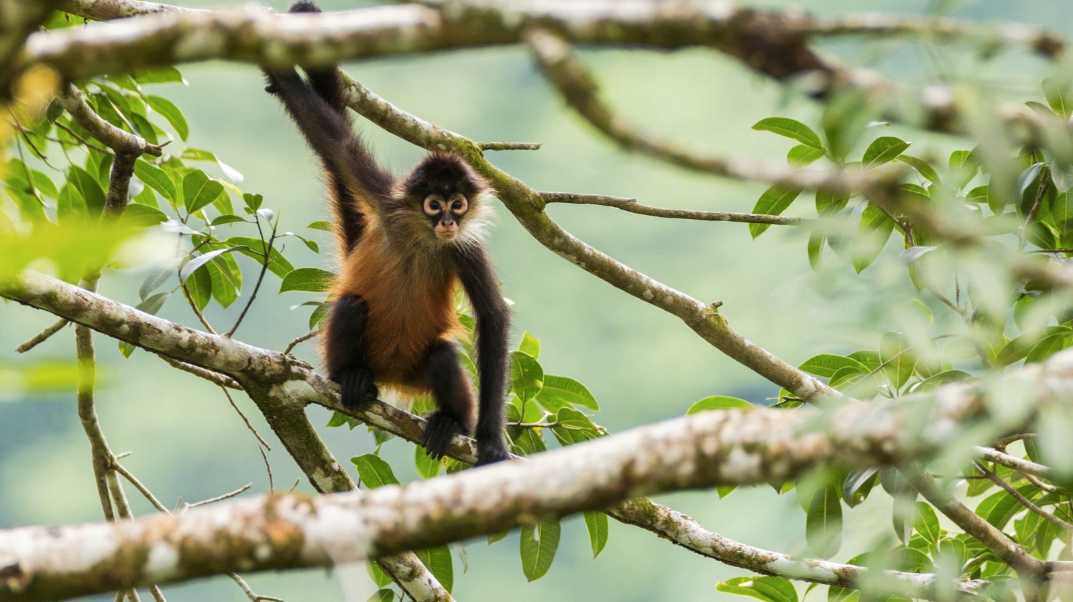
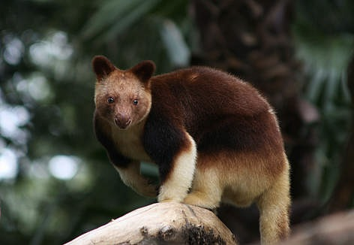
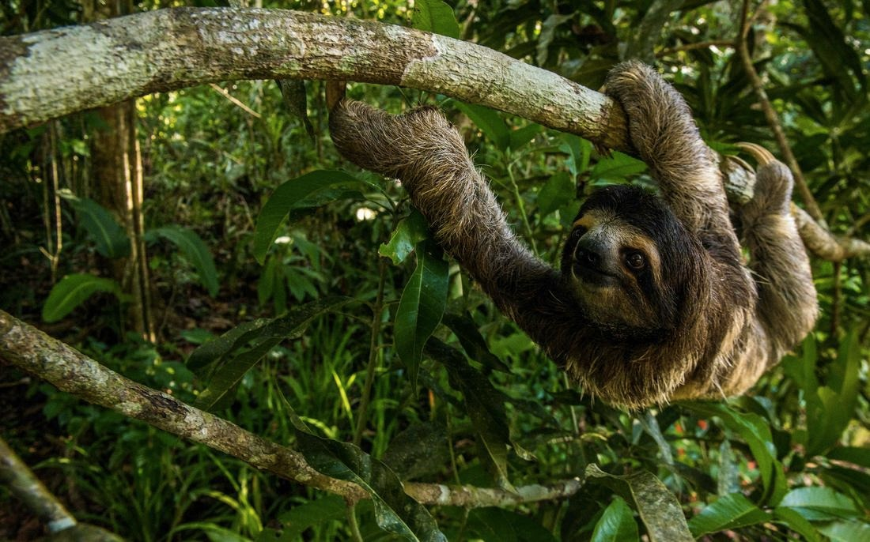
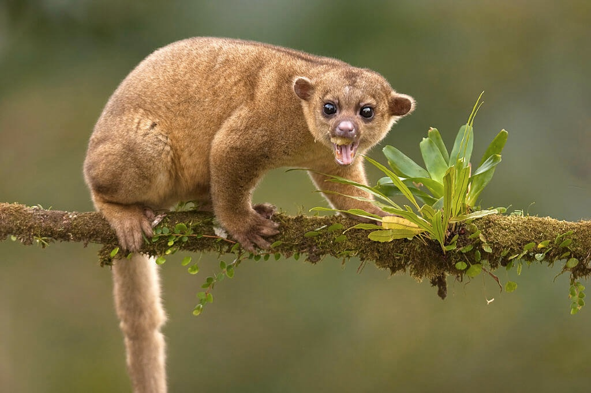
Animals
spider monkeys
kinkajou
tree kangaroos
three-toed sloth

Slide 15
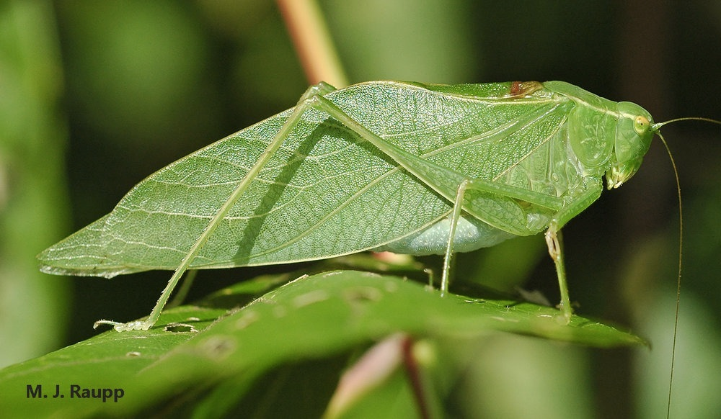
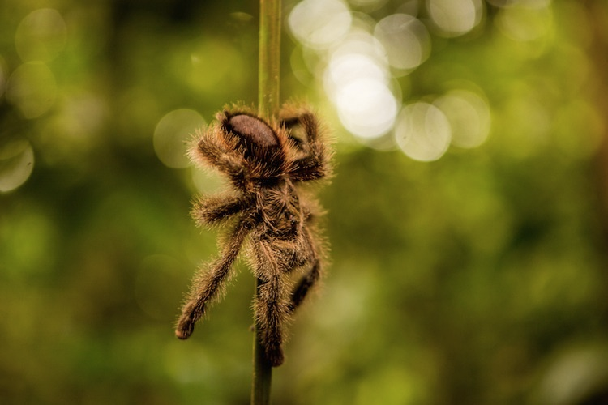
Insects
42000 different species of insects in 1 hectare of tropical rainforest

Slide 16
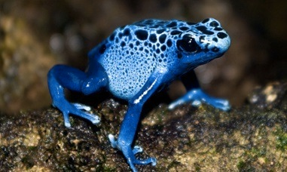
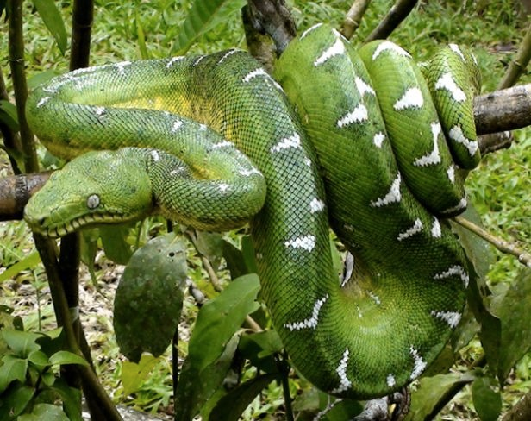
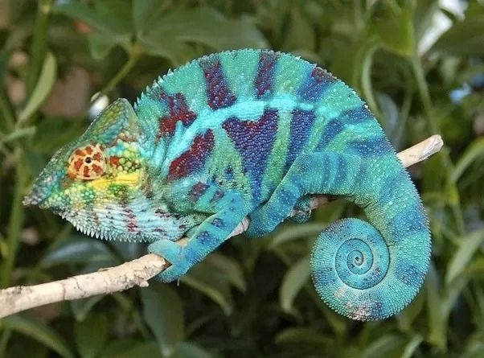
Reptiles and Amphibians

Slide 17
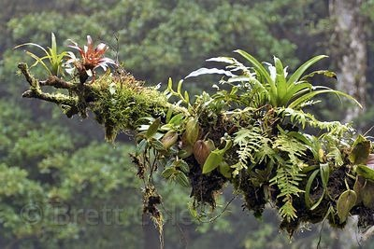
Plants
1 hectare of tropical rainforest can have over 300 species of trees and 1500 species of higher plants
2/3 of the world’s flowering plants are in tropical rainforests
trees have average hight of 40 m but some can reach 80 m
a single rain forest tree may support several thousand species of insects
there are plants that can’t live without particular species of fungi, the hummingbirds or insects and animals

