Slide 1
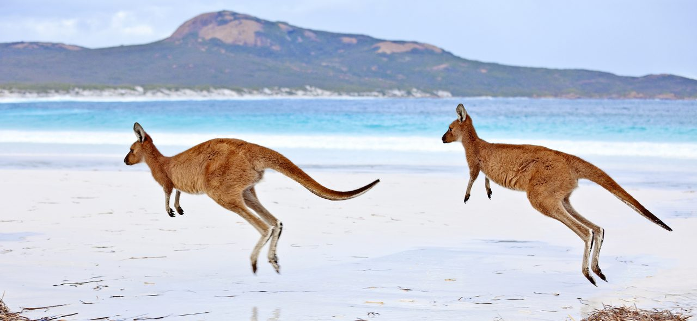
Outdoor Education in Australia and New Zealand
By Thomas Peter Harris

Slide 2
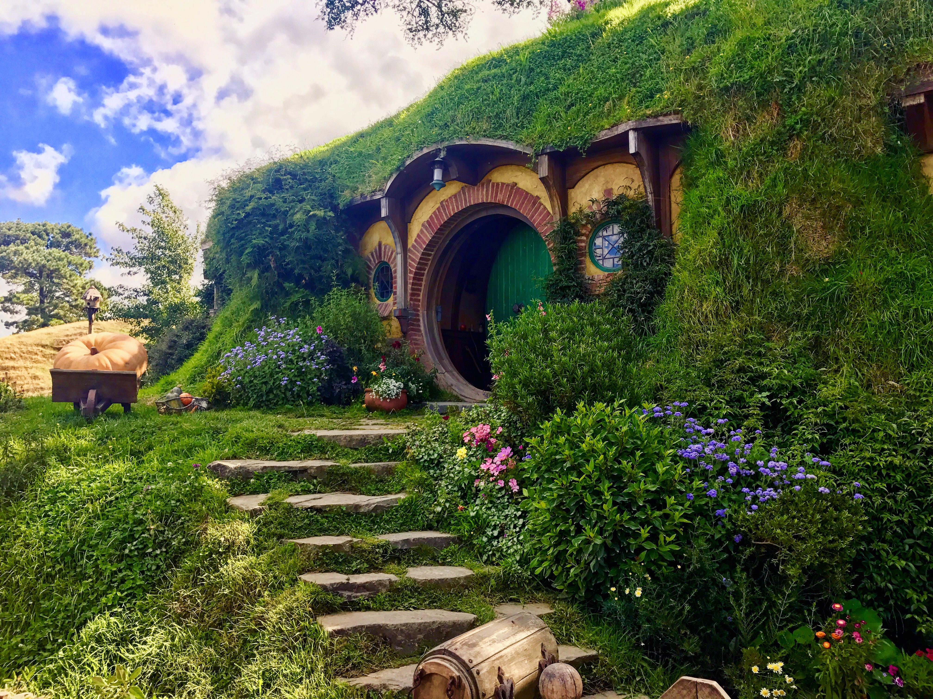
My Home

Slide 3
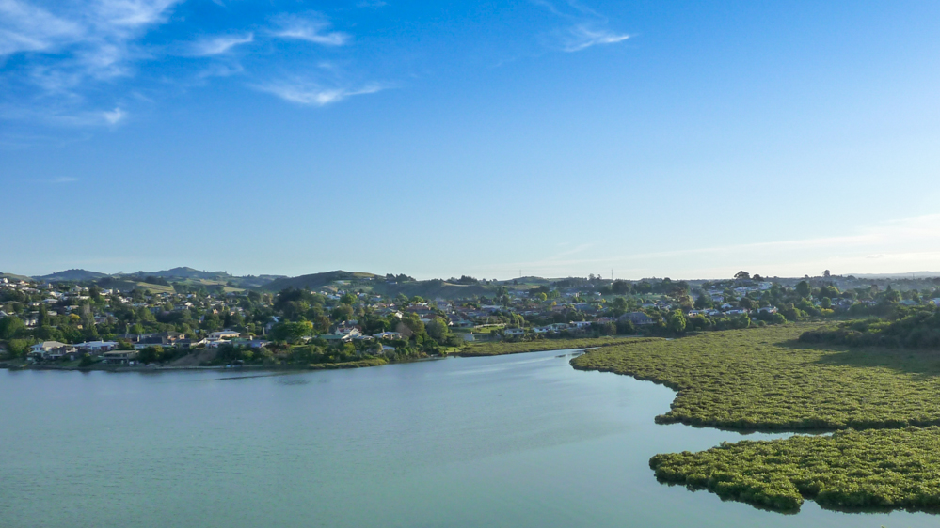
My Real Home

Slide 4
Key concepts
Outdoor education and body care and physical safety
Identify safe and unsafe practices;
Assess risk, make informed decisions, and take appropriate actions to stay safe
Mental health
Develop trust in themselves and in other people.
Develop sensitivity towards others and show them respect by acknowledging individual differences and the right of every person to be accepted.

Slide 5
To develop personal skills in the context of the outdoors, students need opportunities to participate in activities that:
Outdoor education
Take place in safe outdoor environments and foster enjoyment and success.
Involve them in assessing opportunities to pursue outdoor activities.
Help them to develop self-management skills.
Mental health
Build confidence by encouraging self-awareness, self-appraisal, and self-advocacy.
Encourage them to use basic assertiveness techniques to give and receive feedback, to address discrimination, and to resolve conflict.
Involve examining the effects of peer pressure, both negative and positive.
Help them to express their own feelings and to listen and respond to others.

Slide 6
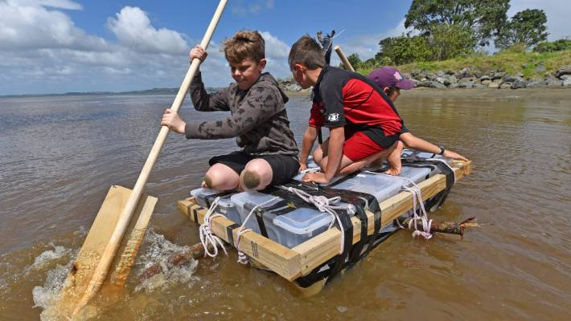
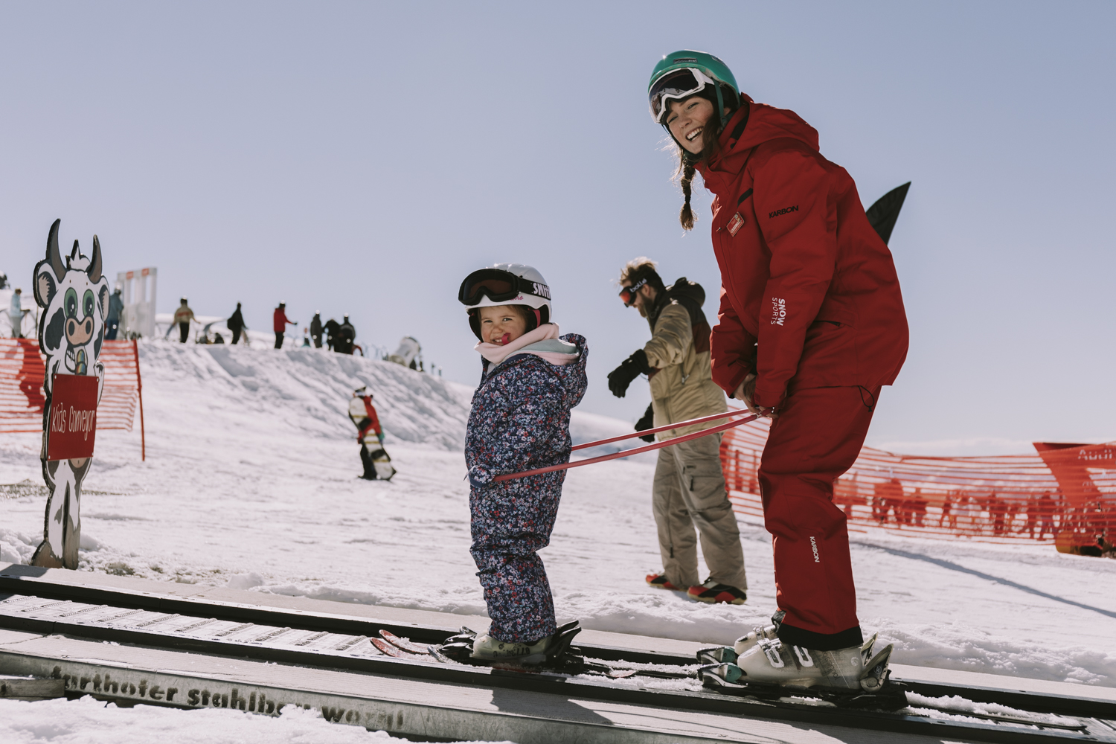
Some Outdoor Activities

Slide 7
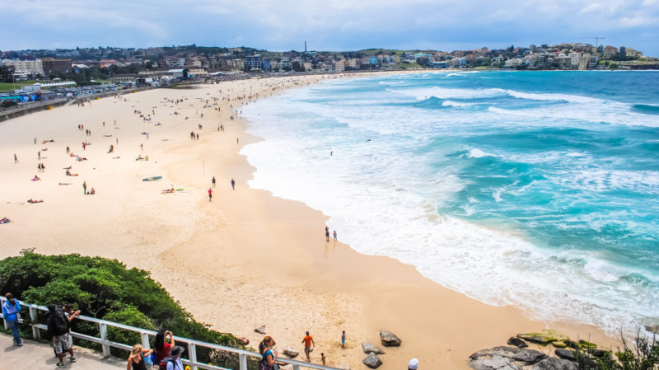
Australia

Slide 8
Outdoor Education: 3-5 Years
Practical – Exploration E.g. walk and talk excursion
Outdoor living knowledge and skills – Introduction to self reliance and minimal impact E.g. carrying fruit/snack/water bottles/personal first aid. Carrying out rubbish
Group Dynamics Skills and Leadership – Introduction to care for others during outdoor activities E.g. buddy systems, staying together, reporting if your buddy is not happy
Outdoor activity knowledge and skills – Introduction to comfort in the outdoors E.g. Equipment for a fruit snack picnic (tarp, etc)
Safety and well being outdoors – Introduction to safe immersion in outdoor environments E.g. Sunsmart dressing for the weather

Slide 9
Environmental awareness – Promoting curiosity, identifying fears of nature and outside environments, and promoting discussion about nature E.g. Investigating under bark and stones, and returning these objects to their original position, exploring rock pools and creeks.
Environmental management, conservation and culture – Minimal impact on a walking excursion E.g. keep to designated walking tracks/board walks.
Ecological literacy key themes – Nature as friend E.g. Sensory experiences in nature such as smelling crushed gum leaves, feeling prickly plants, looking after native animals.
Health and the Outdoors – The importance of fresh air and open space for play E.g. Allow time for running, jumping, rolling, climbing, laughing and exploring.

Slide 10
Outdoor education: 5-6 Years
Practical – Exploration E.g. Picnic in a natural setting
Outdoor living knowledge and skills – Introduction to self reliance and minimal impact E.g. Carrying food, what to bring. Using non-disposable containers. Carrying out rubbish
Group Dynamics Skills and Leadership – Introduction to care for others during outdoor activities E.g. buddy systems, staying together, reporting if your buddy is not happy
Outdoor activity knowledge and skills – Introduction to comfort in the outdoors E.g. Equipment for a picnic.
Safety and well being outdoors – Introduction to safe immersion in outdoor environments E.g. Sunsmart dressing for the weather

Slide 11
Environmental awareness – Promoting curiosity, identifying fears of nature and outside environments, and promoting discussion about nature E.g. Observing nature, exploration of nature within boundaries.
Environmental management, conservation and culture – Minimal impact on a walking excursion E.g. keep to designated walking tracks/board walks.
Ecological literacy key themes – Nature as friend E.g. Sensory experiences in nature such as visit to area of natural significance.
Health and the Outdoors – The importance of fresh air and open space for play E.g. Allow time for running, jumping, rolling, climbing, laughing and exploring.

Slide 12
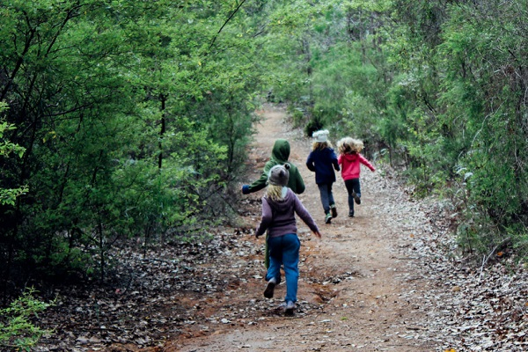
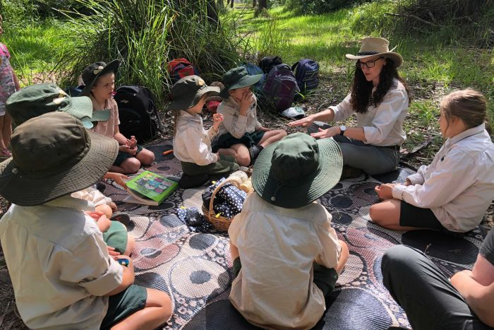
Some Outdoor Activities

Slide 13
References
https://outdooreducationaustralia.org.au/education/curriculum-guidelines/#toggle-id-11
https://health.tki.org.nz/Key-collections/Curriculum-in-action/In-the-Outdoors/Key-concepts

