Slide 1
WINTERWINTW
BIANCA, EIRIK, NATALIIA, NADINE & GRETA
WINTER ADVENTURE

Slide 2
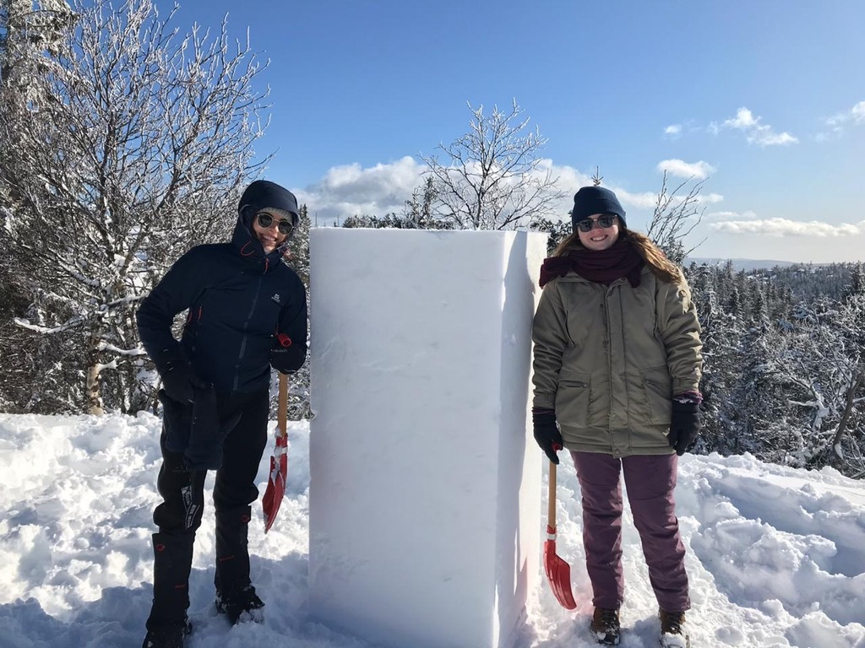
The way to our snow sculptureuilding the

Slide 3
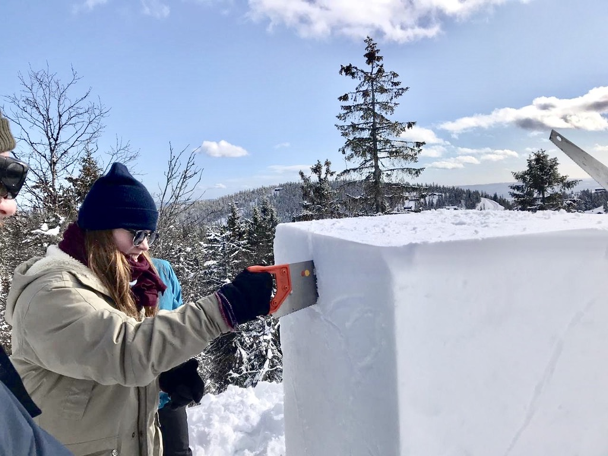
Building the snow sculpturehe way to our

Slide 4
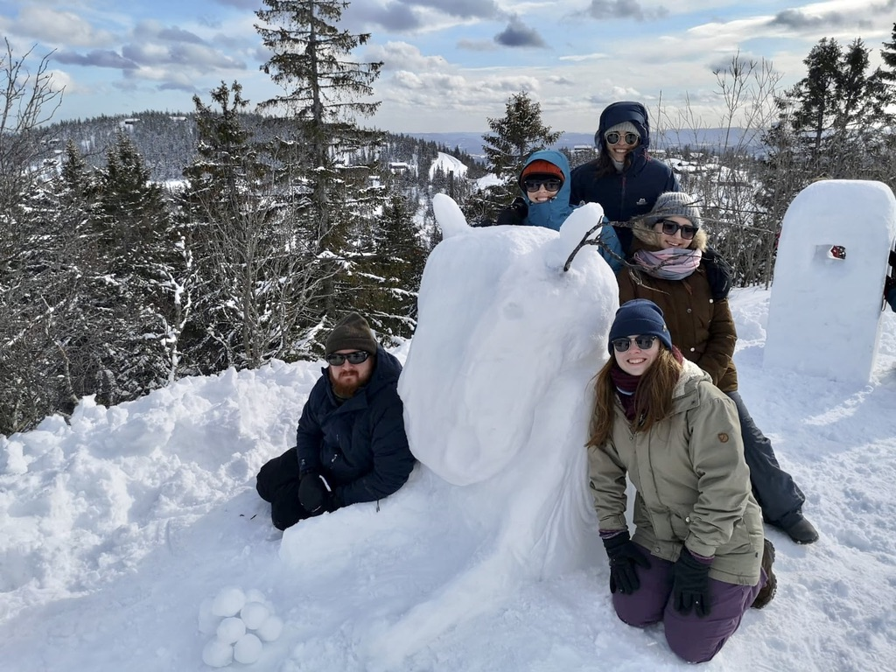
CCCWEFFFDEFDSAFFBUILDINDNDNDKlekDKFFleelletDle
LET US PRESENT YOU…
…MOOSE JEFF!

Slide 5
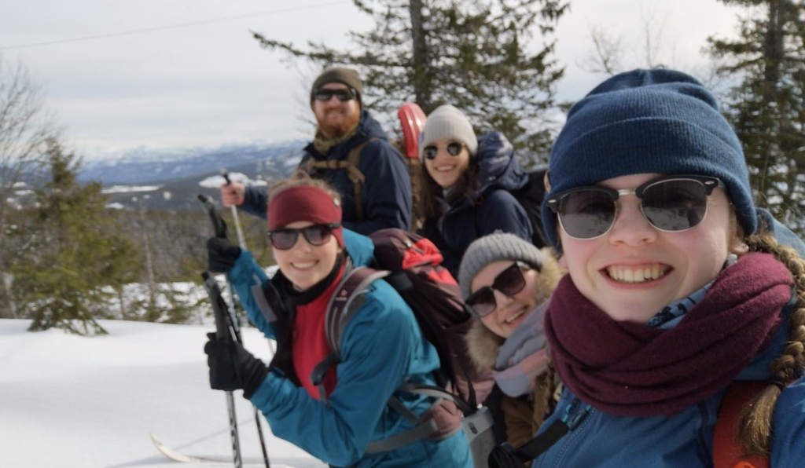
CCXXXXCCCRCCWIINASCKJBJ
EIRIK = PROFESSIONAL XC-SKIER
BIANCA & NADINE = ADVANCED XC-SKIERS
GRETA & NATALIIA = XC-BEGINNERS
XC - SKIING

Slide 6
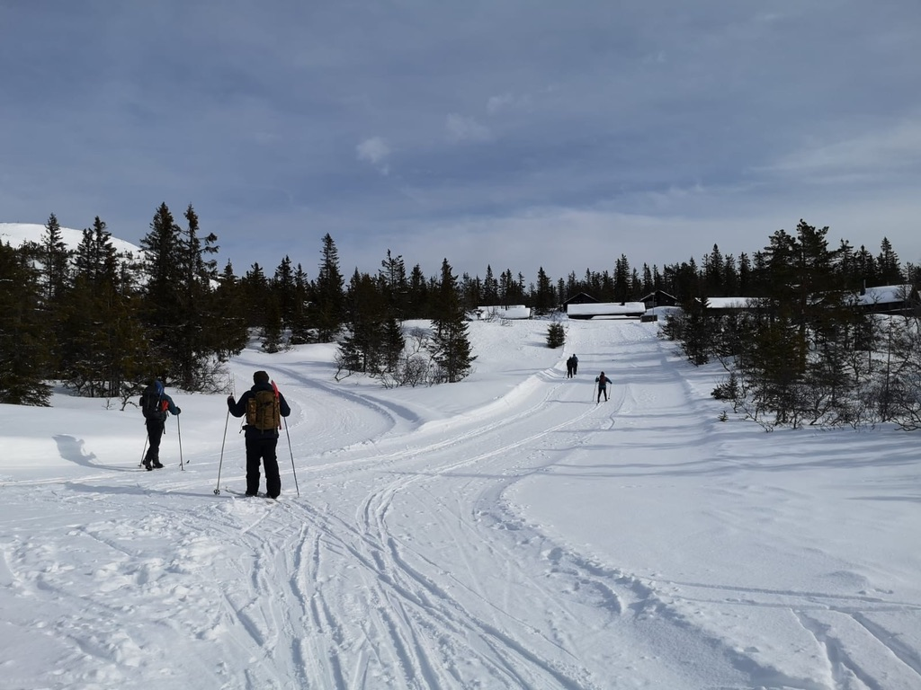

Slide 9
IM
IMPROVEMENTS, ACHIEVEMENTS & ACTIVITIES
NADINE = IMPROVING THE SKILLS, PISTE WITH JUMPS
NATALIIA = LEARNING HOW TO SKI
EIRIK = LEARNING HOW TO TEACH XC-SKIING
BIANCA = PREPARING THE SKIS, BRAKING WITH XC-SKIS, JUMPING
(GRETA = LEARNING HOW TO SKI)

Slide 10
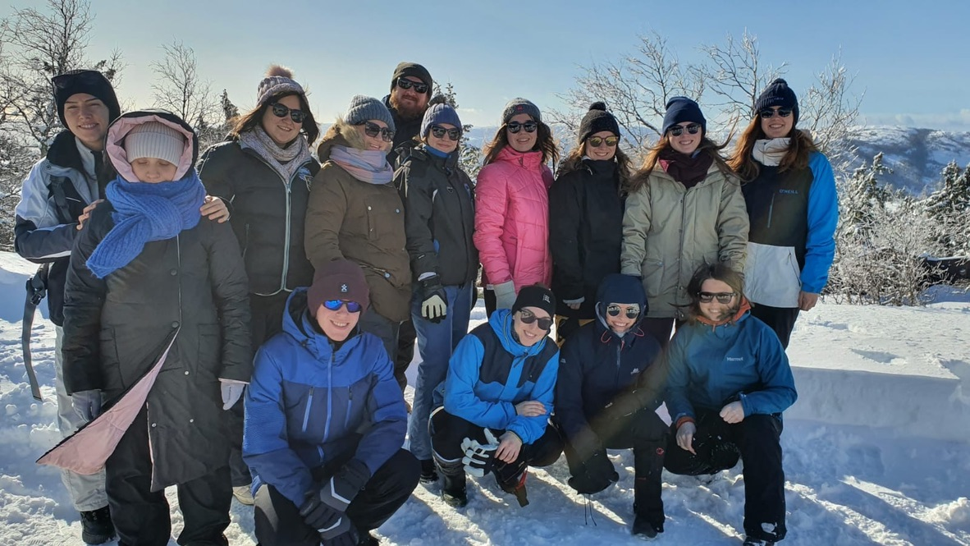
CC
CONCLUSION
ENJOYED THE TRIP
MANY MOMENTS OF LAUGHTER
STEPPING OUT OF OUR COMFORT ZONES
NEW EXPERIENCES
BUILDING RELATIONS

