Slide 1

Mexico folklor music
By Tania

Slide 2
Mexican music types
Mexico has a very large range of music. The main classification is in seven different genres:
the indigenous music,
the Mexican son,
the corrido,
the northern music,
the Mexican bolero,
romantic ballads and
urban contemporary music.
We can find some musical elements shared between these genres which shows us the complexity of the Mexican cultural mix.

Slide 3
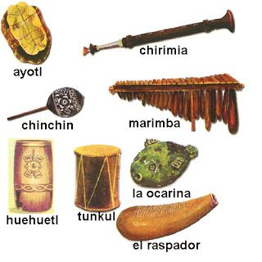
Indegenous instruments
Several sound and material elements of the prehispanic music were fused with the music that came to America with the colonizers. Musical practices were not eliminated but reworked and adapted to the new conquered America.

Slide 4


Prehispanic music
It is not possible to know exactly how the musical expressions sounded before the conquest because none of the indigenous groups developed a type of written music. We can have an idea of the lyrics, musical performance and construction of musical instruments because of some archaeological materials and artistic representations, in addition to oral testimonies of the first chronicle tellers.

Slide 5
Huichol music
One of the strongest survivors of the prehispanic music is the wirrárika culture originally from the Huichol culture. The huicholes were established in the western part of Mexico and every year they cross the desert as a ritual all the to Wirikuta their sacred land. The huichol music is dedicated to the corn, the deers and the peyote( hallucimogenic plant) the three central elements of their religious system.
https://www.youtube.com/watch?v=7QUPebrhuhk

Slide 6
The mexican «Son»
«Son» is a group of music and dance expressions which synthesizes the Hispanic, indigenous and African inheritance. In some areas of the huasteca area in Mexico the term “huapango is used to define “son” because it is a celebration.
To play these different subgenders they use string instruments derivatives of Spanish instruments like: guitar, lute, bandurria, the harp and the violin.

Slide 7
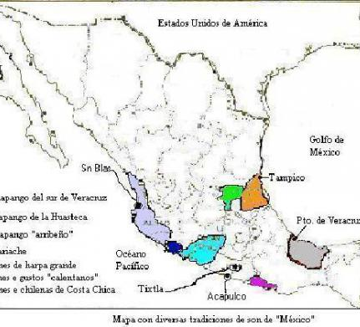

Map of the «sones» by region
There are at least ten different types of “son” depending on the region they come from. The names are:
son huasteco,
son jarocho,
son jaliciense,
son sinaloense,
son arribeño and
son abajeño.

Slide 8
Huapango
Huapango is a “son” from the huasteca region which origins are from the colony times in Mexico in the XIX century. It is characterized by the mix of indigenous sounds, African and Spanish. The use of the “falsetto” in the singing form and the clasic technic.
Https://www.youtube.com/watch?v=akiJxGT1BjI
Modernized huapango
https://www.youtube.com/watch?v=O0VaLlMpVn8
https://www.youtube.com/watch?v=ZCDf3XQKKKA

Slide 9
THE MARIMBA INSTRUMENT
In the Region of Veracruz, Chiapas and other states in the South of Mexico an instrument called “marimba” was developed and became a symbol of the son and the huapango. The “marimba” came to Mexico with the African slaves the Spanish conquerors brought to the South coasts of Mexico. The first modern “marimba” was designed by C. de Jesus Borras Moreno in the year 1892 in Chiapas.
https://www.youtube.com/watch?v=RmpDi4Om-UY

Slide 10
The corrido, ranchera and balads
The «corrido» comes from two parts of Mexico, one from the North and other from the South. It it characterized by telling stories a derivate from the sing deed and the minstrels poesi. This songs narrates stories of heroes, popular charachters and even though criminals or narcodealers. It was an important way to tell news during the Mexican Revolucion since nespapers was not in use. In the North the use of the instrument «accordeon» is also very charachteristic of the corridos.
The balads and rancheras, are romatic songs from the XIX century . This genre combines elements from the zarzuela, italian ballads, habanera and cuban bolero. The influence of these last ones created the romantic «music trio» . From this genre was created as well the »ranchera» style which was played in the country side inspirated in the romatic picture of horses, catuses and magueys. It has also elemts of the corrido, the son and the ballads.

