Slide 1
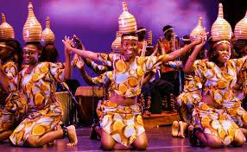
Tanzania folk music

Slide 2
zeze
Notes:
https://www.youtube.com/watch?v=1Z2WxyunhUo

Slide 3
Ngoma(drums)
Notes:
https://www.youtube.com/watch?v=egzufQ1ZDCk&list=RDpKkk0T7N2NA&index=2

Slide 4
Instruments
Marimba
Notes:
https://www.youtube.com/watch?v=SkNA1X1lA9E

