Slide 1
Oil politics and economy The Norwegian perspective
Angel, Miquel & Sarah

Slide 2
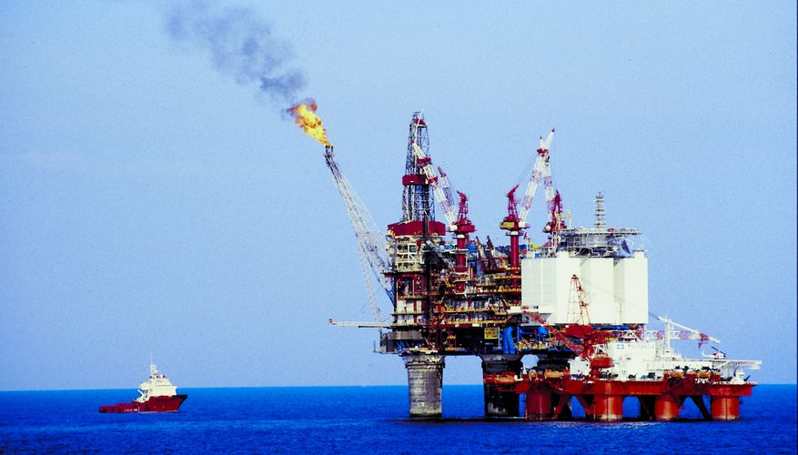
Introduction

Slide 3
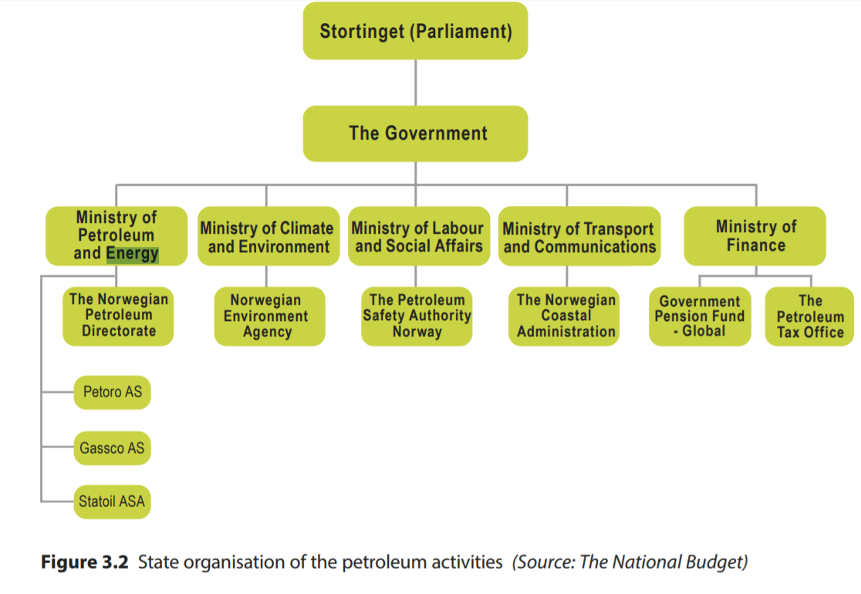
State organisation

Slide 4
Is it only the state who gets the oil?
Petroleum Act (1996)
The Licences
The act provides the general legal basis for the licensing system that governs Norwegian petroleum activities.
The license grants companies exclusive rights to surveys, exploration drilling and production of petroleum within the geographical area covered by the licence.

Slide 5
Other examples of organisation: free market
Canada, in contrast to Norway, has a free-market approach. That means that the government is discouraged from long-term public planning, in favour of allowing the market to determine the pace and scope of the development.

Slide 6
The oil fund (1991)
The creation of an oil fund ensures a stability in the government revenues and spending.
A 96% aboard investment of the GPFG
A 4% annual maximum withdrawal of oil in Norway.
295 billion NOK (2000) – 5000 billion NOK (2014)

Slide 7
Economy
Why is oil more expensive in Norway?
What affects the price of oil?
Quick look:
1975 - 3% of GDP
1980 – 14% of GDP
2000 – 23% of GDP
Currently around 22% and 67% of Norwegian exports

Slide 8
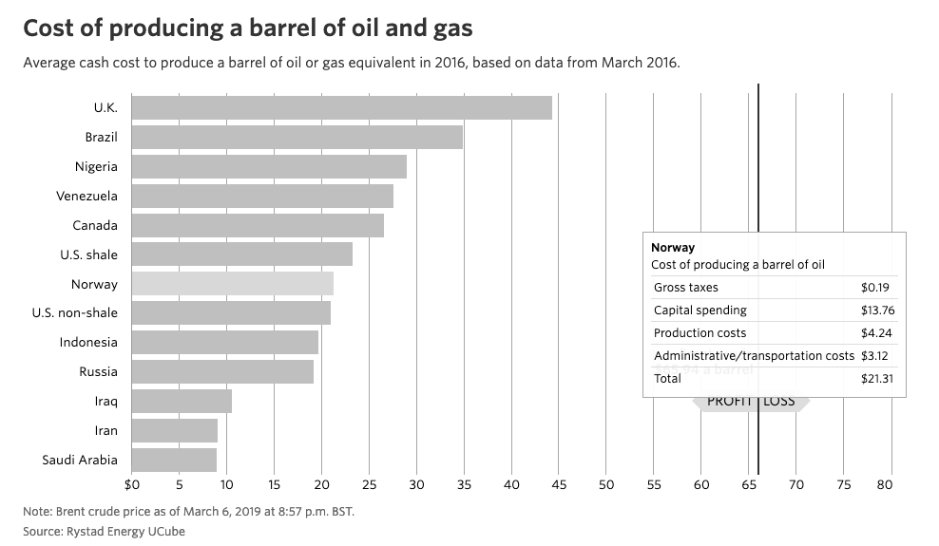
Why is oil more expensive in Norway?

Slide 9
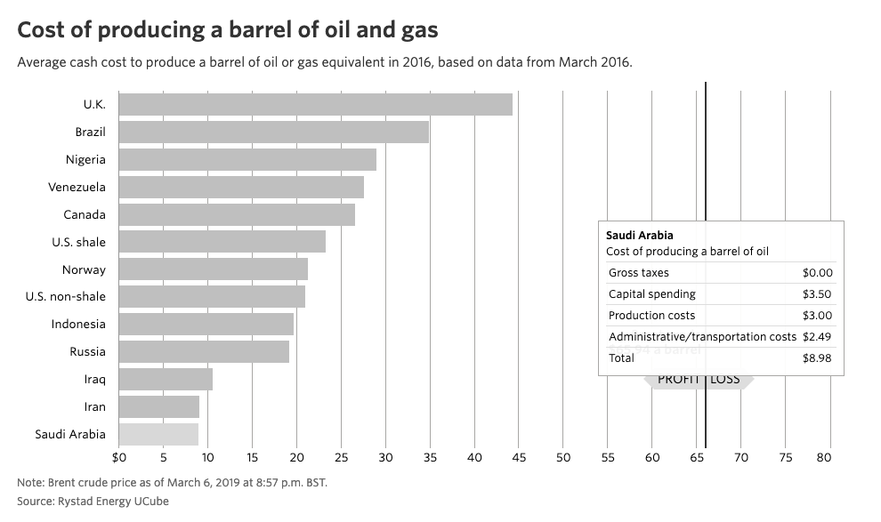
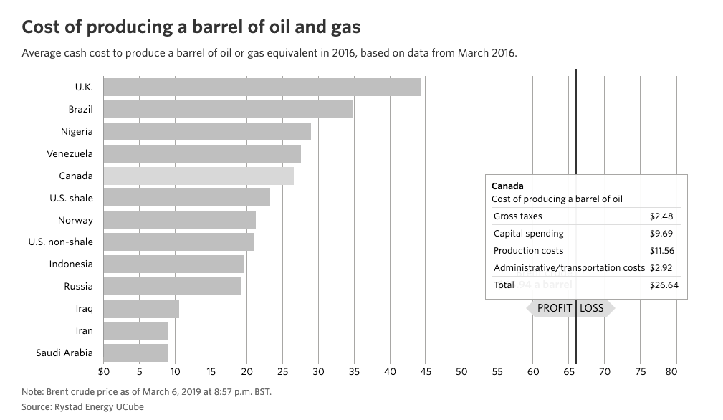
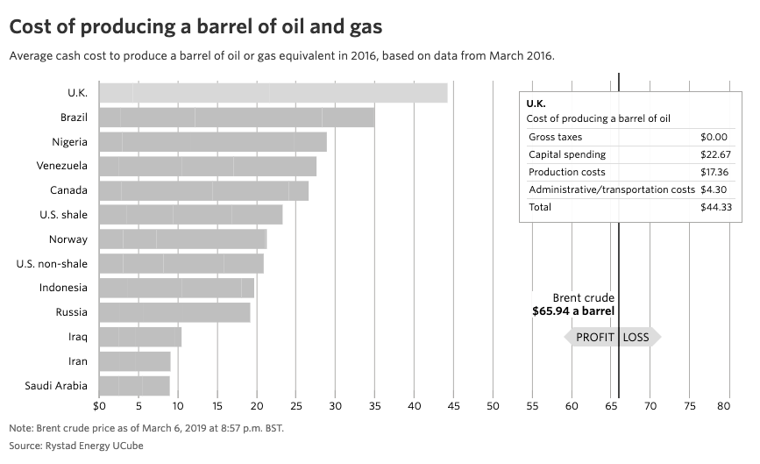
What about other countries?

Slide 10
What affects the price of oil?
Availability on the world market
Demand
Regulation of price and output
Historic incidents that influenced price:
1950 Korean war
1956 Suez crisis
1967 Six-day war doubled the price of oil
1973 Yam Kippur war quadrupled the price of oil
1979 Iranian Revolution
1991 Gulf war
1998 Economic crisis in Asia leads to a major fall in the price of oil
2007-08 The financial crisis and unstable oil production first boosted prices and then prompted a big drop
2011 Arab Spring political unrest in Egypt, Libya, Yemen, Bahrain and other countries pushed up oil prices

Slide 11
The 10 oil commandments (1971)
1st commandment
National supervision and control must be ensured for all operations on the NCS.
2nd commandment
Petroleum discoveries must be exploited in a way which makes Norway as independent as possible of others for its supplies of crude oil.
3rdcommandment
New industry will be developed on the basis of petroleum.
4th commandment
The development of an oil industry must take necessary account of existing industrial activities and the protection of nature and the environment.
5th commandment
Flaring of exploitable gas on the NCS must not be accepted except during brief periods of testing.
6th commandment
Petroleum from the NCS must as a general rule be landed in Norway, except in those cases where socio-political considerations dictate a different solution.
7th commandment
The state must become involved at all appropriate levels and contribute to a coordination of Norwegian interests in Norway’s petroleum industry as well as the creation of an integrated oil community which sets its sights both nationally and internationally.
8th commandment
A state oil company will be established which can look after the government’s commercial interests and pursue appropriate collaboration with domestic and foreign oil interests
9th commandment
A pattern of activities must be selected north of the 62nd parallel which reflects the special socio-political conditions prevailing in that part of the country.
10th commandment
Large Norwegian petroleum discoveries could present new tasks for Norway’s foreign policy.

