Slide 1
My nature area
OUTDOOR EDUCATION AND EXPERIENTIAL LEARNING | SPRING 2019
Lidia González Valera

Slide 2
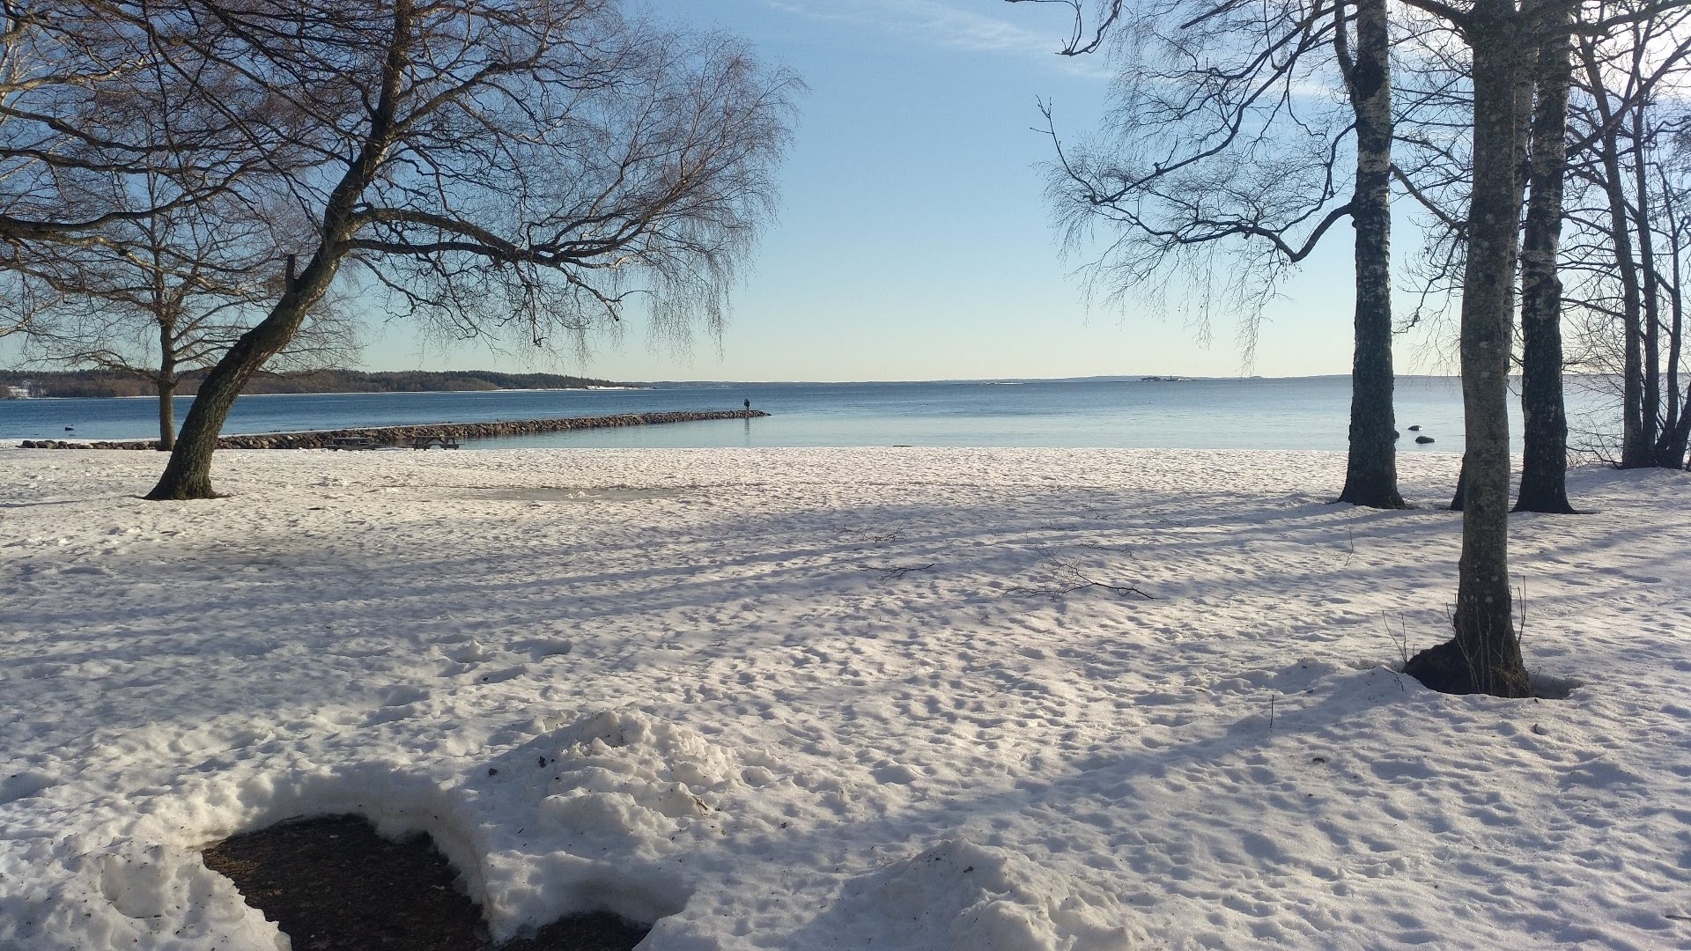
Winter - February

Slide 3
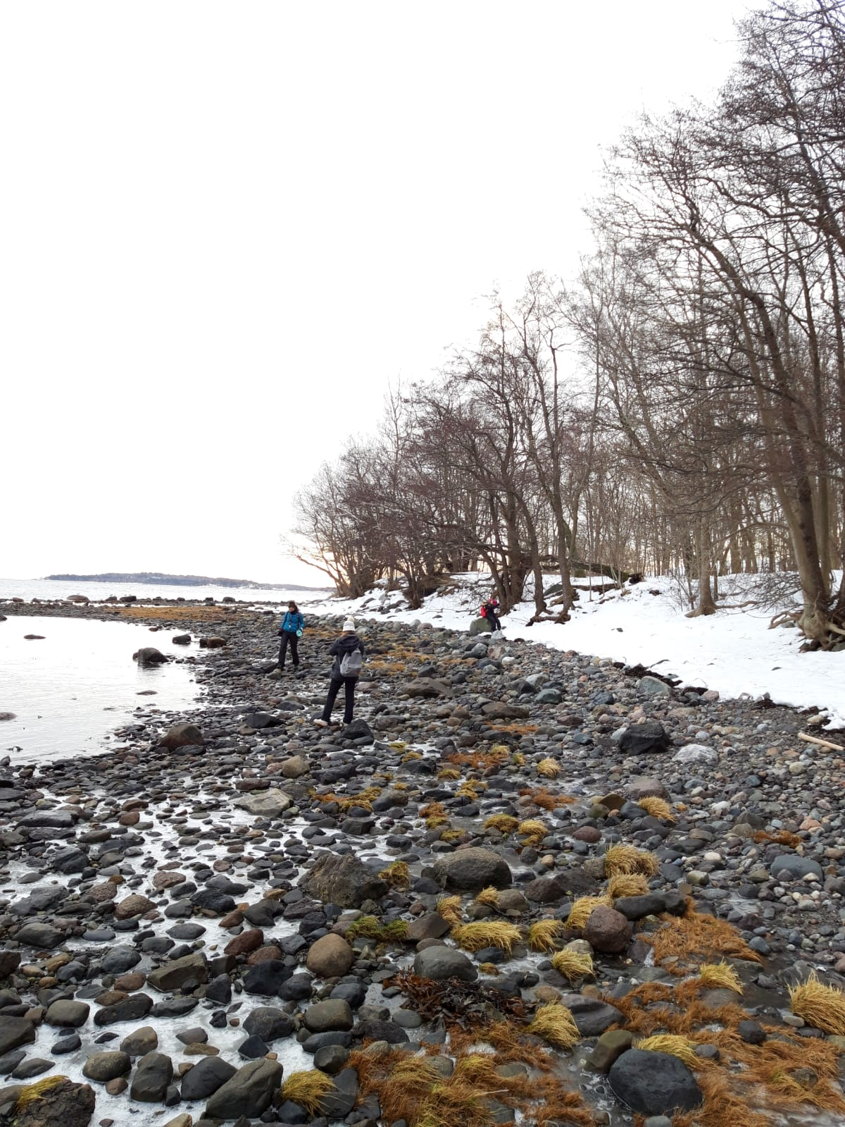
Winter - February

Slide 4
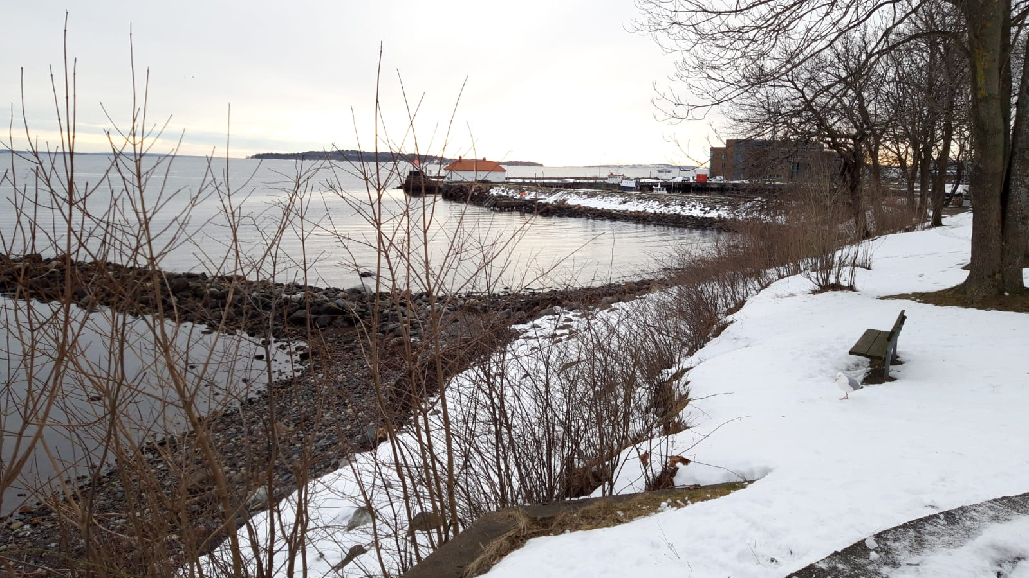
Winter - February

Slide 5
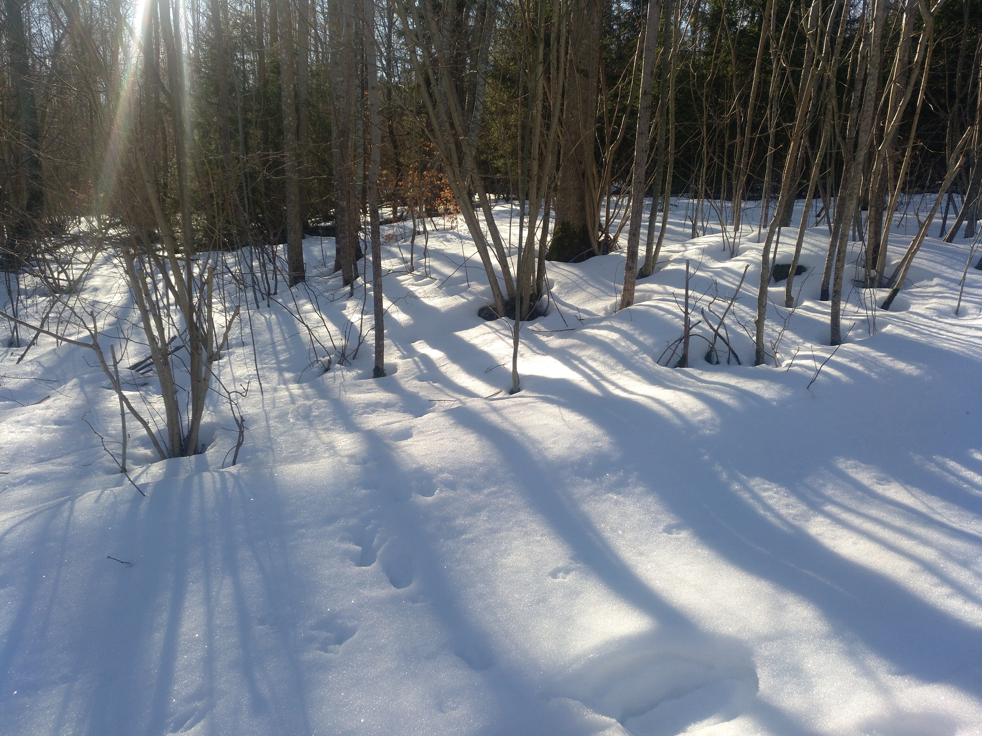
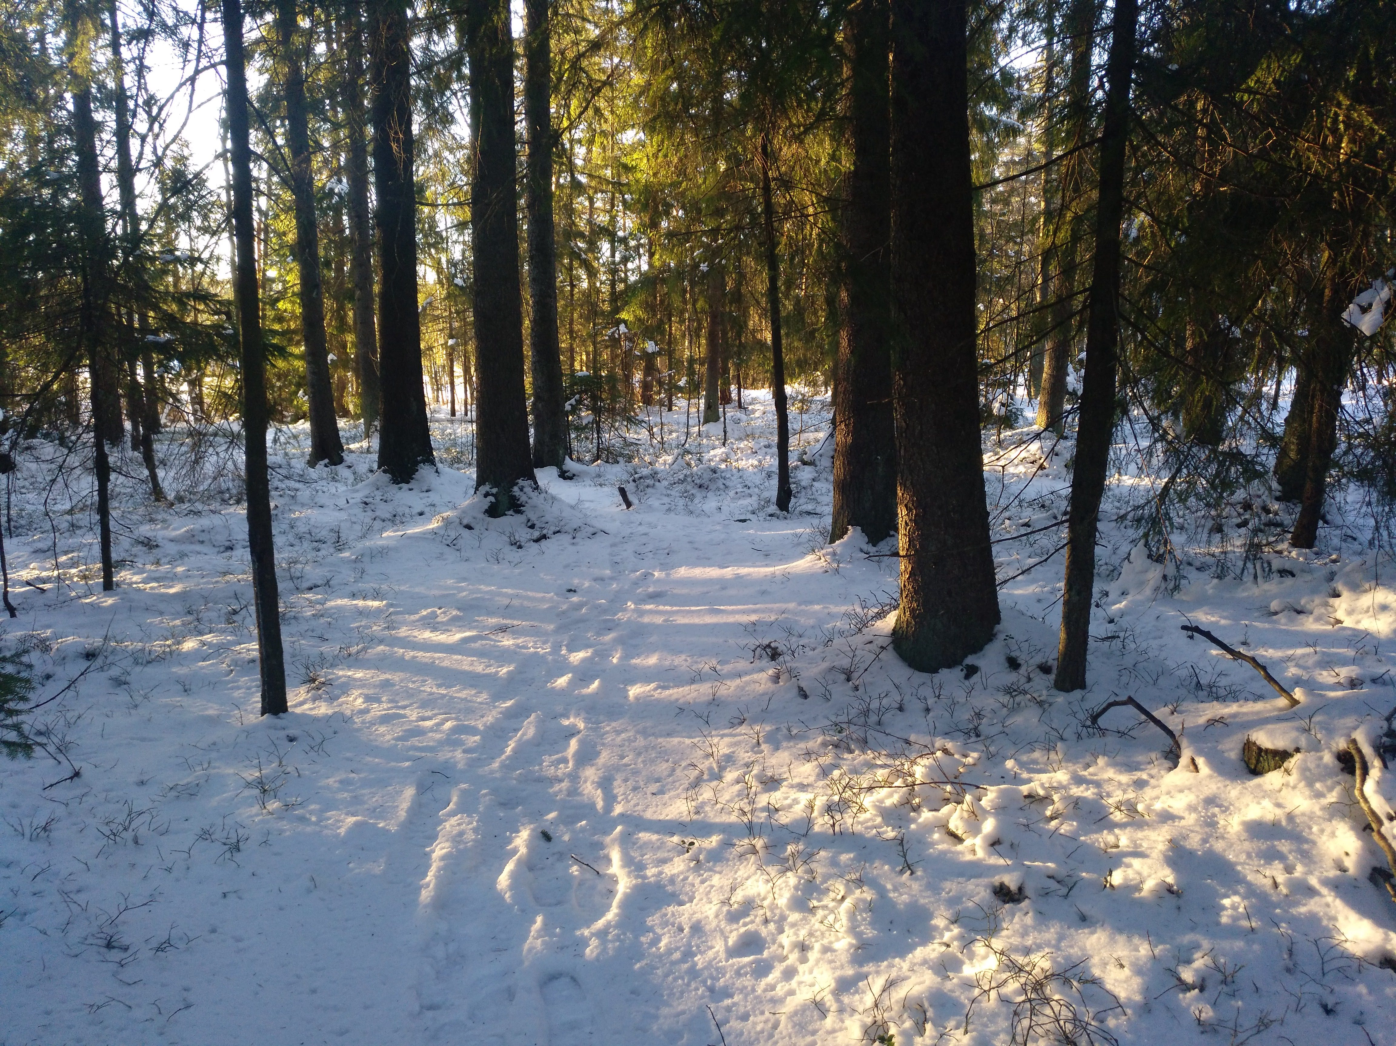
Surroundings - February

