Slide 1
My homeplace - Impressions from Germany
presented by
Alina Tremel, Ilaria Kintzi & Nadine Murgia

Slide 2
NERESHEIM
Nadine Murgia

Slide 3
SUMMARY NERESHEIM
Baden-Württemberg / Ostalb-Kreis / Neresheim
Informations about Neresheim
Attractions
Seasons
Nature reserve „Zwing“
Citypark
Affordances around this Area
Outdoor play & Outdoor learning

Slide 4
Baden-Württemberg / Ostalb-Kreis / Neresheim

Slide 5
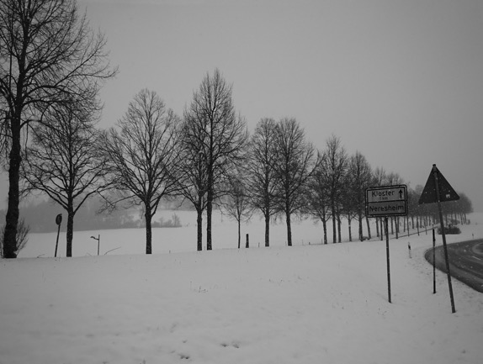
Informations about Neresheim

Slide 6
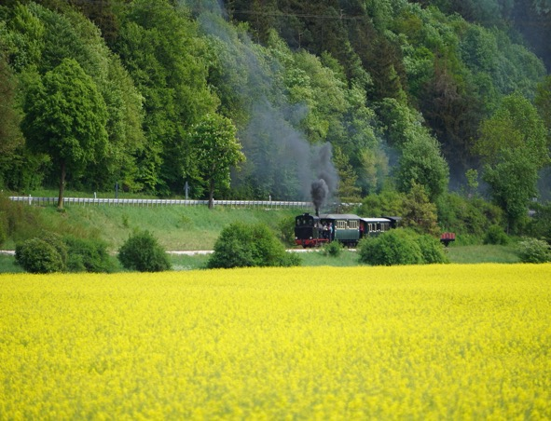
Neresheim – attractions

Slide 7
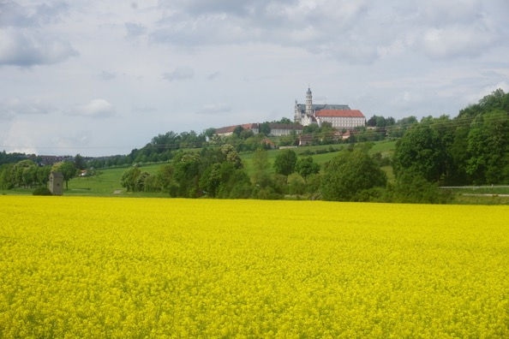
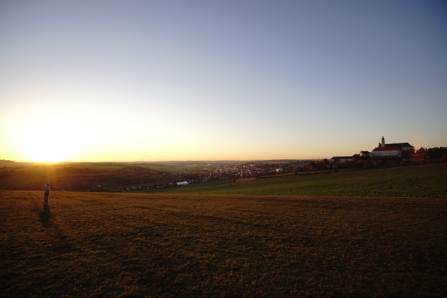
Neresheim – Spring & Summer

Slide 8
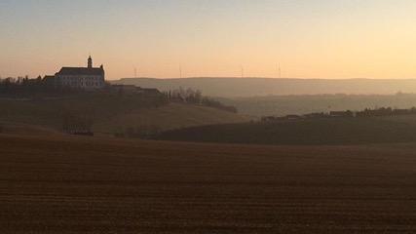
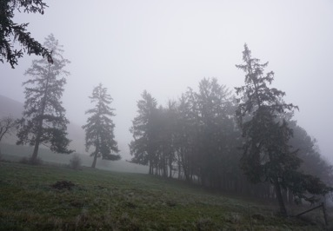
Neresheim – autumn & winter

Slide 9
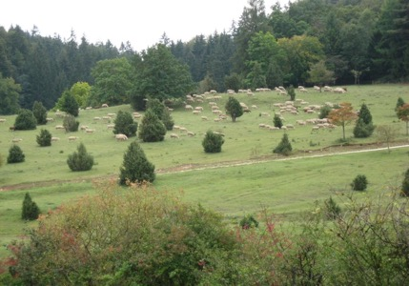
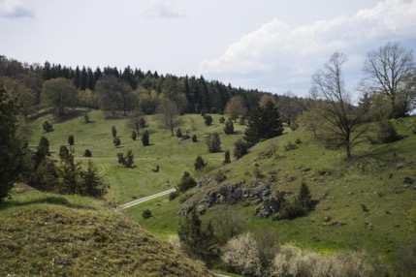
Nature reserve "Zwing"

Slide 10
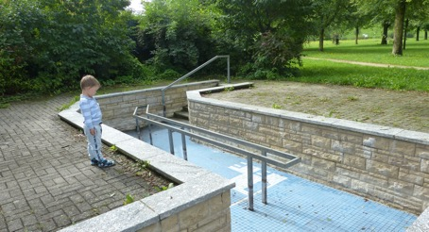
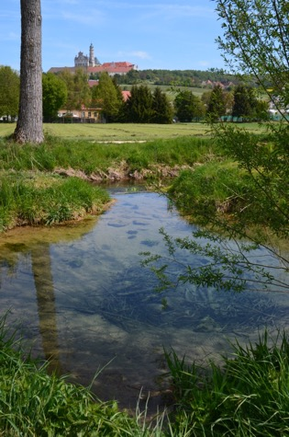
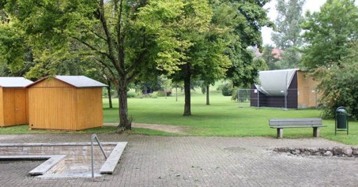
City park with water treading pool

Slide 11
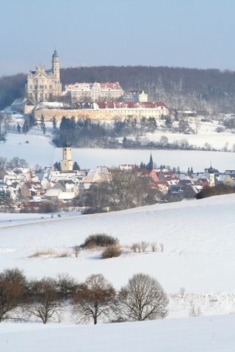
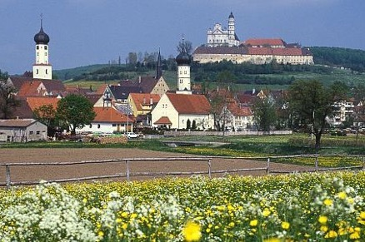
Affordances / Outdoor play & Outdoor learning
The monastery mountain
Nature reserve
City park with treading pool
_________________________________
High altitude play
High Speed Play
Playing near dangerous elements
Rough and Tumble Game

