Slide 1
My Homeplace
Cluj-Napoca, Romania
Anamaria Ioana Coci
Babes-Bolyai University, Romania
OE-FRI1000-1 19V Outdoor and Friluft Course
February 25th, 2019

Slide 2
Content
I. Fast facts about Romania & Cluj-Napoca
II. Photos of my homeplace
III. ‘Sense' of my home landscapes and places
IV. Affordances for outdoor play and learning

Slide 3
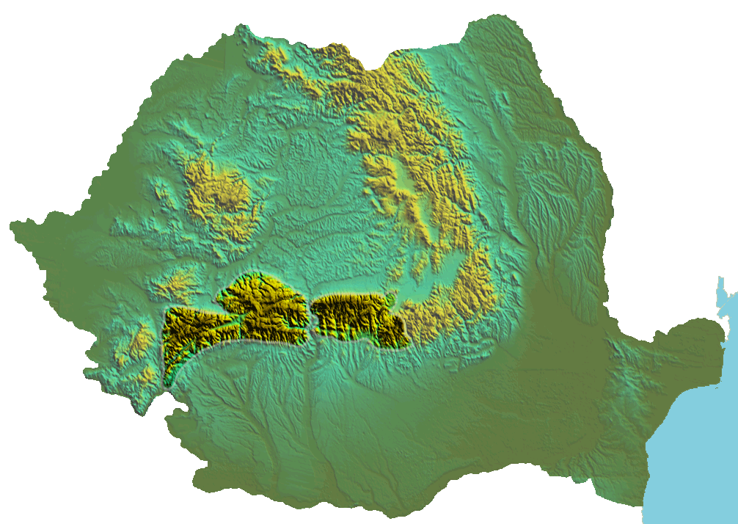
Fast Facts - Romania
Location: Romania is situated in the southeastern part of Central Europe
Main Ethnic Groups: Romanian 84%, Hungarian 6.1%, Gipsy 3.1%, German 0.2%, Ukrainian 0.2%
Climate: Temperate, four distinct seasons
Capital: Bucharest
Form of State: Romania is a semi-presidential democracy based on a bicameral Parliament: the Chamber of Representatives and the Senate.
The Carpathian Mountains are home to one of the largest undisturbed forests in Europe.
Source: Romania. Natural and Cultural, (n.d.). “Did You know?” Retrieved February 24th, 2019, from: http://romaniatourism.com/did-you-know.htm

Slide 4
Fast Facts about my city - Cluj-Napoca
Location: Northwestern part of Romania
Historic Capital of Transylvania
Population: 326.000 (3rd largest city in Romania)
Cluj-Napoca is the most important academic, cultural, industrial and business centers in Romania.
Cluj-Napoca held the titles of European Youth Capital in 2015 and European City of Sport in 2018.
Source: Romania. Natural and Cultural, (n.d.). “Cluj-Napoca” Retrieved February 24th, 2019, from: http://romaniatourism.com/cluj-napoca.html

Slide 5
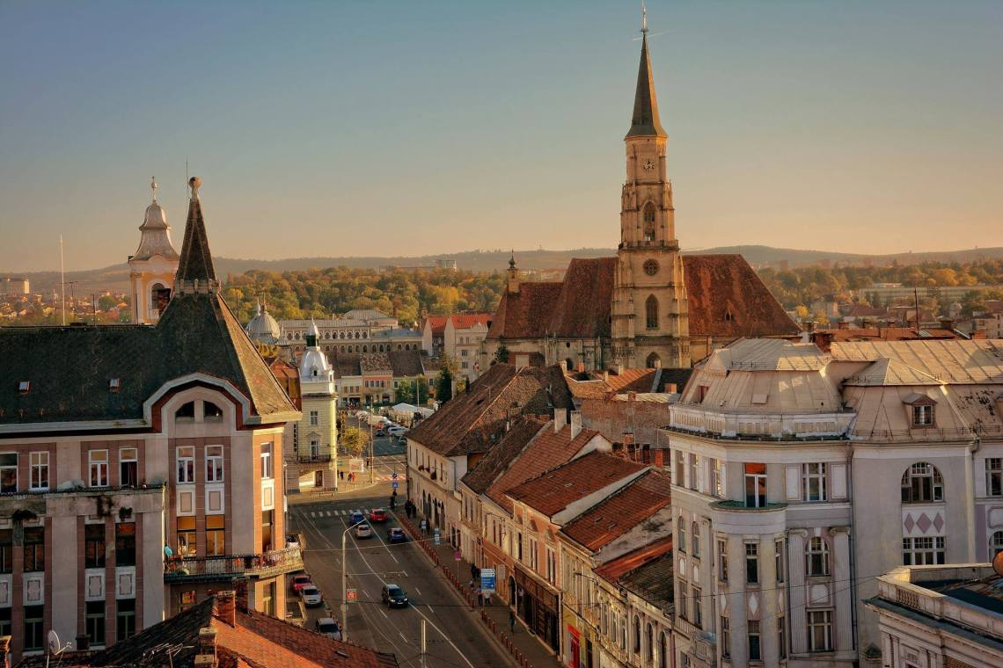
Source: Marius Iliescu (2018), Retrieved February 24th, 2019 from: https://blog.eurail.com/travel-western-romania-by-train/

Slide 6
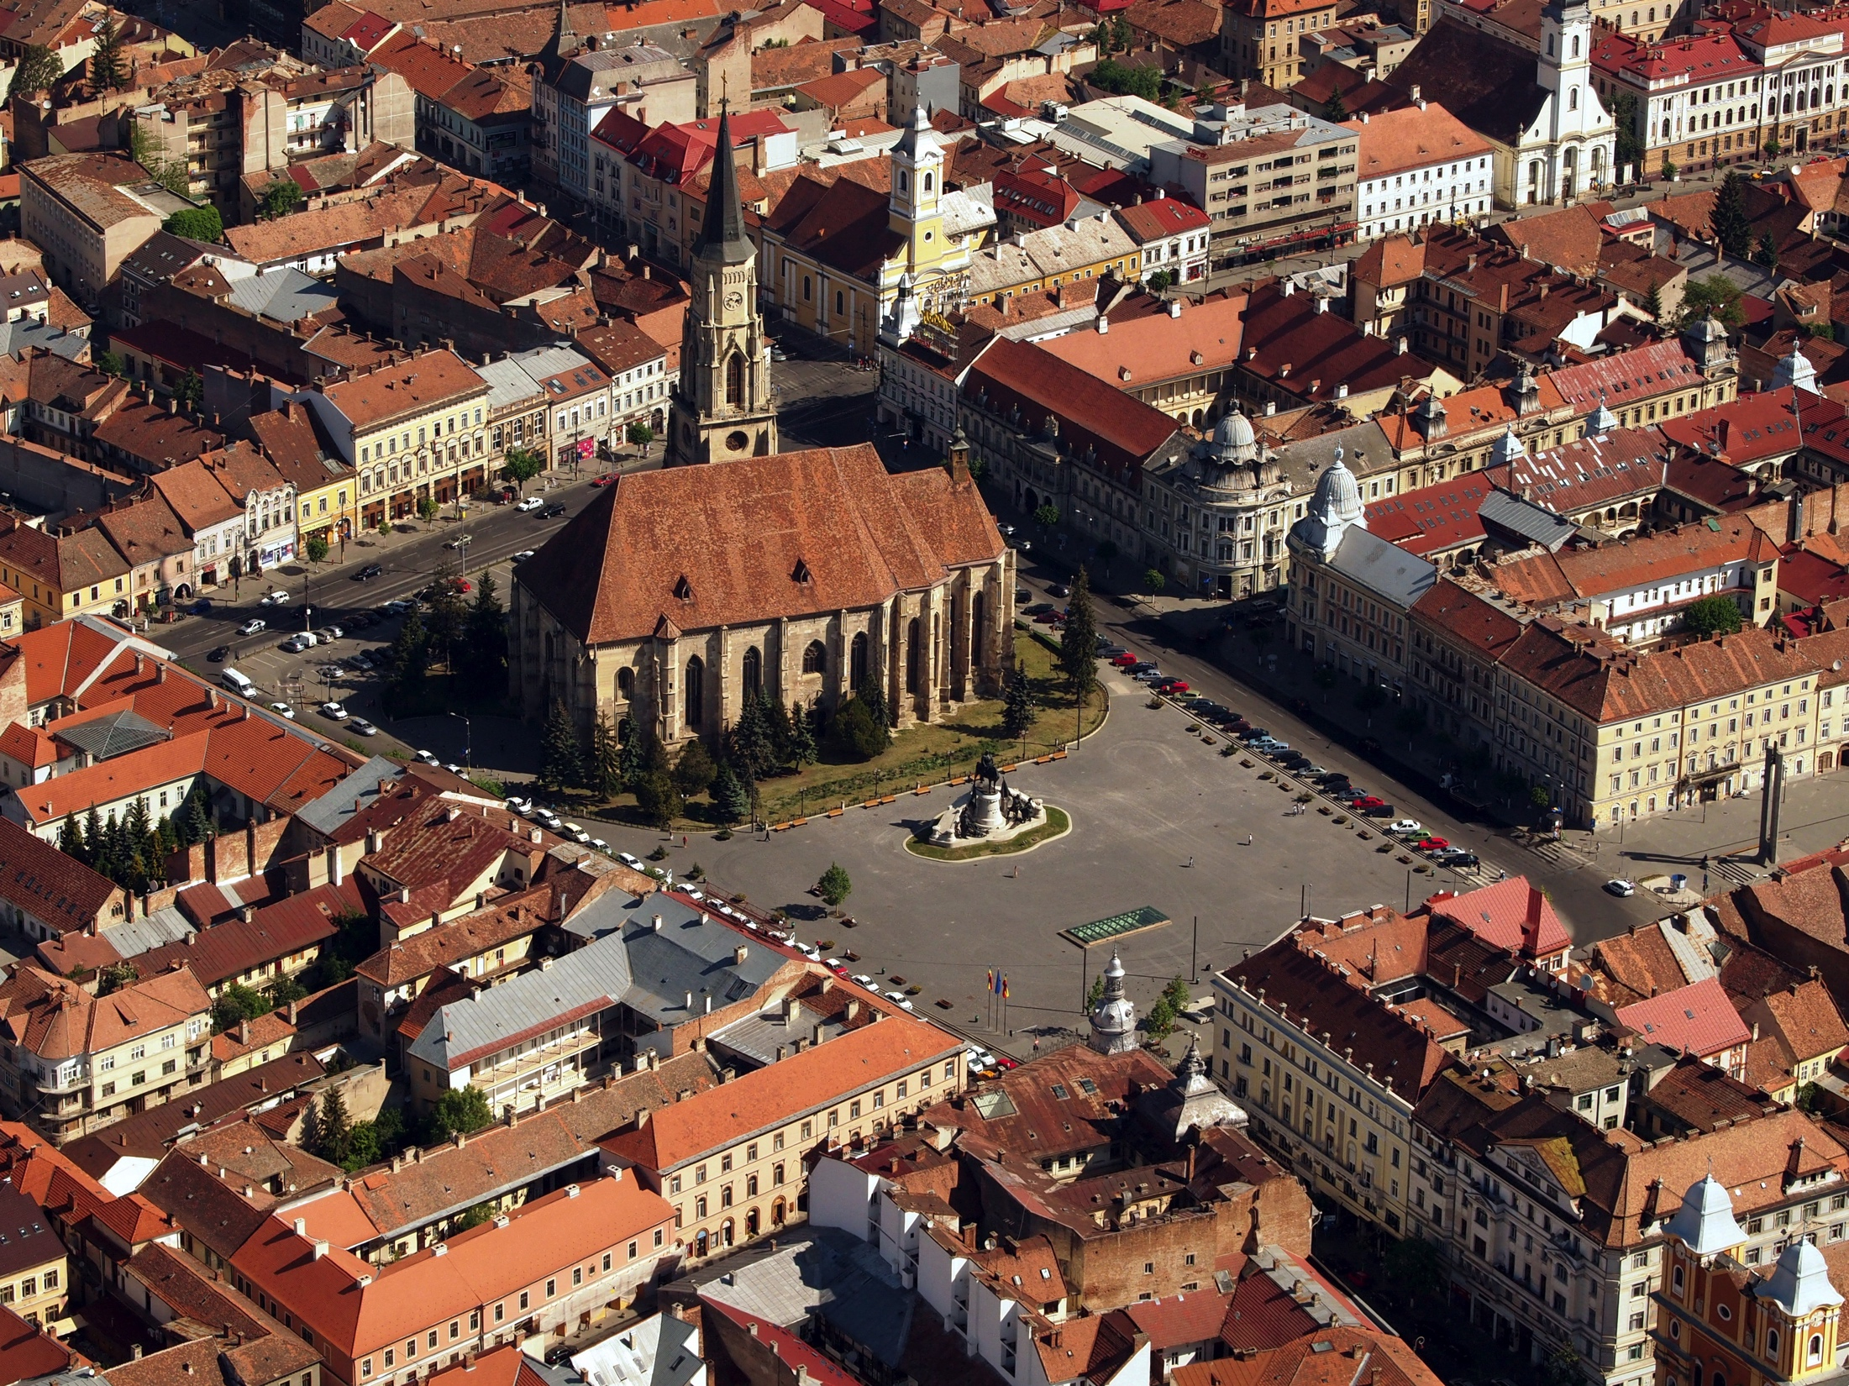
Source: European geography association - for students and young geographers (2017), Retrieved February 24th, 2019 from:
https://egea.eu/activities/great-people-from-iasi-is-visiting-cluj-napoca/

Slide 7
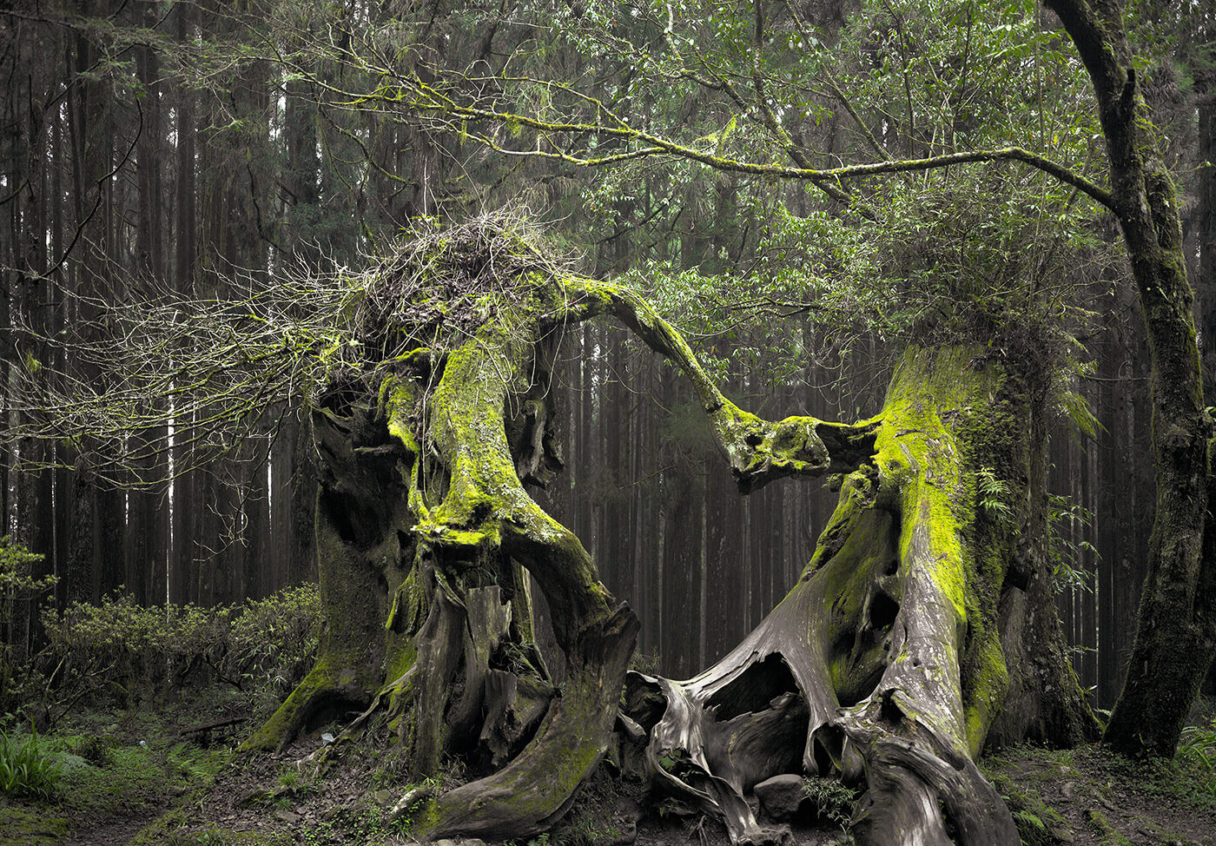
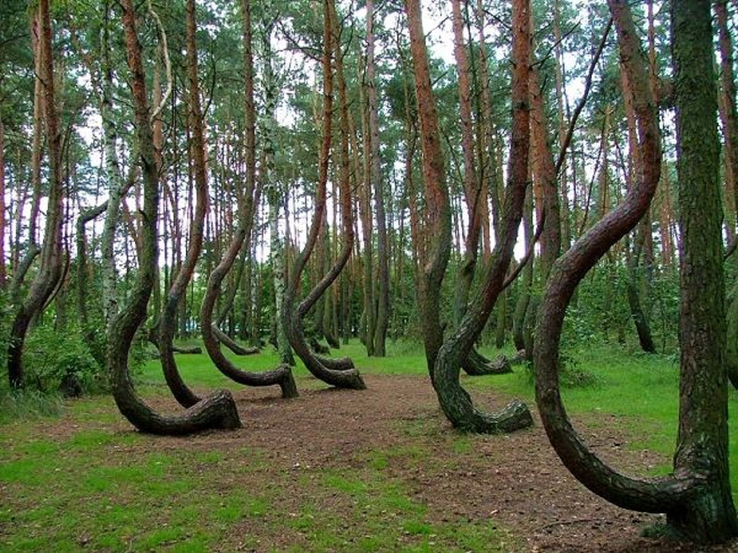
Landscapes from my city
Hoia - Baciu Woods
Source: Hoia Baciu Forest, Retrieved 24th February, 2019, from: https://hoiabaciuforest.com

Slide 8
Affordances for outdoor play and learning in this place
Storytelling

Slide 9
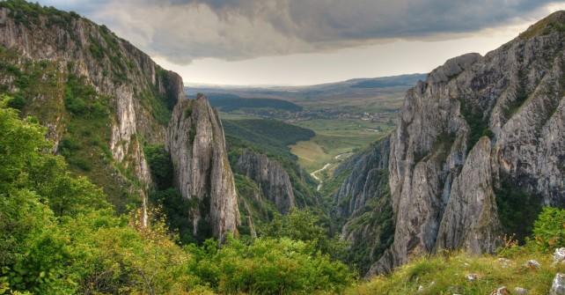
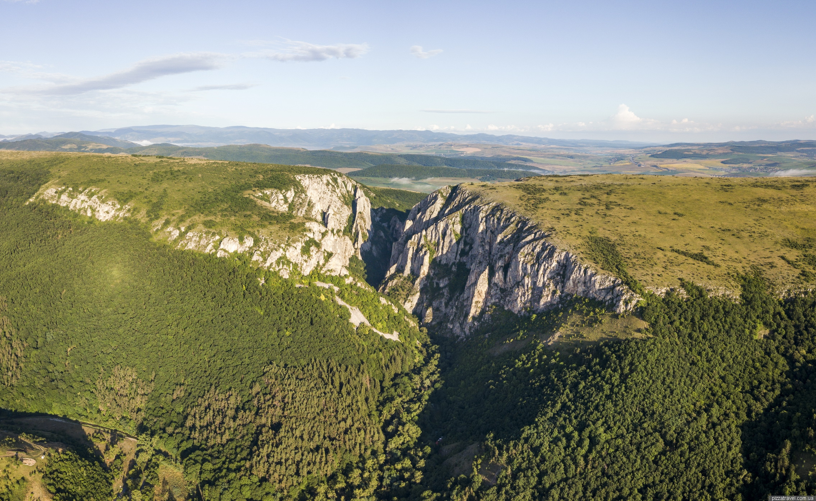
Landscapes from my city
II. Turda Gorges
Source: Wikipedia, 2016. Turda Gorges, Retrieved 24th February, 2019, from: https://en.wikipedia.org/wiki/Turda_Gorge

Slide 10
Affordances for outdoor play and learning in this place
Geography lessons
(learning about landforms, rocks, plants and animal species some of them rare or endangered).

Slide 11
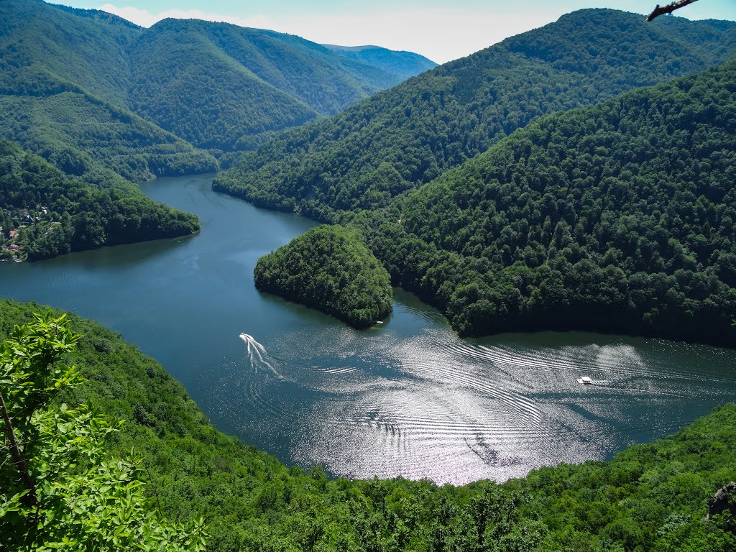
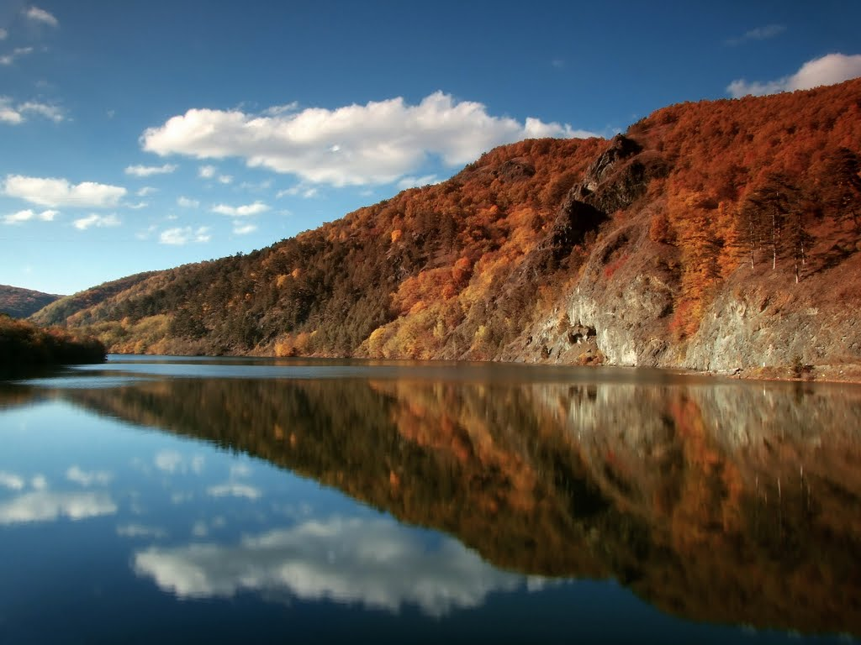
Landscapes from my city
III. Tarnita Lake
Source: Thank You Romania. Retrieved February 24th, 2019, from: https://thankyouromania.ro/lacul-tarnita/obiective-turistice-transilvania-cluj-lacul-tarnita-foto-panoramio/m

Slide 12
Affordances for outdoor play and learning in this place
Fishing
(learning about the types of fishes that are found in the lake, playing different water-games.)

Slide 13
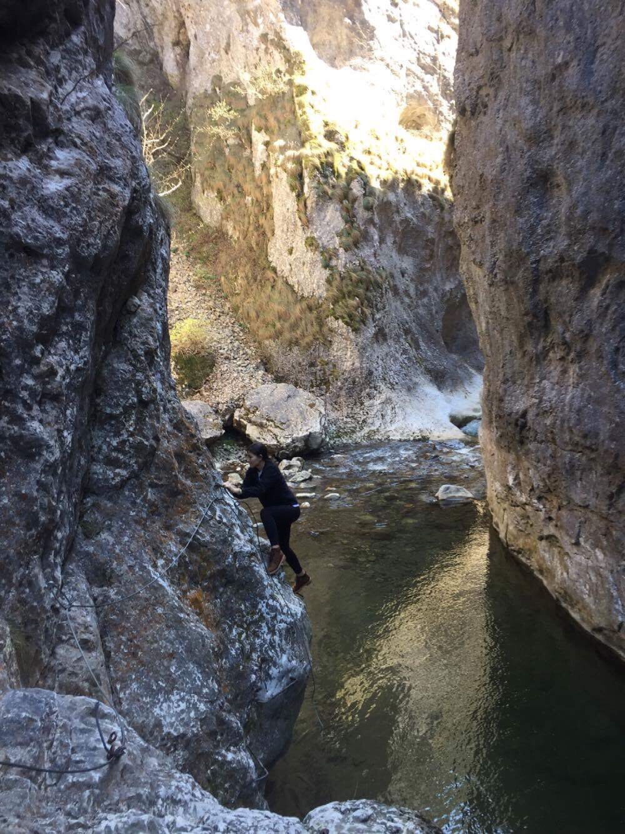
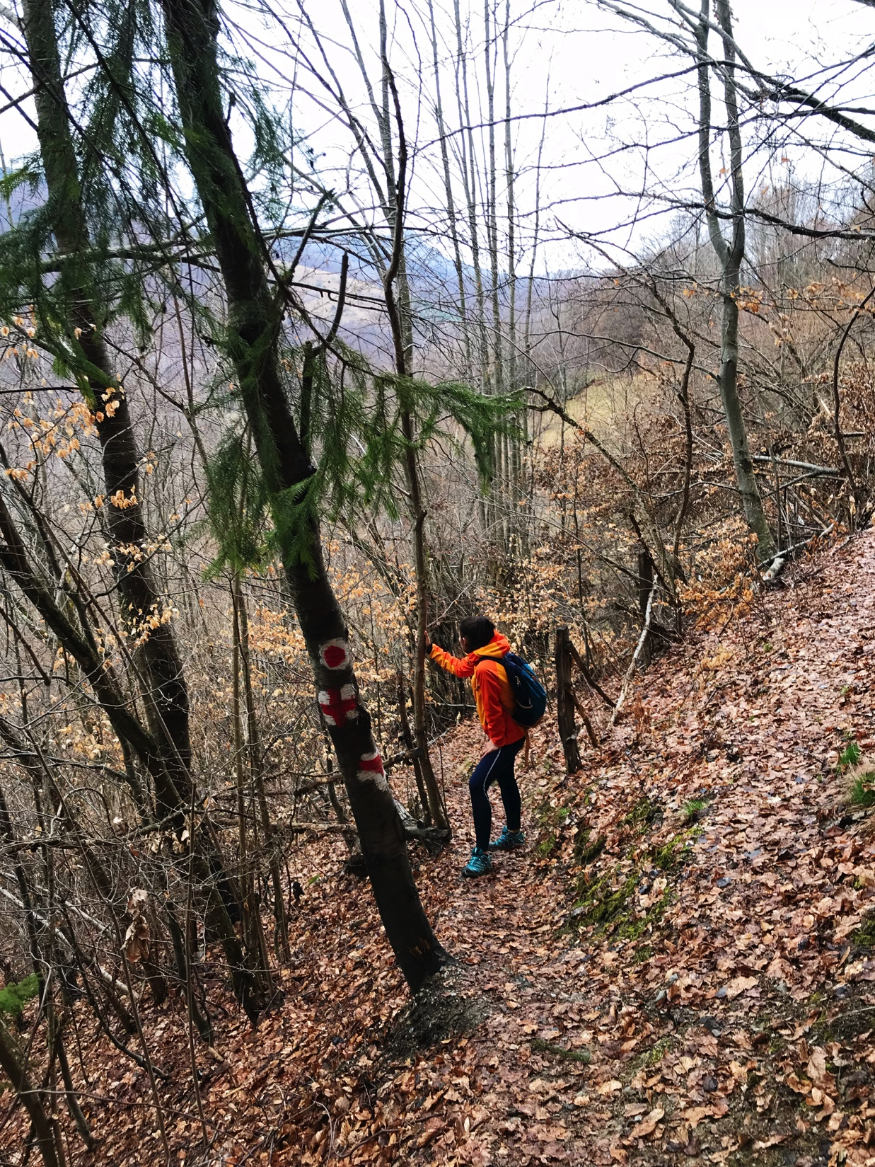
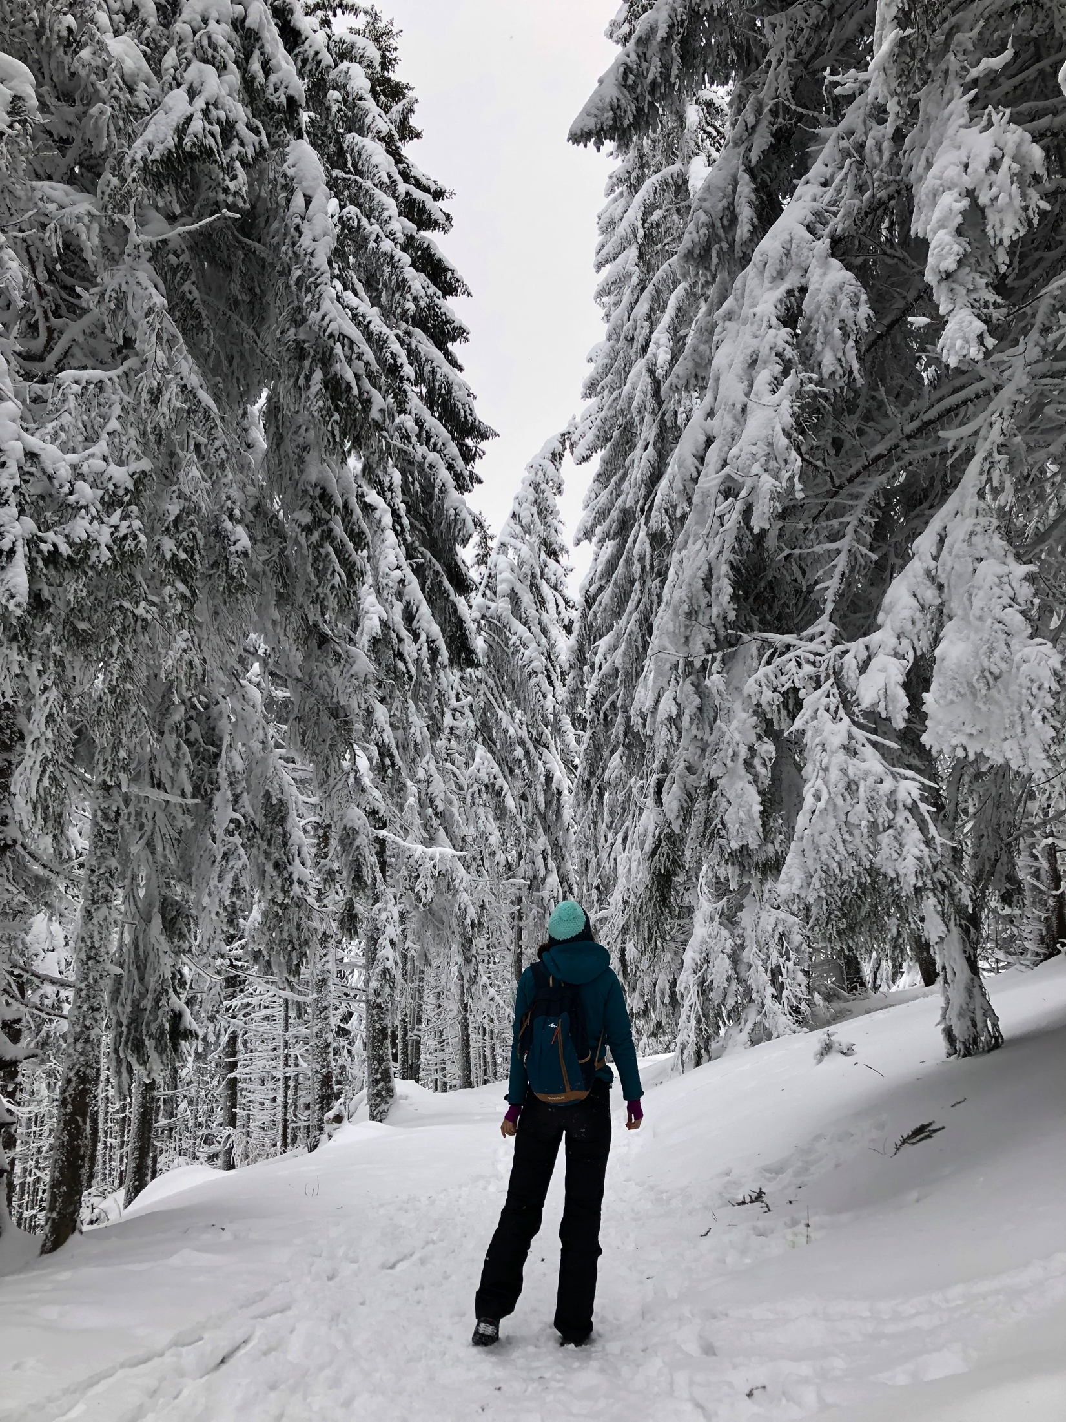
Landscapes from my city
IV. Apuseni Mountains

Slide 14
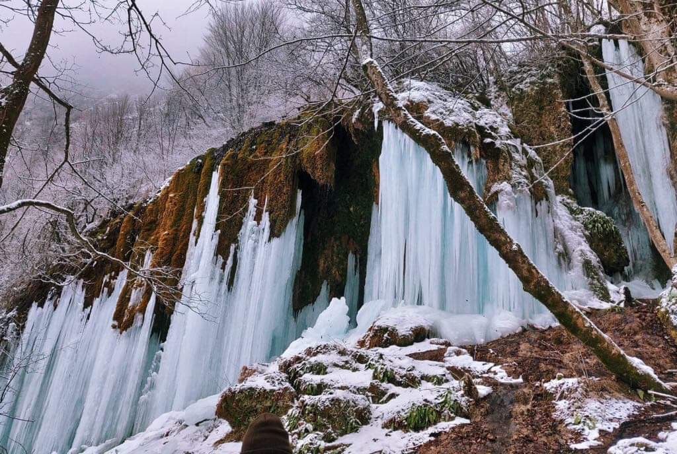
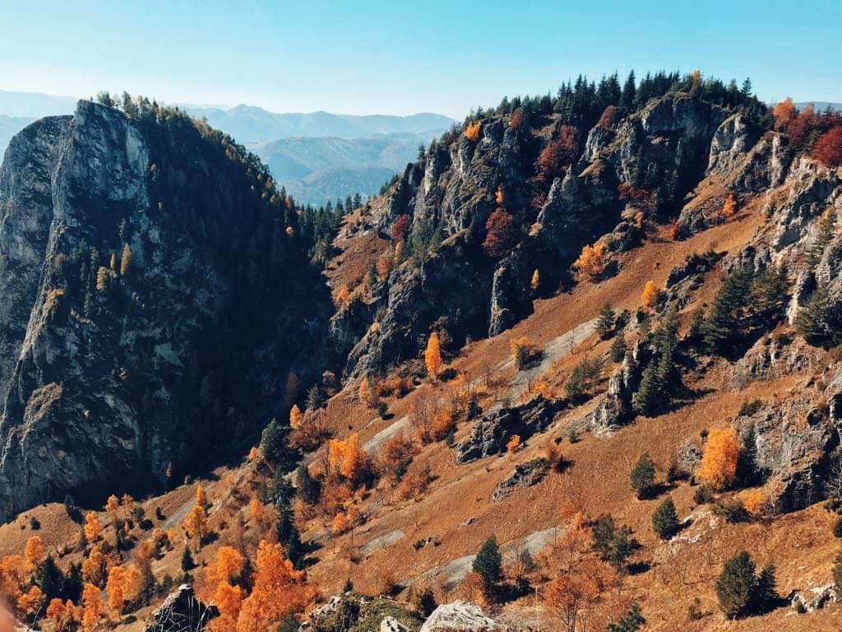
Landscapes from my city
IV. Apuseni Mountains

Slide 15
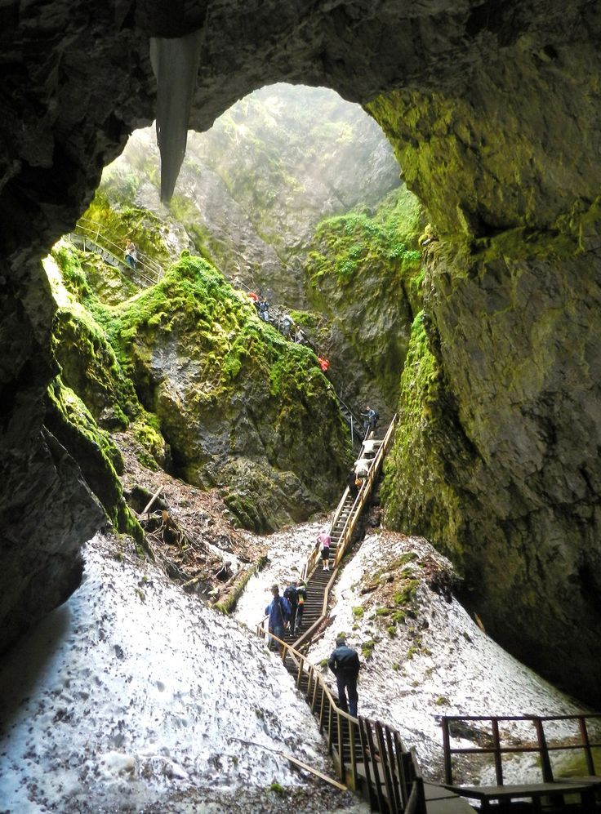
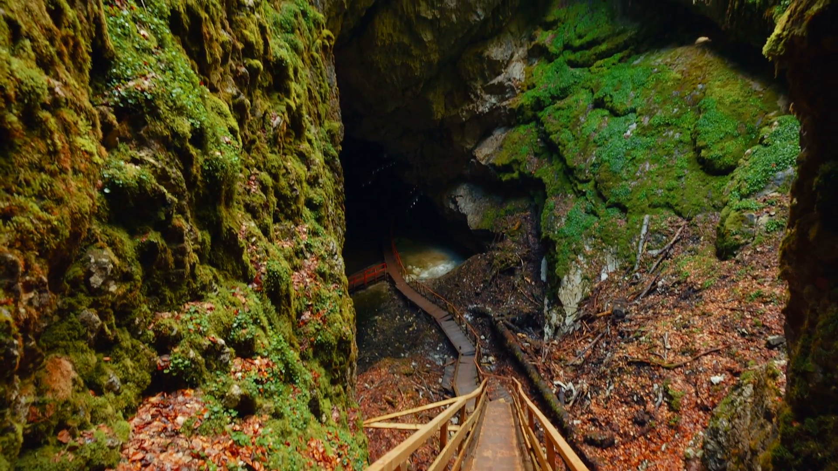
Landscapes from my city
IV. Apuseni Mountains
Scarisoara Ice Cave- second biggest underground glacier in south-eastern Europe
Source: Travel Guide Romania, (n.d.). Scarisoara Ice Cave. Retreieved February 24th, 2019, from: https://travelguideromania.com/scarisoara-ice-cave-biggest-underground-glacier-romania/

Slide 16
Affordances for outdoor play and learning in this place
Geography lessons
Biology lessons
Different games depending on the season

Slide 17
References
Romania. Natural and Cultural, (n.d.). “Did You know?” Retrieved February 24th, 2019, from: http://romaniatourism.com/did-you-know.htm
Romania. Natural and Cultural, (2018). “Cluj-Napoca” Retrieved February 24th, 2019, from: http://romaniatourism.com/cluj-napoca.html
Marius Iliescu (2018), Retrieved February 24th, 2019 from: https://blog.eurail.com/travel-western-romania-by-train/
Wikipedia, 2016. Turda Gorges, Retrieved 24th February, 2019, from: https://en.wikipedia.org/wiki/Turda_Gorge
Thank You Romania. Retrieved February 24th, 2019, from: https://thankyouromania.ro/lacul-tarnita/obiective-turistice-transilvania-cluj-lacul-tarnita-foto-panoramio/m
Travel Guide Romania, (n.d.). Scarisoara Ice Cave. Retreieved February 24th, 2019, from: https://travelguideromania.com/scarisoara-ice-cave-biggest-underground-glacier-romania/

