Slide 1
Rivers and streams

Slide 2
Content
Geography
Structure
Physical Conditions
  Light
  Temperature
  Water Movements
Chemical Conditions
  Oxygen
  Biology
Human Influence

Slide 3
1. Geography
Rivers drain most of the landscapes of the world, all this process appears after the rain pours and drains channels in the soil that will connect furthermore one with each other and become larger and larger.
  e.g.: Nile, Danube, Amazon, Missippissippi, Volga
When it comes to water movements in rivers
  they deliver food, remove waste, they affect the size and shape and behavior of the river.
  the amount of water carried by rivers is called water discharge and differs on the climate and differs on the climate regime of the specific country e.g.: the tropical rivers that don’t flow that much during dry season become torrents during wet season.

Slide 4
2. Structure
3 spatial dimensions:
  Weed channel: Contains water even during flow conditions
  Active channel: Inundate during high flows
  Riparian Zone: Outside the active channel, Transition between aquatic environment and the upland terrestrial environment
divided vertically into water surface, water column, the bottom or benthic zone
  Benthic zone: icludes the surface of the bottom subtrate and the interior of through depths at which substantial surface water still flows
  Hyportheic zone: transition between areas of surface water flow and groundwater
  Preatic Zone: containing groundwater below the the hyporheic zone

Slide 5
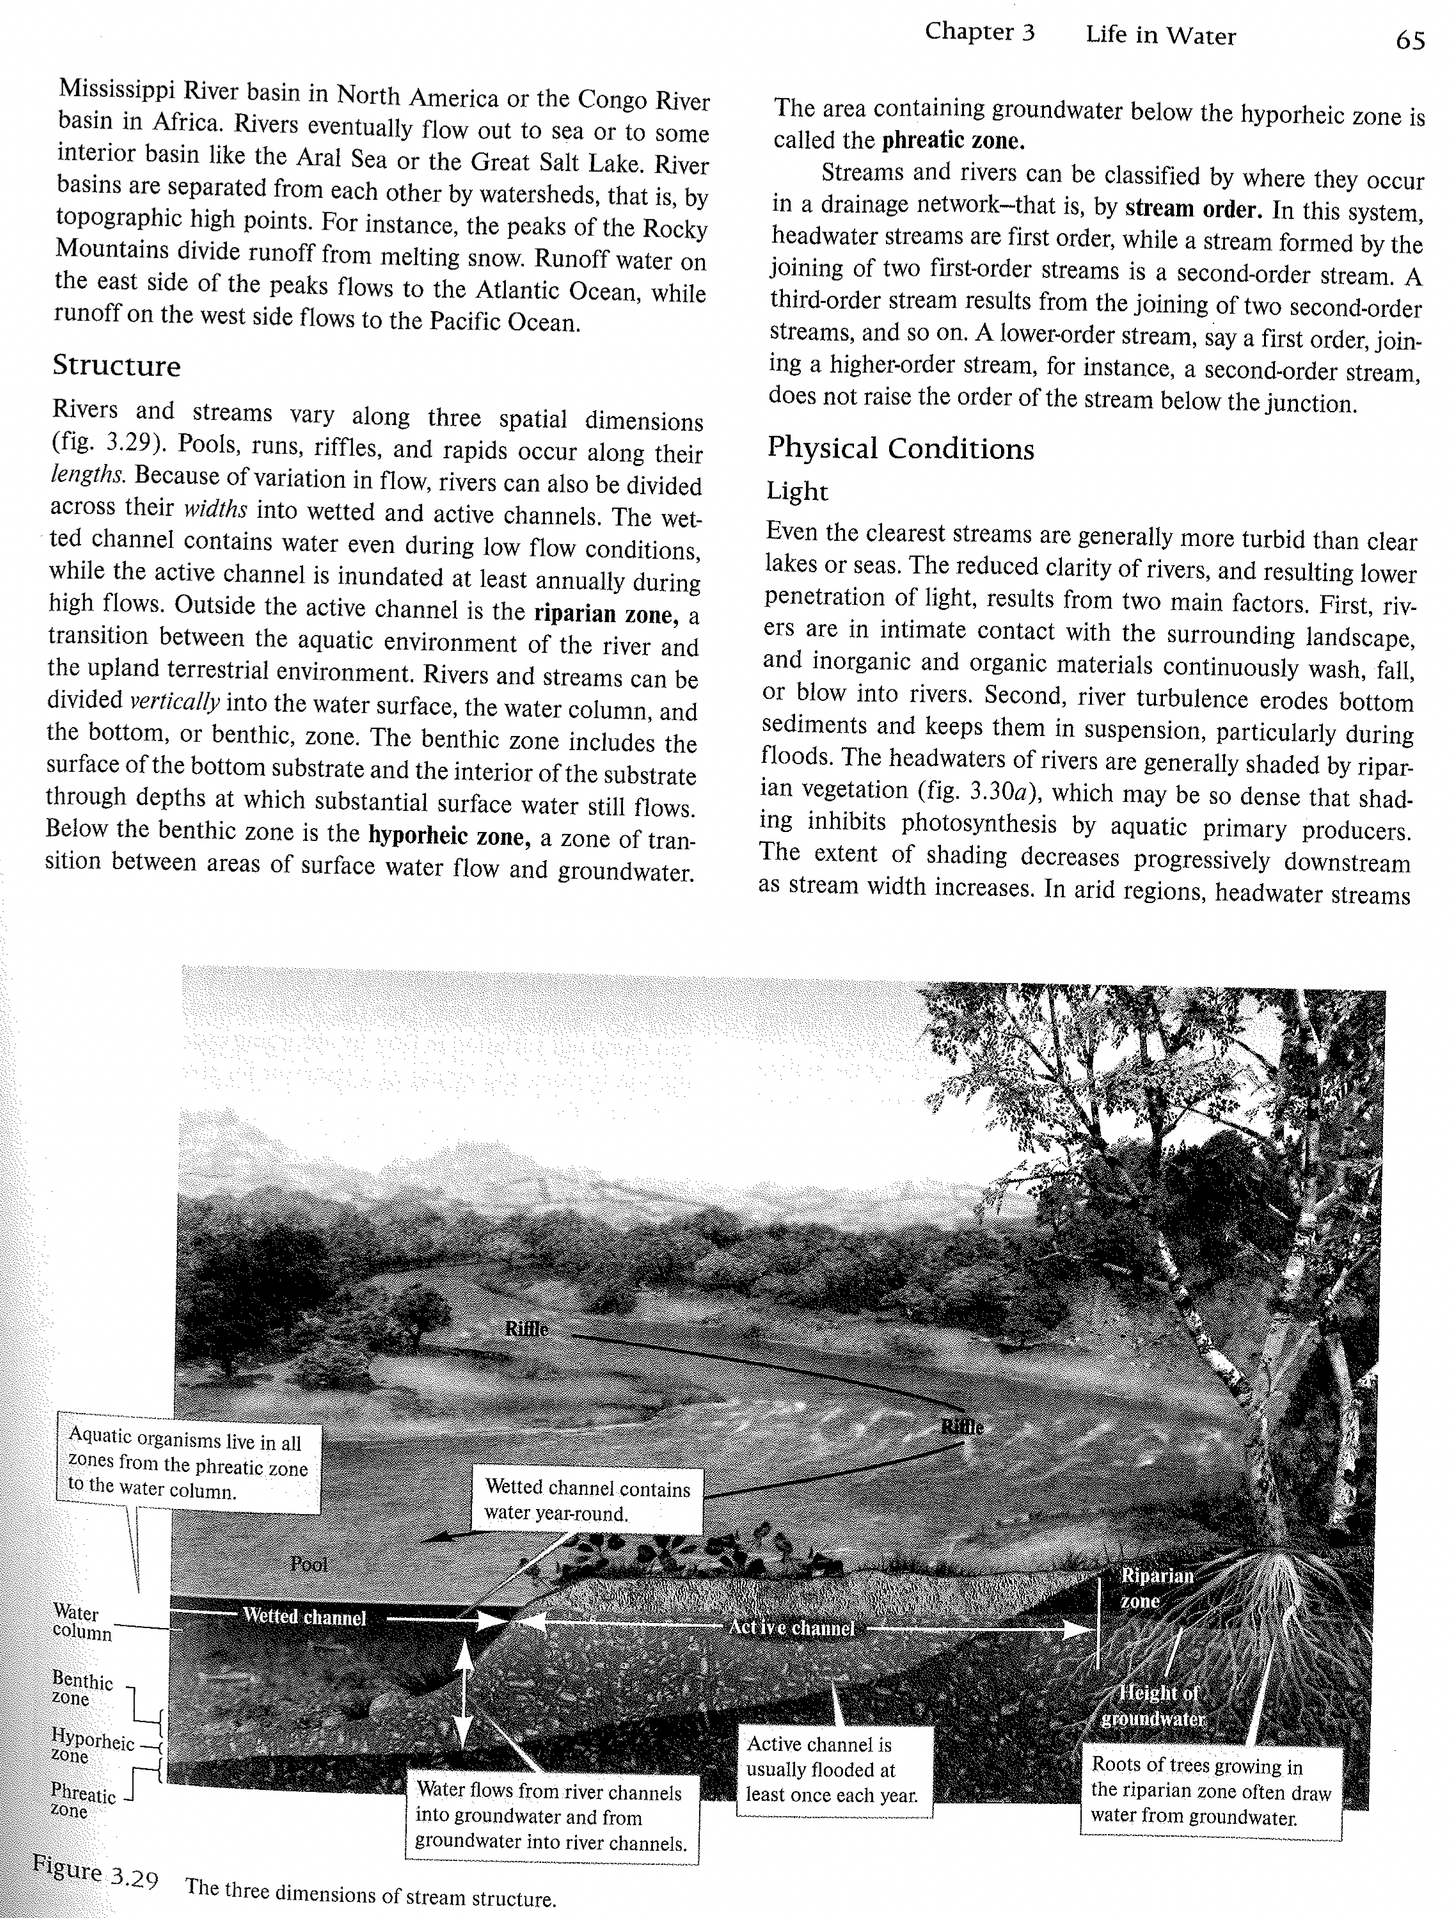

Slide 6
3. Physical Conditions
Light
There are 2 reasons why they are not that clear:
Rivers are in intimate contact with the surrounding landscape. So inorganic and organic materials are falling or blowing into the rivers.
River turbulences erodes bottom sediments
2. Temperature
The temperature of rivers follow the air temperature.
The coldest river temperatures: 0°C.
The warmest rivers: around 30°C.
3. Water Movements
When it comes to water movements in rivers
  they deliver food, remove waste, they affect the size and shape and behavior of the river.
  the amount of water carried by rivers is called water discharge and differs on the climate and differs on the climate regime of the specific country e.g.: the tropical rivers that don’t flow that much during dry season become torrents during wet season.

Slide 7
4. Chemical Conditions
Oxygen
The amount of oxygen found in rivers and streams is inversely correlated to the temperature of the water. This means that when the water is cold there is more Oxygen, and when it is warm there is less Oxygen
2. Biology
The number of species found in rivers and streams depends on the climate it is in. Generally there are more species found in tropical climates and less in temperate climates.
The amount of species also depends on where in the river they live, due to the oxygen levels and temperature.
At the headwaters - Usually lower temperatures and higher 02. Leaves and plant parts are the main energy source
Medium sized streams - Algae and Aquatic plants are main energy source. Warmer temperatures and less oxygen
Large Rivers - Fine particulate organic matter are the main energy sources. Higher temperatures and far less oxygen

Slide 8
5. Human Influence
Rivers are important for humans for:
Commerce
Transportation
Irrigation
Waste disposal
Rivers can also be a threat because they can flood.
Humans have poisoned, channelized and polluted rivers by filling them with sewage.
The building of reservoirs- has had a huge impact on river systems.

