Slide 1
Decoding Verne’s Un Billet de loterie
On the mysterious professor S and other real life persons, that became models for characters in Verne’s novel, ‘The Lottery ticket’.
NAJVS Toronto, Canada, June 2017 Per Johan Moe dep. Language and Literature studies USN, Norway

Slide 2
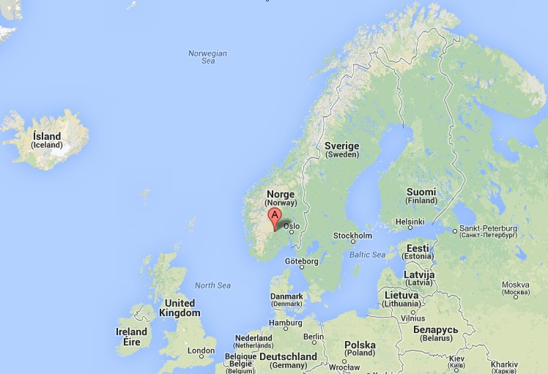
Decoding Verne’s Un Billet de loterie
“…Telemark, noted above all countries in the world for the beauty of its scenery. The writer has had the pleasure of visiting it. […] he brought back with him such a vivid recollection of its manifold charms that he would be glad to convey some idea of it to the reader of this simple narrative.”
-Jules Verne, BL, 1886
Notes:
PJ based at Dep Languages in a University Coll. South of the capital – same region as Verne travelled in 1861

Slide 3
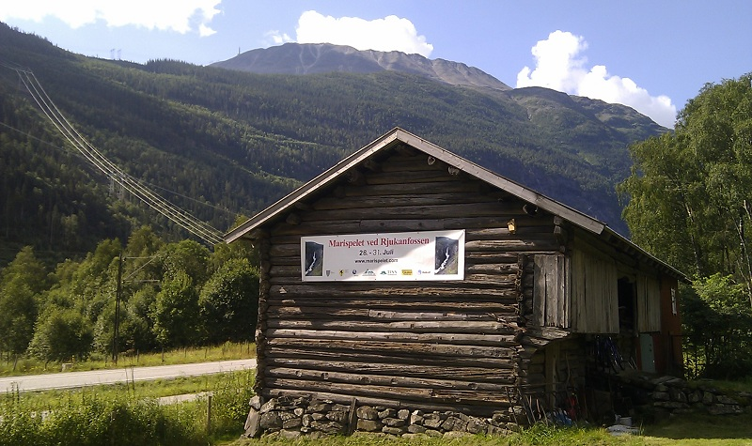
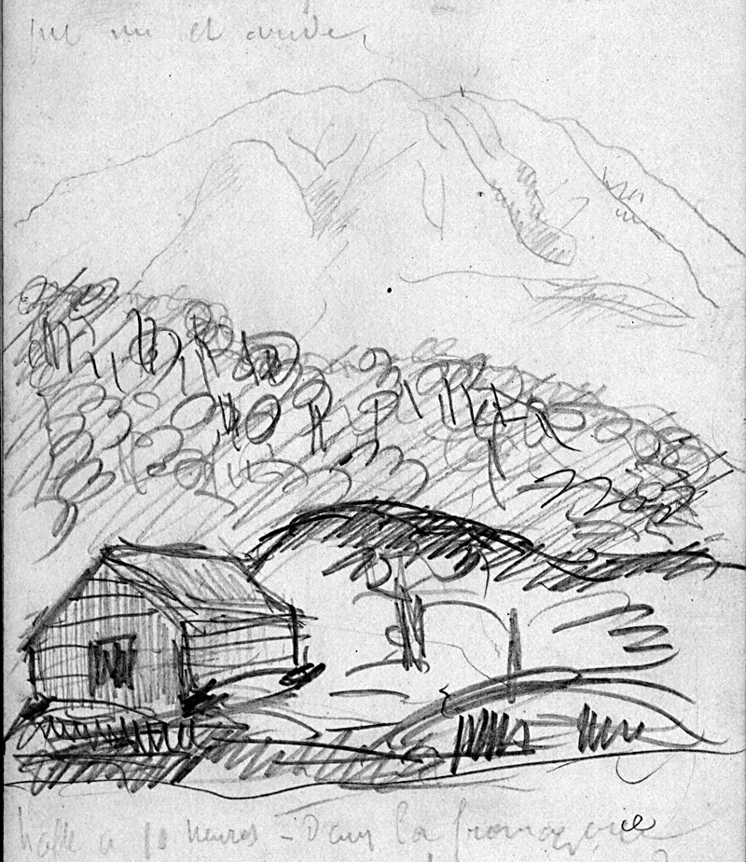
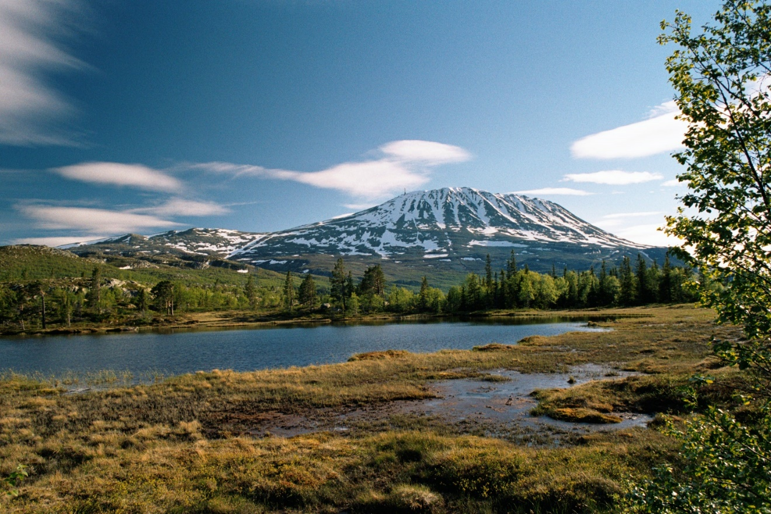
Commemorations in 2011 and 2017 Verne’s journeys in 1861 and 1867
jules-verne.no
www.jules-verne.no

Slide 4
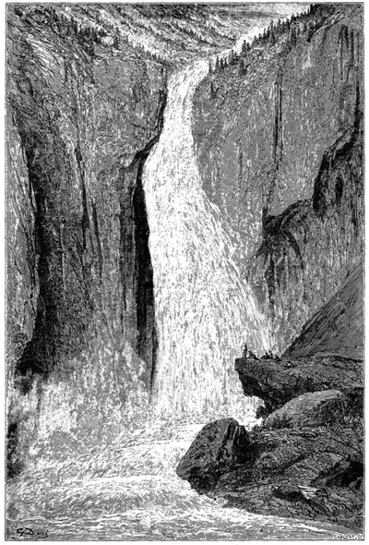
Chasing Waterfalls?
Verne probably had further reasons for travelling
Was five weeks in Scandinavia in 1861, a catalyst for writing prose?
Notes:
The end – stop on the 1861 + 867 journeys was Niagara and Rjukan WATERFALL 5 weeks Scandinavia => 5 weeks Balloon ….. Anyway the africa book was started half a year just after …. A NOVEL inspired by the journey did Why did Jules Verne go to Norway? Det har vært antatt at Verne som så mange notabiliteter – kom for å se RJUKANFOSSEN – JA, det vakte definitivt interessen – DET EKSOTISKE - DET NORDLIGE OGSÅ boken, Fem uker i ballong ble Vernes gjennombrudd som ROMAN-forfatter. Den ble påbegynt halvåret etter en reise han foretok til Norge. – Han var i Sverige, Norge og Danmark en fem ukers tid i juli og august 1861. Flere fortellinger som kom i tiden etter har referanser til Norge. Mye tyder at Vernes første reiser til utlandet (Skottland og Norge) forløste forfatterskapet. [Sannynligvis var formålet med reisen å forberede bokprosjekter han hadde på beddingen]

Slide 5
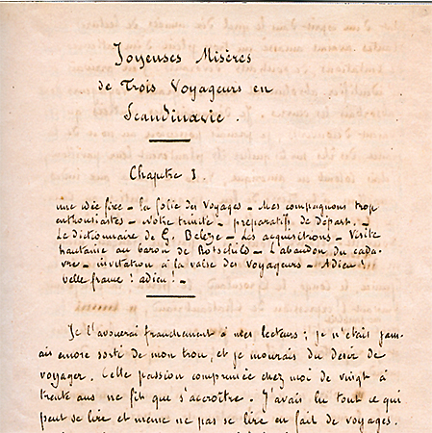
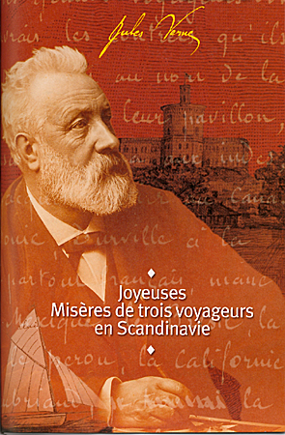
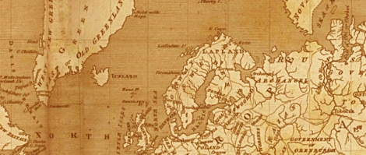
Verne’s first journeys went North, to the coastal nations; Scotland and Norway
«Joyeuses Misères de Trois Voyageurs en Scandinavie»
“Having reflected at length, I chose the Scandinavian states as the goal of my explorations” – Jules Verne, 1861
Pr. 2003 t.Norw.2010
www.jules-verne.no
Notes:
So, a book with all Scandinavian material was probably under way. Why did Verne/Hetzel wait 25 years? En dokumentarisk teksten (ikke fullført ) ble skrevet i 1861, i forkant av reisen

Slide 6
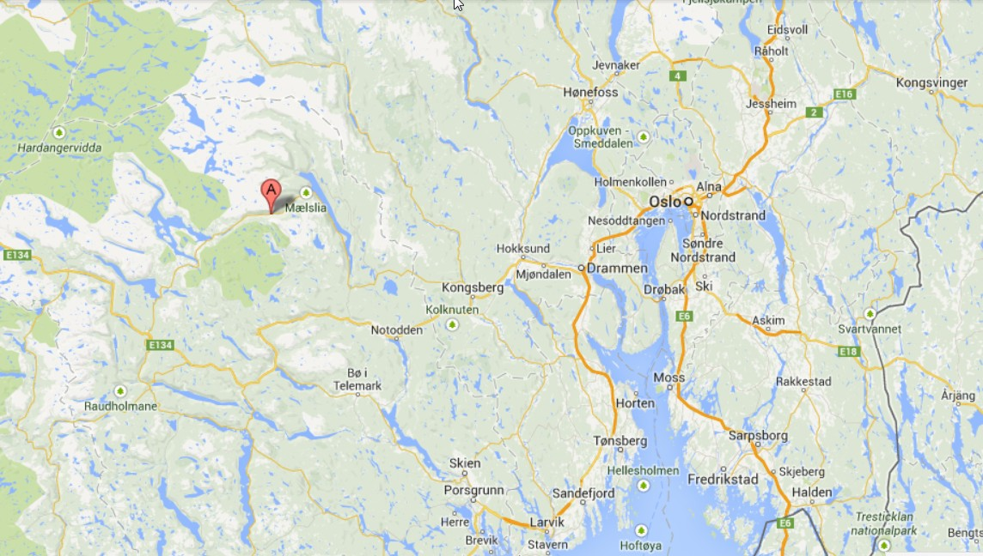
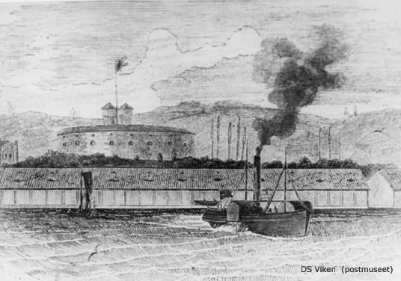
Jules Verne in Norway, July –August 1861 visiting the counties Telemark - Buskerud – Vestfold
Arr. Stavern in Vestfold, on July 18. on mail- paddle wheel steamer «Viken»
Notes:
Quick Describe journey, (USN)

Slide 7
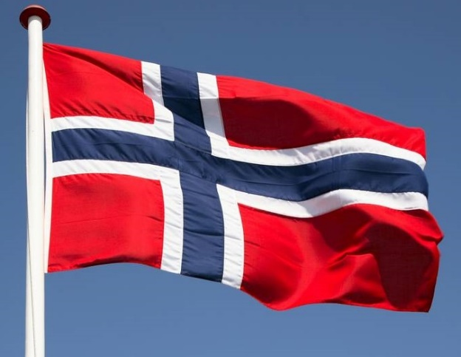
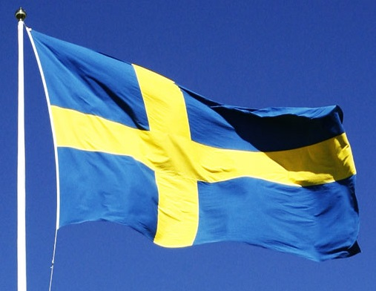
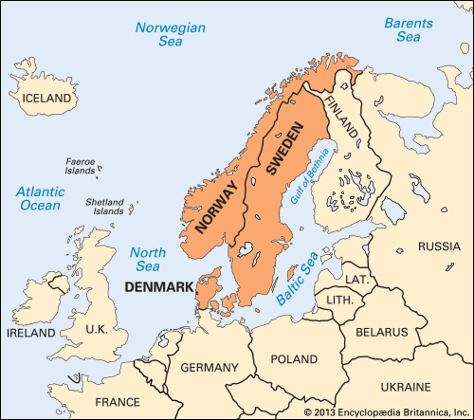
The union years in Scandinavia Commenting on Norway later, Verne several times referred to the nations on the Scandinavian Peninsula as one country

Slide 8
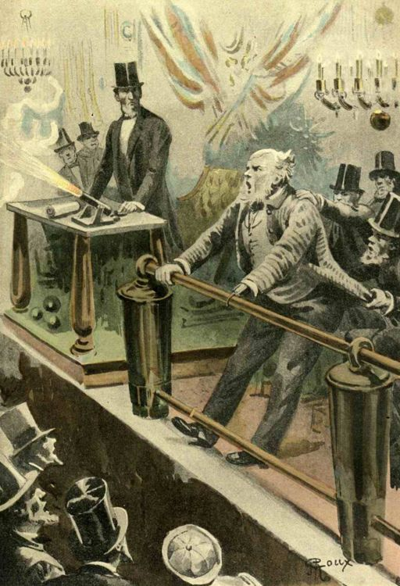
De la Terre à la Lune (1865) / ‘From the earth to the moon’
“Norwegians do not like to send their money to Sweden”
"Cinquante-deux mille rixdales […] tel fut l'appoint de la Suède et de la Norvège. Le chiffre était considérable relativement au pays; mais il eût été certainement plus élevé, si la souscription avait eu lieu Christiania en même temps qu'à Stockholm. Pour une raison ou pour une autre, les Norvégiens n'aiment pas à envoyer leur argent en Suède" - Verne,TL ch.XII
Notes:
One example is in TL

Slide 9
To novels set in Norway, in two consecutive years - 1885 and 1886
Andrè Laurie /Verne
Jules Verne
www.jules-verne.no
Notes:
(FUN) FACTS: neither published in Sweden

Slide 10
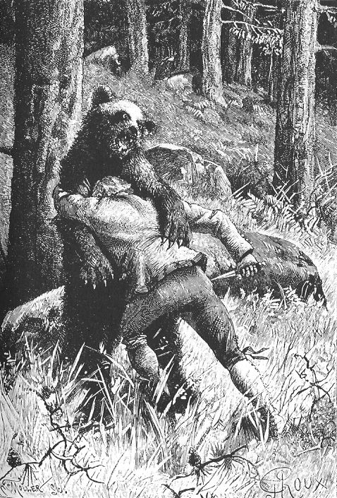
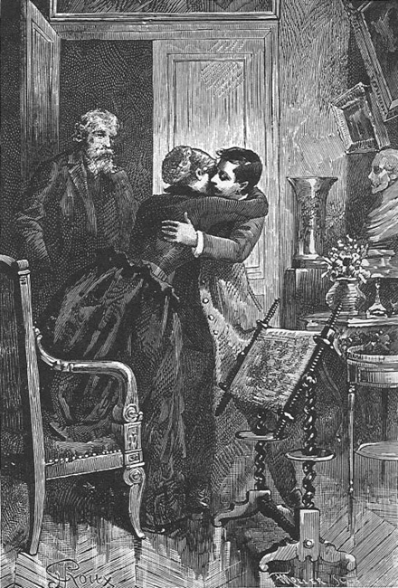
Similarities:
Both published by Hetzel in mid 1880s Both set in Norway, reflecting the union years Both with a characters ‘related’ to Verne’s Bretagne Both seems to be inspired by material from the same French magazine Both include references to old Norwegian legends (st. Sunniva and Maristien)
Notes:
Both commenting on protagonist related to Verne’s Bretagne [has all these years pusseled me … if composed by Grousset, WHY focus on Verne’s home county Note: several Verne-stories reflects the (author’s dream: Brittany boy going North: Wait with : - ERIC – the first ‘in history’ to sail both NorthWest / NorthEast –passages the same year

Slide 11
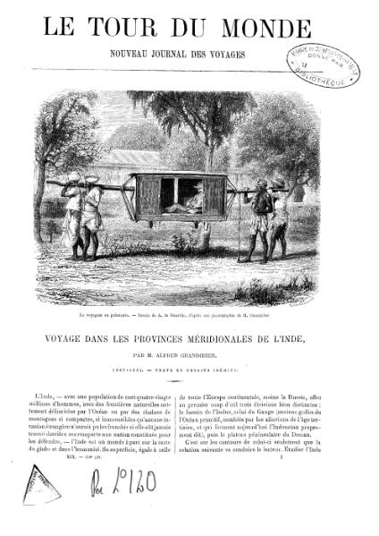
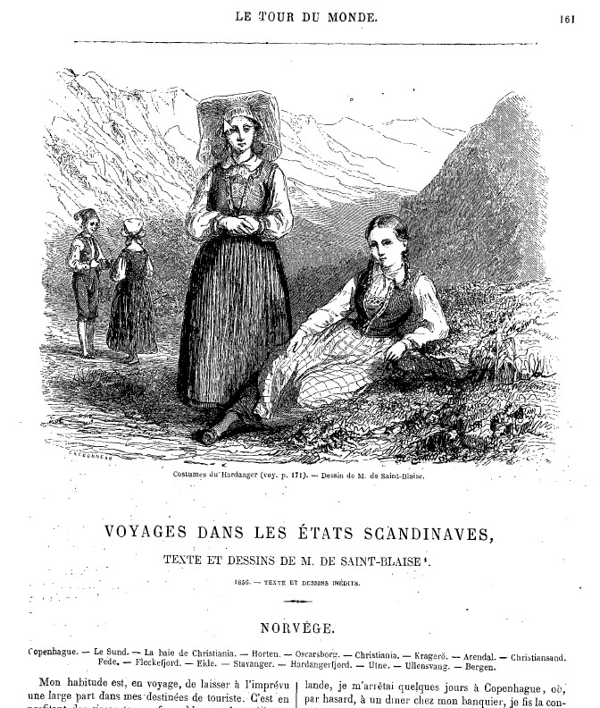
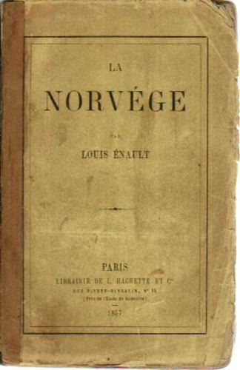
Literary sources to inspire
«Certains paysages publiés dans le Tour du Monde sur la Norvège et le Danemark me séduisirent fort.» «En parcourant le livre de M. Enault sur la Norvège [...]» Verne, 1861: 3 [Joyeuses Misères de trois voyageurs en Scandinavie]
www.jules-verne.no
Notes:
Literary sources to inspire Jules Verne - No secret – both to GO to N. and to write….

Slide 12
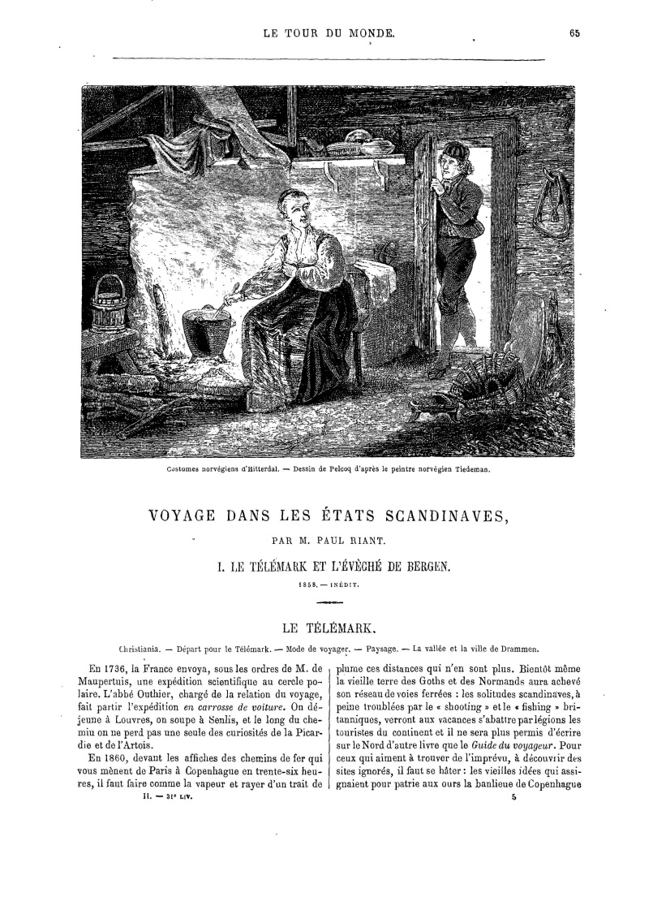
Le Tour du monde - travel magazine
Paul Riant (1860) Saint-Blaise (1861) Saint-Blaize (1862)
‘Voyage dans les États scandinaves par M. Paul Riant 1860 (1858) (Le Télémark et l'évêché de Bergen.)
www.jules-verne.no

Slide 13
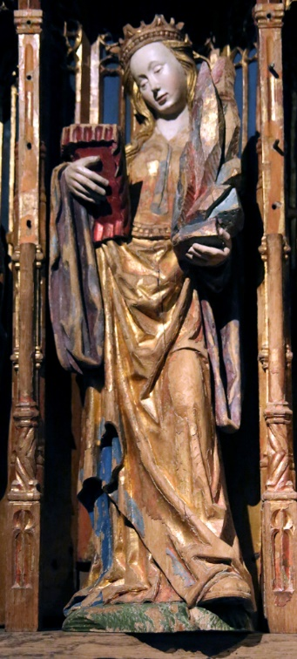
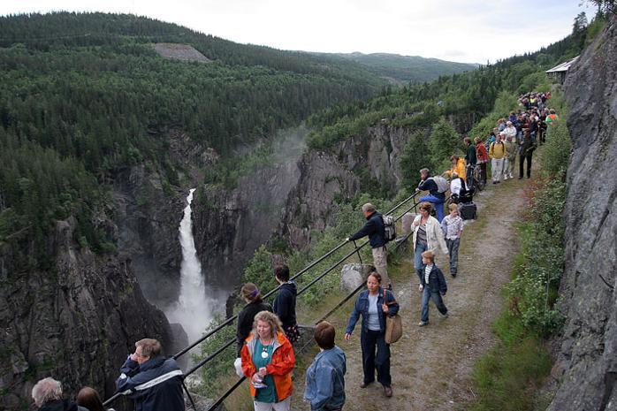
Hetzel /Verne/Laurie - collected inspirational elements from LTdM
The same 1860 -article points to old Norwegian legends: Maristien (Mary’s cliff path) Saint Sunniva
www.jules-verne.no

Slide 14
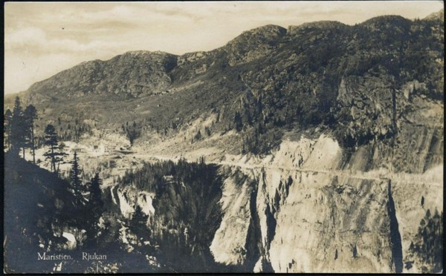
Legend about ‘Maristien’ (Mary’s cliff path)
Le Tour du monde Paul Riant 1860 (1858)
Norw. Photo 1900s
« Le légende du Maristien (passe de Marie) […] une sorte de cran à peine accessible, véritable casse-cou, célèbre sous le nom de Maristien (passe de Marie). Toute une légende se rattache à ce lieu: au temps jadis, on dit que le sentier fut découvert par la belle Marie de Vestfjordal
Notes:
Google: A kind of notch [difficult] accessible, a real daredevil, famous under the name of Maristien (passe de Marie). A legend is attached to this place: in the old days, it is said that the path was discovered by the beautiful Mary of Vestfjordal

Slide 15
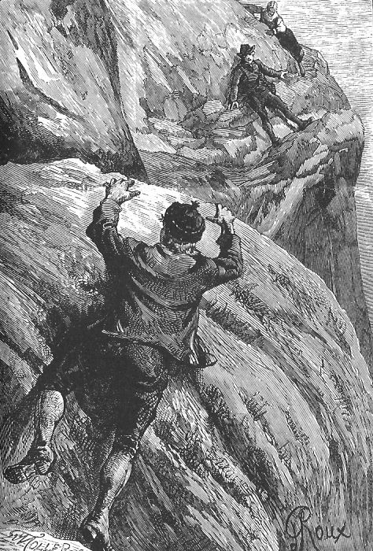
Legend about ‘Maristien’ (Mary’s cliff path)
“And now the daring tourist was slowly but persistently making his way over the rough and slippery ledge of rock, destitute alike of shrubbery or grass, known as the Passe de Marie, or the Maristien.
It is more than probable, however, that he was ignorant of the legend that has made this pass so widely known.
One day Eystein endeavored to reach his betrothed, the beautiful Marie of Vesfjorddal, by this dangerous path………..” - BL. 1886 ch.VIII
« – Il faut le sauver ! dit Hulda » - Verne, BL 1886
Notes:
In Verne’s novel it is exactly on this dangerous path – that the protagonist of the novel – as mountain tourist - is introduced – reaching a dead end…..

Slide 16
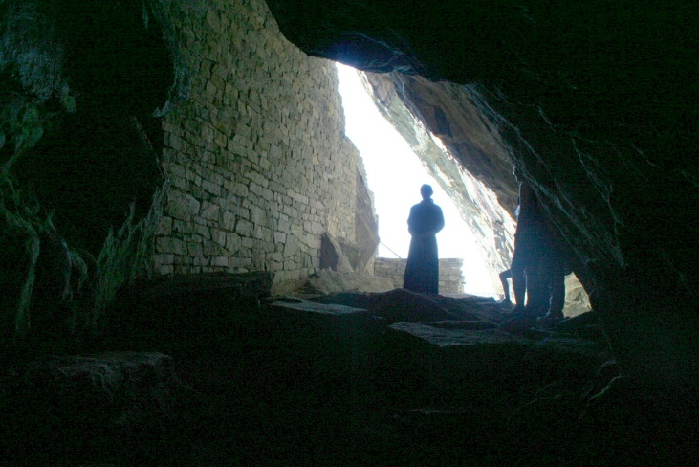
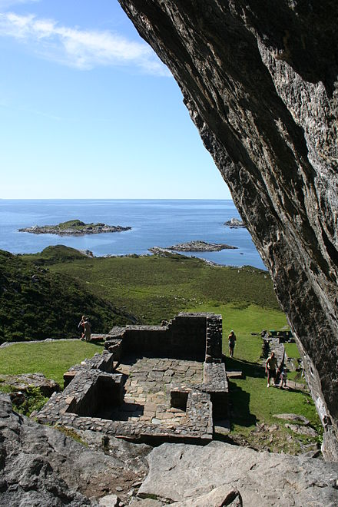
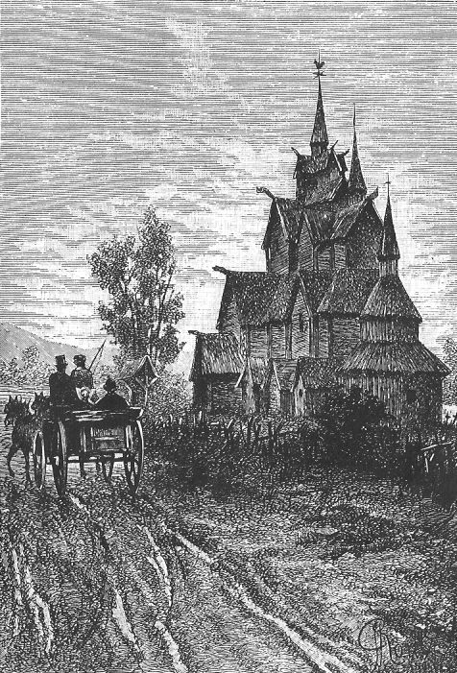
Le Tour du monde explains also about two old catholic places of worship in Norway
The Saint Mikael’s Crypt, inside a cave in Nordfjord (‘Fiord du Noroe’) and the ancient, wooden Hitterdal ‘stave’ church.
“…l'église d'Hitterdal, un des rares monuments de bois du treizième siècle qui subsistent encore en Norvége. […] Mais l'extérieur est parfaitement conservé et surprend par son étrangeté. En somme, c'est avec la fameuse crypte de Sanct Mikaêl, sur le Nordfjord, […] le monument le plus ancien de l'architecture catholique dans ces pays.” - LTdM 1860

Slide 17
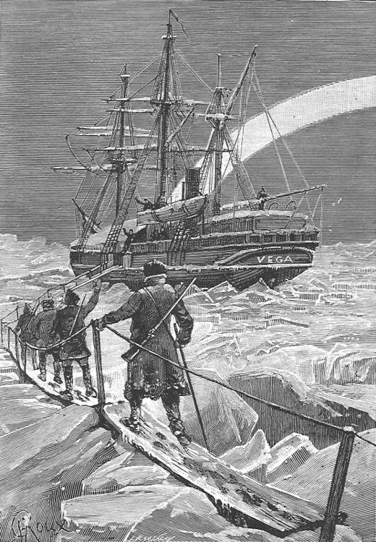
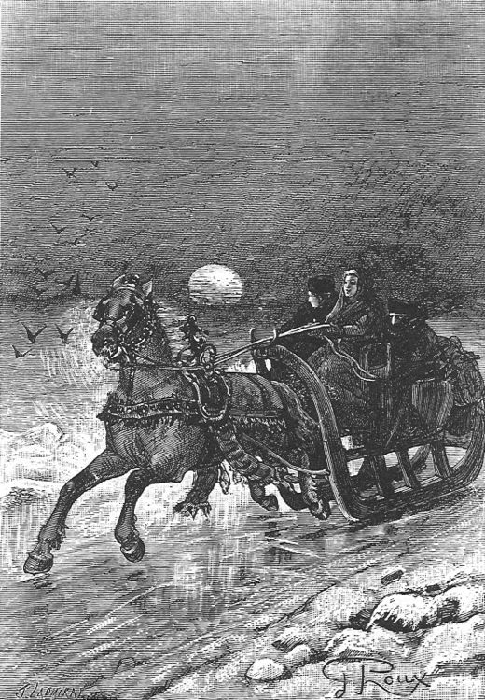
L´epave du Cynthia (1885) by André Laurie (Verne credited as co-writer)
The action of the novel in Norway, Sweden and the Arctic Ocean
www.jules-verne.no
Notes:
Kort ressyme: tiny community at the mouth of NORD fjord in western norway. Based on fisheries and the production of cod liver oil. Here lives a fisherman and his family who has adopted a boy apparently of Celtic origin who, as a baby, drifted ashore on a LIFEBUOY. He grew up to be a sailor and in 1879, he sets off to look fro the famous arctic explorer Nordenskiøld who was in the arctic. Spare det meste om Nordenskiøld

Slide 18
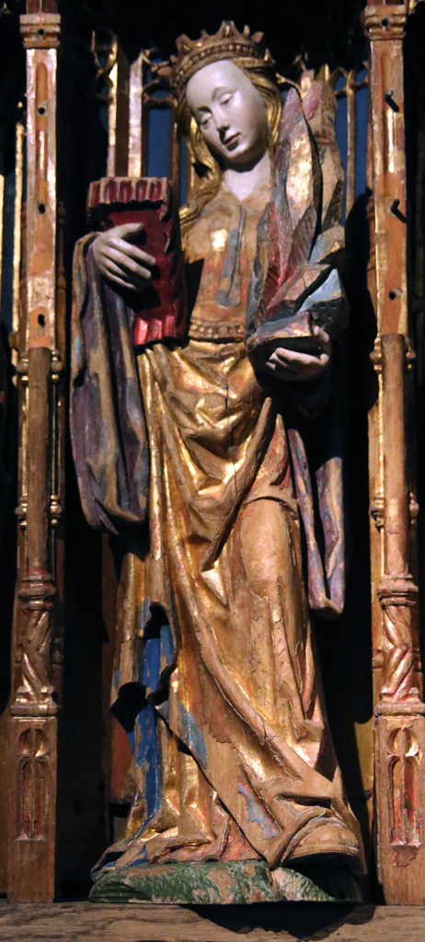
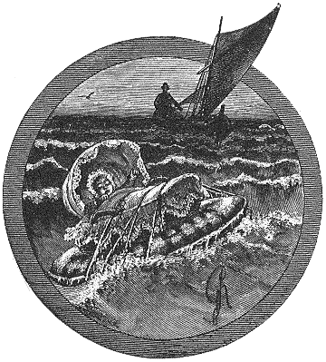
“The waif of the «Cynthia»” Alludes to an old legend i Norway about the Saint Sunniva - a Celtic child drifting ashore, over the ocean from Ireland
www.jules-verne.no

Slide 19
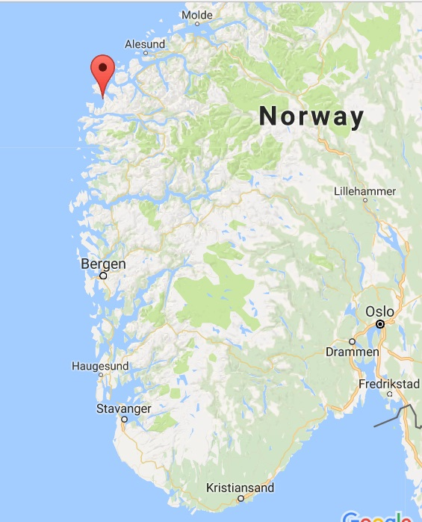
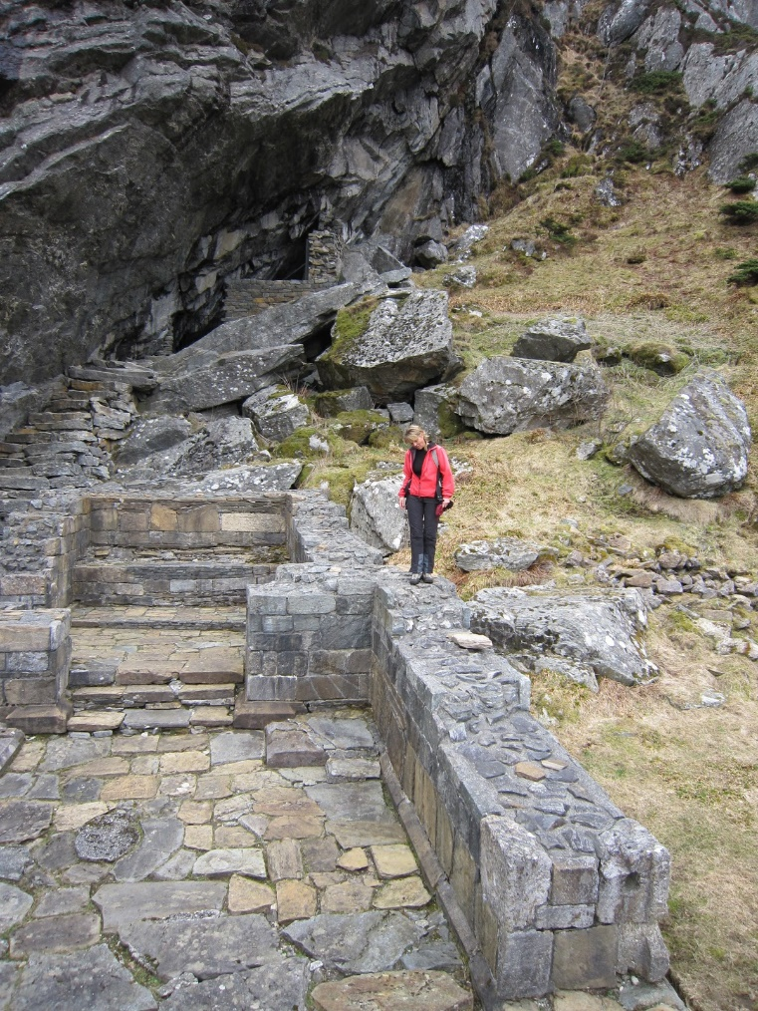
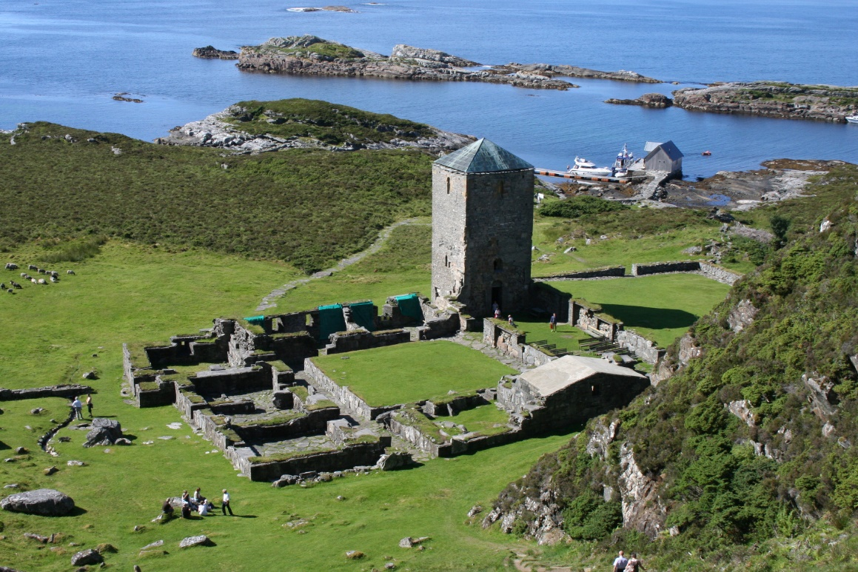
Legend of Saint Sunniva - echoed in the ‘Cynthia’ novel On the Island Selja, where she came ashore, a Church, later a Monastery, was built - at Nordboe
Notes:
Phonetic likeness? - Cynthia – Sunniva –even: Selja ….. And the place of action in novel: ‘Noroe’ – MAP Fiord de Noroe

Slide 20
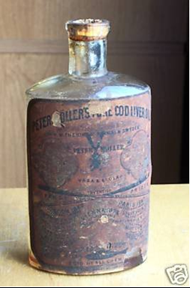
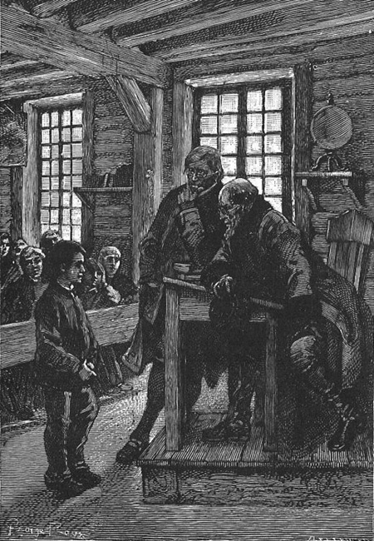
L’pave du Cynthia (Waif of the Cynthia) 1885,
Ch.1: «There is probably neither in Europe nor anywhere else a scholar whose face is more universally known than that of Dr. Schwaryencrona, of Stockholm. His portrait appears on the millions of bottles with green seals, […]A proof of this is what happened one day in a primary school in Noroe, on the western coast of Norway, a few leagues from Bergen” - Laurie/Verne, EC 1885
Action: 1858 +onwards
Notes:
Action of novel. Cynthia went down in 1858 – Eric H went to school ca. 1864 – Peter Møller Tran produksjon 1854 – Frantz Peckel Møller på int. messer 1860 Nordenskiøld 1879

Slide 21
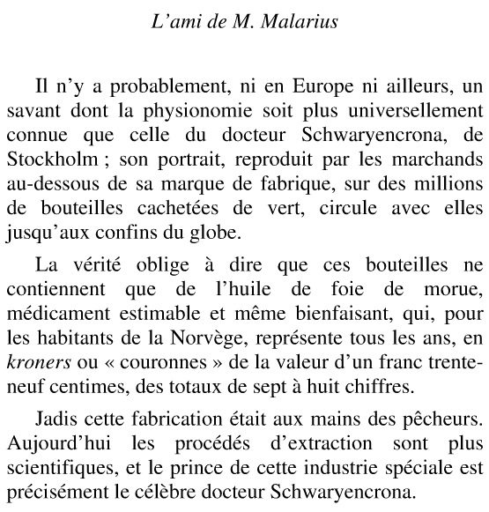
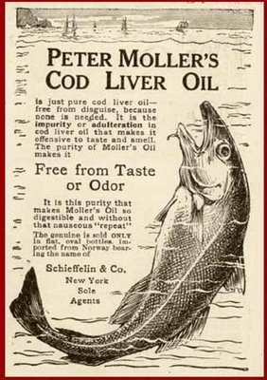
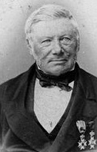
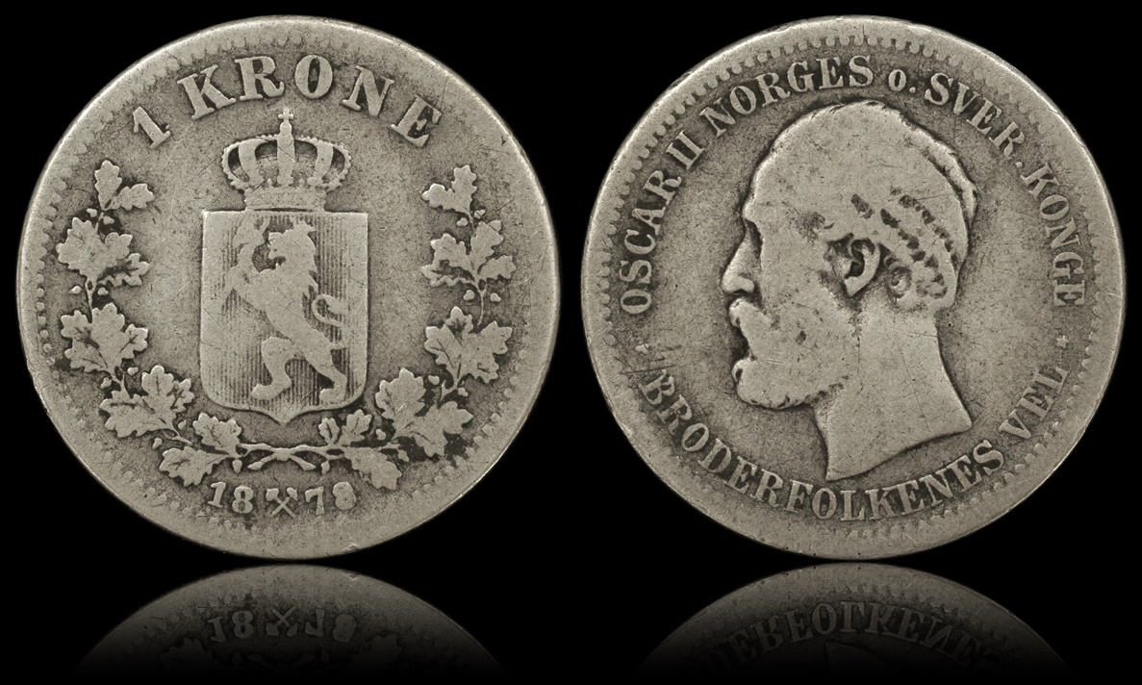
Dr. Schwaryencrona Norwegian: Sverige krona = the Swedish Crown (monetary unit)
Peter Møller (1793-1869)
Notes:
Huge industry in the Nordjord area – particularly from 1860 – internationally known

Slide 22
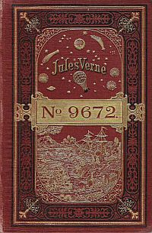
Un Billet de loterie Le numéro 9672 Published 1886
Copenhagen 1888
www.jules-verne.no
Notes:
Tema for paper – Verne’s background for BL

Slide 23
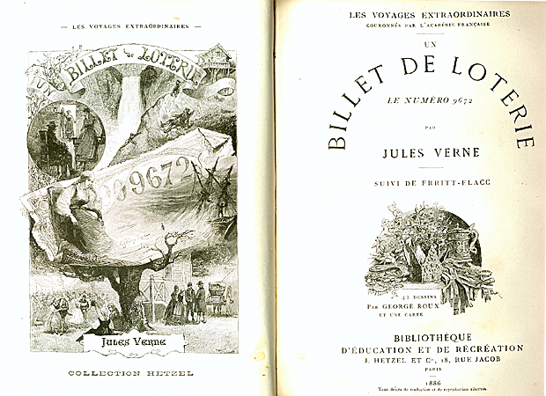
We are in the year 1861-2. Ole, a fisherman from Telemark, engaged to Hulda, at Dale guesthouse - is missing at sea. Just before capsizing he puts, together with a letter, a lottery ticket he has bought to his beloved one, in a bottle and throws into the water. At home, the female proprietor; the widow Dame Hansen, has got a mortgage on the guest house – and is now indebted to a loan shark by the Swedish name Sandquist. Luckily, their saviour arrives; Member of Parliament Sylvius Hog. Along the way we also get acquainted with the physician, Dr. Boek and travel organiser Benett.
Notes:
Det siste navnet, Bennett – får kanskje noen bjeller til å ringe ….. Det skal vi komme tilbake til Telemarkingen Ole jobber på fiskebåt - forlovet med Hulda, på Mm Hansens gjestgiveri ved Rjukan - vil gifte seg når Ole har spart nok penger - moren har har belånt eiendommen Den svenske lånehai Sandquist akter å overta grunnet betalingsproblemene - skaper stor uhygge for Hulda og hennes bror, fjellfører Juel Heldigvis dukker en reddende engel opp en dag Juel er på oppdrag i fjellet Den berømte jus-professor og stortingsrepresentant Sylvius Hog (Skog) har forvillet seg inn i farlig, stupbratt fjellterreng ved Maristien Rjukanfossen - blir siden Hansen-familien en stor takk skyldig. Oles fiskebåt forliser på havet –når hans siste time er kommet, skrives avskjedsbrev via flaskepost, sammen med pengelodd Derav navnet på fortellingen – og lotteriseddelens nummer: 9672

Slide 24
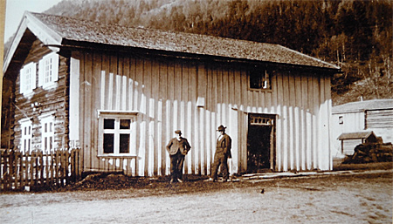
L’auberge á ‘Vestfjorddalen’ Verne’s story starts at a guest house at Dale, close to Rjukan in Telemark
The inn keeper who met Verne, on the left - John Olsen Dahle
Verne’s diary, Saturday, July 27, 1861: ‘We arrive in front of Dal at 15.15, a charming guest house with red furniture and red beds – the house with red exterior’’
Notes:
Gjestgiveriet på Dale – FØRST drevet av Ole Torgersen Dale (som JV hadde lest om i LTdM) – huset en rekke kjente reisende på 1800-tallet. Da JV selv bodde på stedet hadde Ole trukket seg tilbake og svigersønen John Olsen Dale hadde overtatt.

Slide 25
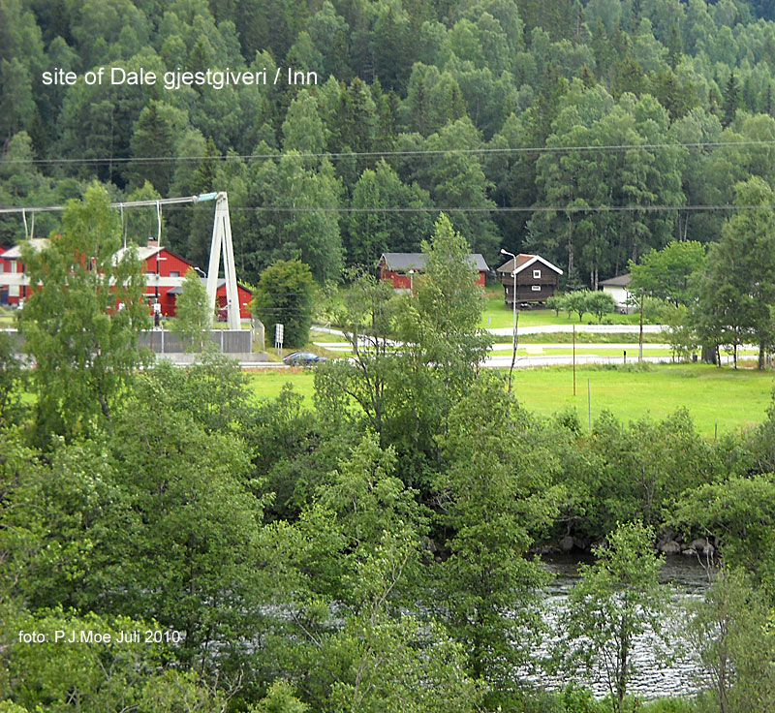
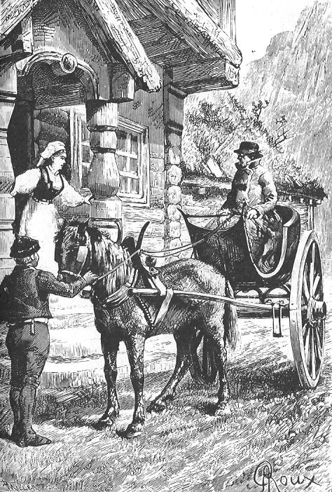
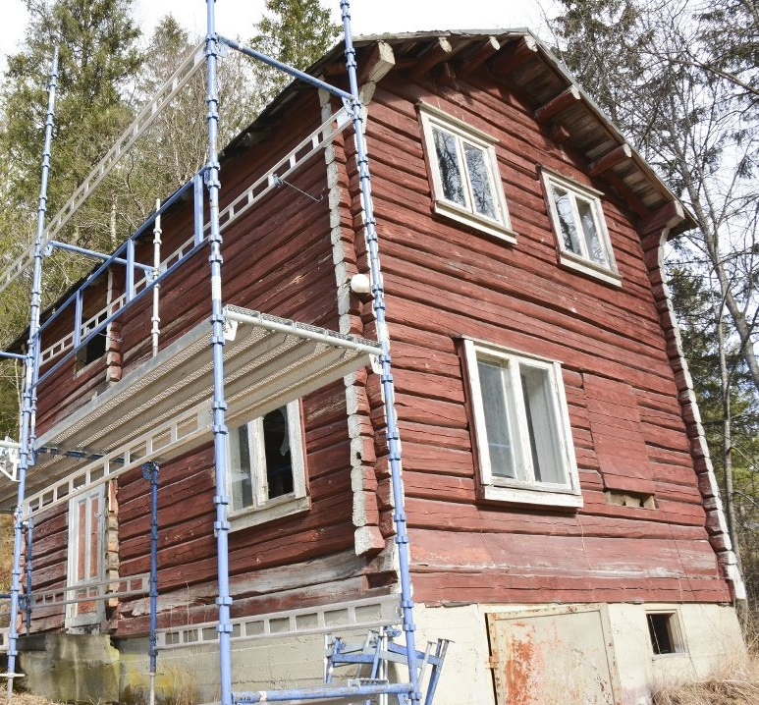
The guest house at Dale, Rjukan

Slide 26
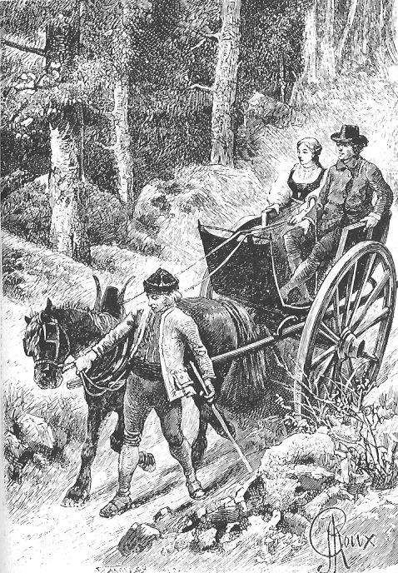
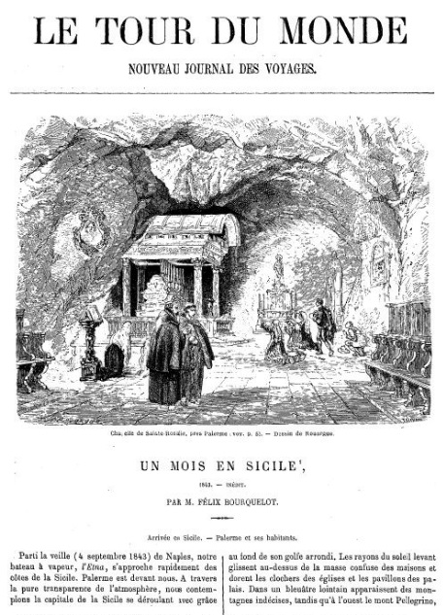
The background for Un Billet de loterie - le numero 9672 Published 1886 – 25 years after visiting Norway
When Verne began writing BL, impressions were not fresh in his memory. He probably had to collect his notes, his diary and re-read back issues of travel magazines.
www.jules-verne.no
Notes:
So, after 25 years – When Verne started writing the novel BL – memories were not fresh

Slide 27
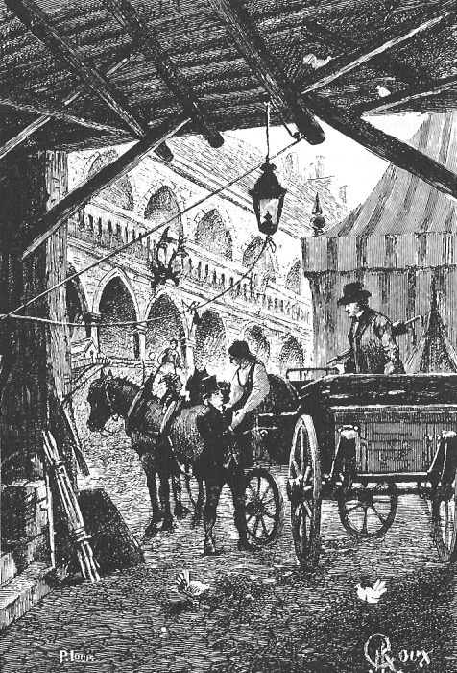
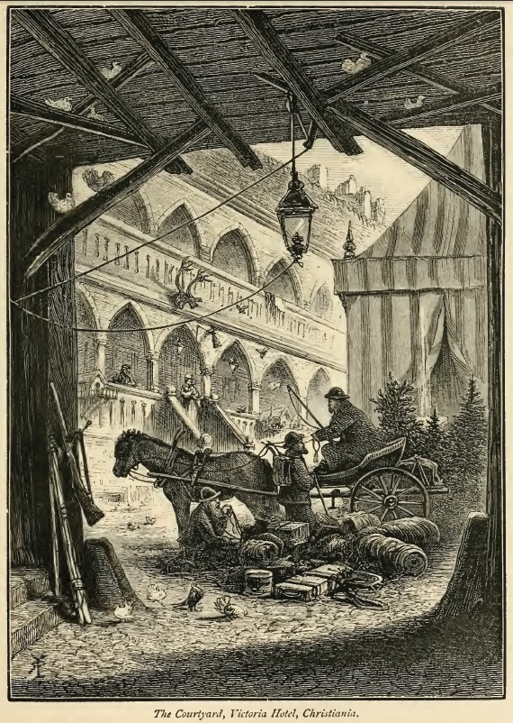
Previous work on BL : PJ.Moe: ‘Intertextuality and Verne’s Norway’ The origin of Un Billet de loterie - on visual and verbal ‘loans’ in the illustrated Hetzel edition.
# verbal intertexts - citations from Le Tour du Monde and (Enault) La Norvège # visual intertexts - engravings /drawings
G. Roux 1886
R.T.Pritchett 1879
www.jules-verne.no
Notes:
In paper: ALSO on WHO JV met in Norway, and eventually wrote into the novel I suggest in paper sources for names, f.eks one of the main characters Joël . IF time permits ,I will end my presentation with these themes

Slide 28
Intertextuality
LTdM: «Le Run […] entrée dans le port de Bergen et débarquions aux Tyske Bodurne quartier de la ville fort original (ill: Le marché aux poissons de Bergen) » (Saint-Blaise, 1861: 172) BL: «En arrivant à Bergen par le Run, Sylvius Hog prit terre au fond du port, sur le quai du marché au poisson. Aussitôt, il se rendit dans le quartier de Tyske-Bodrone» (Verne, 1886: cXIII)
[Boderne]
Xtra

Slide 29
Intertextuality
360 days of rain /year, in Bergen:
LTdM: «Ceci, est le quotidien de Bergen; sur les trois cent soixante-cinq jours de l’année, il y en à trois cent soixante de pluvieux» (Saint-Blaize, 1862: 174) BL: «Naturellement, il pleuvait, puisque la pluie tombe à Bergen trois cent soixante jours par an» (Verne, 1886: cXIII)
Notes:
Verne’s Pessimistic description of the atlantic coastal climate in Bergen on the west coast of Norway 360 days of RAIN pr/ year - is a description borrowed fro Saint- Blaise

Slide 30
Verne indicated sources for illustrations:
«Pour le numéro 9672, on trouvera tout ce qui concerne le Rjukanfos, les paysages norvégiens et les costumes, dans le Tour du Monde, 1860, 2. semestre, États Scandinaves et 1861, 1er. semestre, et 1862, 2e semestre.» - Verne, in letter to Hetzel, October 15, 1885

Slide 31
Visual intertexts - BL
www.jules-verne.no
Pritchett, 1879
Notes:
Lite endret – på livbøyen kan vi lese «RUN»

Slide 32
Jules Verne’s Diary from Norway, 1861 Bibliothèques d’Amiens, France Collection Jules Verne v/ Bernhard Sinoquet (some of) transcriptions by Volker Dehs
P J Moe
Notes:
Et helt spesielt VIKTIG MATERIALE for meg – til studiene av Vernes norske forbindelse er denne dagboken. Bernhard Sinoquet AMIENS - kindly game me exclusive right to SHOW these drawings. Reg. diary VOLKER’s Transcription very important. Mye uleselig for en utrent skrifttyder NOW, in BL it is hard to find geographical details – not already documented in LTdM: as far as I can see; only Tinnes – nicely depicted in his diary

Slide 33
Jules Verne’s Diary from Norway, 1861
Drawings, shown with permission on www.jules-verne.no courtesy of Bibliothèques d’Amiens
www.jules-verne.no
Notes:
Mer tekst: JV.no

Slide 34
Un Billet de loterie and written sources Most geographical details in novel, may originate from published texts - exept details about ‘Tinness’
BL: «Sylvius Hog, sans s’y arrêter, put apercevoir l’église d’Hitterdal, un vieil édifice très curieux »
www.jules-verne.no
Xtra
Notes:
My observation is: Geographical details CAME from LTdM & Enault’s Norvege ONLY TINNESS is unique [because of the FANOUS CHURCH – while theme/ athmosphere / characters --

Slide 35
Why publish/write the novel, set in Norway 25 years after visiting the country?
«musique – la mer – liberté» (Verne, J.J.1973) - political and social ideas - subject to political sensorship
Novels from countries fighting for freedom - a new direction in his authorship
x

Slide 36
Novels set in countries with an ongoing struggle - for indepence, freedom, or … La Maison à vapeur (1880) India L’Archipel en feu (1884) – Greece Mathias Sandorf (1885) – Hungary Un Billet de loterie (1886) – Norway Nord contre Sud (1887) – N.America Le Chemin de France (1887) - France Famille sans nom (1889) – Quebec, Canada
Notes:
[Michel Strogoff –kurér (1876) – Turkestan] Mange forbinder JV med Sci – Fi bøker N.Am = borgerkrig Saken er at en rekke fortellinger – er klart forankret i samtiden - i 8oårene kom en rekke fortellinger der uavhengighetskamp er bakteppet for handlingen

Slide 37
Historical background for Un Billet de Loterie
- When does the story take place? - When was it written? …… seen in relation to Norwegian history
In the novel, Verne did not focus on his own unique observations regarding places and nature or geography. But:
Main theme, atmosphere and cast, seems to be built on Verne’s own experiences during his stay in Norway
OK?
Notes:
The action of the novel is set to the 2nd part of 1800s. The protests against the unionen with Sverige startet to get harder – exactly at the time when Verne visited both these counytries. Verne was collecting material at the time when an important questions came up. The book was published 25 years later publisert when the Parliament demanded to end the union.

Slide 38
Polarization in Scandinavia during the union years – (1814 – 1905) Swedes vs Norwegians
Verne in the novel: «À l’époque où se passe cette histoire […] ces deux pays scandinaves, peu enclins à vivre d’une vie commune (Verne, 1886 -BL)

Slide 39
Details from Verne’s diary from Norway, 1861
Conflict in Scandinavia - the underlying theme of BL Negative Swedish attitudes towards Norwegians - probably overheard while in Stockholm: «July 8, 1861: Le Suédois detestents les Norwegiens […] July 12, 1861: Chaque Suédois a volontiers sa petite maison - les francais sont amis - ils detestent les Norwegiens» (Verne, 1861 - JV MS 12.5)
www.jules-verne.no
Notes:
Napoleonic wars – 300 yrs Danish king – UNION w/ Sweden 1814 – 1905 - acording to diary : also met leading POLITICIANS (my interpretation)

Slide 40
Characters in the novel Ole Joël Hulda Mme. Hansen Dr.Boek Benett The protagonist Sylvius – [salvage] The antagonist Sandgöist – [egoiste]
Notes:
Staving fra fransk utgave Unfortunately, Mme Hansen is in debt to a Mr Sandgoïst. Luckily, their ‘savior’ soon arrives: Sylvius. The book, published when Verne’s memories of Norway may have faded a little, fits thematically well into his list of stories set in political turbulent surroundings every year between 1884 and 18878. After 300 years under the Danish king, Norway was in union with Sweden from 1814 – 1905. The tale about Lottery Ticket no. 9672 was set in the birth-of-a-nation years in Norwegian history, written exactly 20 years before breaking loose from union with Sweden. The polarization on the Scandinavian peninsula is the underlying theme of the novel and may be Verne’ s main reason for selecting what I believe to be the symbolic names of main characters.

Slide 41
Polarization on the Scandinavian Peninsula - symbolic names on main characters?
LTdM on Norway: « familles répondant au nom latin de Sylvius Skog en Norvége, du Bois en Normandie, Boice en Angleterre, […]» (Riant, 1860)
LTdM on Sweden: «Ce brave homme, nommé Sandgoist, donna à chacun de nous de la paille fraiche […]» (Saint-Blaize, 1862
Notes:
PJ: Astonished on 1st reading: Sandquist is a typically Swedish name ……. Most important: Verne spends a big space in NOVEL describing the Professor-politician Sylvius Hog At the same time – explaining a a lot about the ongoing CONFLICT

Slide 42
The name: ‘Sylvius Skog’
Sylvius /silva => (latin) forest [in Norwegian: Skog ]
Le Tour du monde: ‘’Beaucoup de familles norvégiennes tombées en paysannerie ont encore leurs écussons et leurs généalogies intactes. Un savant professeur de Copenhague, qui possède parfaitement l'histoire de notre Normandie, fut étonné de retrouver une conformité entière d'armes entre quatre familles répondant au nom latin de Sylvius Skog en Norvége, du Bois en Normandie, Boice en Angleterre, et Boyis en Suède (branche émigrée d'Écosse au seizième siècle)’’. - LTdM, ‘Voyage dans les États scandinaves’ (2. sem. 1860, Note 10)
URL: URL, LTdM

Slide 43
Polarization - Symbolic names on main characters ? Sandgoïst the Swede - Sylvius the Norwegian
Notes:
George Roux has depicted the Antagonist / Protagonist – at Guesthouse in diametrically opposite pose Sandquist ALONE - Sylvius lovingly surrounded by, and tended to …..

Slide 44
Jules Verne and time Novel published in 1886 Action of story takes place 1861-2
Why did Verne back-date the text? Was it important to connect his cast of characters to people he actually met himself?
Xtra sjk
Notes:
Min teori er at dette har å gjøre med at Verne fikk ideer til en symbolikk (som så ofte ellers i andre romaner) en underliggende tematikk han ville bygge inn i romanteksten – OG at han ønsket å modellere sine romanfigurer omkring reelle personer han møtte i 1861. Samtidig hadde han kanskje et ønske om å anonymisere disse – eller unngå uheldige konsekvenser for dem. Dessuten, som jeg vil forsøke å vise – ble viktige politiskespørsmål i Norge avklart på den tiden da romanen faktisk kom ut.

Slide 45
Jules Verne’s contacts in Norway – the proprietor ‘Hotellvertinde’, the widow Inger Kristine Hansen, at Kongsberg
Diary, Wednesday July 24: Departure [Hokksund] the fog is getting denser, more and more “Ariveé à 2 heures à Konsberg - hotel Handsen”
Hansen’s ‘Private Hotel’
She may have been Verne’s model for Madame Hansen « l’auberge de dame Hansen » - the widow, who in the novel ran the guesthouse at Dale (Rjukan)
www.jules-verne.no
Notes:
I vernes roman er innehaver ikke (den faktiske Ole Torgersen Dahle/ svigersønn John Olsen Dale) - men enken Madame Hansen – Det viser seg at Verne selv overnattet hos enkefru Hansen – men et par døgn før- på Kongsberg

Slide 46
Jules Verne and Thomas Bennett
Travel notes from July, 1861 - indicates that Verne modelled several characters in the novel around people he met “ Lundi 22 M.Benett – la voiture […] voyage a Rykanyfos “ (Verne, 1861 - diary)
- travel organizer
www.jules-verne.no
Notes:
Just a little back step in time…… In the Capital. Most foreign tourist going to telemark, had the journey organized by Benett. Det skal jeg gå videre inn på nå: roman-karakterer; Bennett, Boeck,

Slide 47
Jules Verne’s contacts in Norway Thomas Bennett is mentioned in the diary, on July 22, and details about him occupies several pages of the novel ”Good-morning, Mr. Benett. It is always a great pleasure to me when I have an opportunity to shake hands with you."
"And for me, professor, it is a great honor."
[....] "I am glad to see that your journey through Central Norway has been safely accomplished."
"Not accomplished, only concluded, for this year." [....] "By the way, you found the carriage you had ordered waiting for you at Tinoset, did you not, professor?" he asked.
"Yes. Having ordered it through you, Monsieur Benett, I felt sure that it would, be there at the appointed time.” - Jules Verne, BL 1886
Bennett’s ‘bazar’ was situated only two blocks away from Verne’s hotel - maybe the the author experienced a similar conversation?
Notes:
Store strandgate 17, nå fred olsen gate – ved børsen - Bennets basar lå et par kvartal unna Hotel du Nord Dersom tid …. kart gate adresser (muntlig)

Slide 48
Jules Verne’s contacts in Norway From Vern’s diary in 1861: Samedi 20 – pluie toute la journée, non sortie – visite du docteur le matin – encouragément – dîner à 2 heures – invitation du docteur pour le lendemain à sa maison de campagne Lundi 22 M.Benett – la voiture […] voyage a Rykanyfos – visite à M. Boek à l`hôpital - pîqure d’épingle […] – lépreux du moyen âge, sorte d’élephantiasis aux mains - horreur - des syphilisés [sic] (Verne, 1861 - diary) x
- The Doctor
Dr. Carl Wilhelm Boeck (1808-1875) - an expert on leprosy and syphilis, - managed his own hospital - MP for Kongsberg - had a country home outside the capital
Notes:
Samme dagbokside igjen – men nå for andre detaljer Vi leser VIDERELese høyt har hoppet over søndag 21. foreløpig … (kommer) DOCTEUR – nevnes en rekke gannger – Verne trengte angivelig legebesøk og reisekameratene hans hadde skaffet kontaktdetaljer - han holdt til like ved…. [KART]

Slide 49
Invited to the Doctor’s country home at Eidsvold - a train ride, just north of the capital – to lake Mjøsa
« encouragément […] – invitation du docteur pour le lendemain à sa maison de campagne »

Slide 50
Oslo, capital of Norway in 1861 called Christiania
Xtra

Slide 51
Notes:
Verne may have need , and according to JM they carried a letter of introduction to a Doctor in N THE ‘nearness’ to everything – maybe the reason for meeting important contacts – and in turn giving good ideas for elements in the novel

Slide 52
Jules Verne’s contacts in Norway
- models for the cast? Dr. Carl Wilhelm Boeck (1808-1875) speciality: leprosy and syphilis MP for Kongsberg
« – Un médecin ! Pourquoi pas mon ami le docteur Boek, de Christiania ? »
« Sur la demande de Sylvius Hog, le célèbre docteur Boek, son ami, vint à Dal voir la jeune malade » - Verne, Un Billet de loterie (1886 : ch. X + XII)
www.jules-verne.no
Notes:
GOING to the Novel BL: Likeså gjerne som at Bennett i romanen var en reell person – kan absolutt Dr.Boek ha vært det. Minst to ganger omtales doktor-vennen til Sylvius – en Doktor Boek

Slide 53
The character Dr. Boek - may have been named after The ‘docteur Boek’ that Verne met, according to diary From the inside cover of diary: «Herre Boeck sende os, her, til xx herre xx Ole Dahle»
Notes:
Ytterligere indikasjon på At Verne hadde kontakt med, og fikk hjelp og støtte av Boeck finner vi på innsiden av permen til dagboken Kommentarene om Dr. Boeck er sentrale for å avkode sammenhengen mellom romanfifurer og reelle historiske personer Karakteristika: Kongsberg / syfilislege / stortingsmann / landsted på Eidsvold

Slide 54
Descriptions of Sylvius Hog in the novel: - professor of law, close friend of the physician, Dr. Boek - famous politician – repeatedly declined a position in the Cabinet - important i the heated debate about Vice-king (roi) in 1854
The ‘viceroy conflict’ during union years with Sweden
Kap. IX - Sylvius Hog avait à peine soixante ans. Encore ne les paraissait-il pas […] sain d’esprit et sain de corps, il plaisait dès le premier abord avec sa belle et aimable figure, sans barbe, […] Sylvius Hog était professeur de législation à Christiania. […] Donc, Sylvius Hog étant un des hommes les plus considérables de son pays, on ne s’étonnera pas qu’il fût membre du Storthing. […] Ainsi était Sylvius Hog. D’un caractère très indépendant, ne voulant rien être, il avait maintes fois refusé d’entrer au ministère. Défenseur de tous les droits de la Norvège, […] Sylvius Hog était de cœur et d’âme pour la Norvège. Il en défendait les intérêts en toute occasion. Aussi, vers 1854, lorsque le Storthing agita la question de ne plus avoir ni vice-roi à la tête du pays ni même de gouverneur, il fut l’un de ceux qui se jetèrent le plus vivement dans la discussion et firent triompher ce principe.
- Verne, Un Billet de loterie (1886
Notes:
THEN to the most interesting elements of this connection between NOVEL and Verne’s real –life –experiences . VERNE PRESENTS THE VICEROY CONFLICT This DRAWING is from the BOOK nearly 60 years of age – but it did not look that way –en sunn sjel i et sunt legeme en vakker og elskelig mann – uten skjegg….. […….] Det er all grunn til å se for seg at vi HER snakker om ENDA EN REELL PERSON Merk: Stortingsdebatten om Vice-roi i 1854

Slide 55
Oslo University - law building

Slide 56
Professor of Law, Anton Martin Schweigaard (1808-1870) ?
Schweigaard was elected into Parliament in 1842. From 1845 to 1869 he was, without comparison, the most influentual representative of the Norwegian ‘Storting’ (Parliament). It was Schweigaard himself, who through his whole life preferred the Storting as his arena. Had he wanted, on several occations he could have entered the cabinet. (Norw. Dictionary – www.snl.no)
paintor: A.Tidemand 1844
Notes:
Tampen brenner på A.M. Schweigaarsd[konf.J.Bing og Dr. olav Mestad] Foran universitetet i Oslo (JUS) Sentral stortingspolitiker under stattholderstriden – professor i jus – førte stattholder–kravet i pennen – ivret for unionsoppløsning - maleri Adolf Tidemand 1844 skulptur 1883

Slide 57
The heated dispute about having av Viceroy ‘Stattholderstriden’ in the 1850s and 1860s Norwegian Parliament decided in 1854 to terminate the arrangement
A key point was §12 second app. jf. §14 in the revised constitution of November 1814:
”…Ligeledes kan Kongen beskikke en Vice-Konge, eller en Statholder”.
This was felt like having a mark, suggesting: vassal state
Notes:
Ifølge den reviderte grunnlov av 4. november 1814 hadde (svenske)kongen rett til å utnevne en stattholder i Norge, Dette ble fra norsk side etter hvert følt som et lydrikemerke, og Stortinget vedtok 1854 (ref. årstall i JV-tekst) å oppheve stattholderposten. Vernes roman ble skrevet i 1885 # Unionsstriden spisset seg i 1860 - unionsskepsisen øker. I 1884 kom partiet Venstre til regjeringsmakten og innledet etter hvert en «knyttenevepolitikk» i unionssaken. # Norges mulighet for å føre en egen utenrikspolitikk hadde lenge vært et stridstema. Nå krevde Venstre at Norge burde få et eget nasjonalt konsulatvesen

Slide 58
Hypothesis: Schweigaard a model for Sylvius?
Repetition/translation: « This was the case with Sylvius Hog. Being extremely independent in character, and utterly devoid of ambition, he had repeatedly declined a position in the Cabinet; and a stanch defender of all the rights of his native land. he had constantly and unflinchingly opposed any threatened encroachment on the part of Sweden […] So, when in 1854 the Storting was discussing the question of having neither a viceroy nor even a governor at the head of the state, he was one of the most enthusiastic champions of the measure.[...] » - Verne, Un Billet de loterie 1886 (tr. Kendall)
ill, novel
A.M. Schweigaard
Xtra
Notes:
Sentral stortingspolitiker under stattholderstriden – professor i jus – førte stattholder–kravet i pennen – ivret for unionsoppløsning

Slide 59
Dimanche 21. Depart par le chemin de fer à 8.15 – billets d´aller et retour. 1er classe – jusqu´à la derniere station près de la rivière que descend du lac Miosee [Mjösa] - conxxx professeur m. S … de legislation
[ Verne/BL: «Sylvius Hog était Professeur de Législation à Christiania» ]
Notes:
In Diary, we remember that Verne commented on having been invited to Doctor Boek’s country home. On Sunday July 21 he wrote details about the train ride AND: also about (meeting) a professor of legisl- now for the way Verne has (scribbeled) down details about the first meeting – the professeur m. S … de legislation

Slide 61
By Train to Eidsvoll together with 2 Norwegian politicians?
Diary: Dimanche 21. depart par le chemin de fer à 8.15 – billets d´aller et retour, 1re classe – jusqu´à la derniere station près de la rivière que descend du lac Miosee [Mjösa] – arrivée station de Eiswold - maison en bois; le bateau à vapeur Dronunde [Dronningen] – le docteur – promenade en bateau à la chute – la pluie a cessé – fleur d`eau – vue de torrents –table oú l`on peut prendre du café – retour – dîner norvègien Conversation avec le docteur et un professeur En Norvége, chambres independantes - pas de code – lois novelles – promenade avec les dames á la grand cascade - Retour aux l´hotel – adresse au professeur” x x
Dr. Carl Wilhelm Boeck specialist in leprosy and syphilis, MP for Kongsberg, country home at Eidsvold
Anton Martin Schweigaard ? Close friend of Dr. Boeck, professor of law, fluid in french, famous politician - the most important, in the union years
Notes:
Om VI GÅR TILBAKE TIL DAGBOKEN Legen Boeck hadde invitert Verne til landstedet på Eidsvold Der ble en interessant samtale om to kammer på tinget og nye lover mm . Verne var selv jurist – men kunne ikke annet enn fransk + Latin og gresk Schweigaard derimotSNAKKET FRANSK hadde hatt stipendieopphold (i tyskland og) FRANKRIKE i 2 ÅR og hadde publisert fagtekst i Paris (Gallica.fr) Boeck hadde også holdt foredrag og publisert ute

Slide 62
The Viceroy conflict 1850-1860 … - the reason for Verne’s waiting? - before publishing of novel ?
23.april 1860: Adresse from the Norwegian Parliament to the Swedish king (Carl VI) - a protest written by A.M. Schweigaard
In 1873 the ‘Storting’ once again decided to terminate the Viceroy arrangement. The act was then ratified by King Oscar II. without protests from Sweden [eff. 1875] In 1884 the Liberal Party came into power and the anti-union pressure increased Vernes novel was written i 1885 …..
Notes:
Schweigaard hadde våren 1860 forfattet en protekst-Tekst som var under behandling da JV var i Norge Stattholderstriden – stortinget protestet mot av svenske-kongen [Carl den VI] nektet å sanksjonere vedtaket fra 1854 om å slutte med vice-konge / stattholder -ordningen

Slide 63
Hypothesis - a tentative interpretation…..

Slide 64
Hypothesis: Verne met, during the union years, important politicians while the Viceroy debate was at it’s most heated stage, this gave ideas for a novel. Some of the characters in the novel were modelled around the actual persons, Boeck og Schweigaard - but Verne chose not to publish as long as they lived. He waited until the struggle had given political results. Verne decided to set the action of the novel to the year they met, the time when Professor Schweigaard was politically most active. The novel came out when the case was settled: 23.april 1860: The Parliament adresses the Swedish king - a protest written by A.M. Schweigaard. The decision to terminate the Viceroy -arrangement was ratified in 1873 by Oscar 2nd (came into effect: 1875) The anti union debate got even more intense in 1884, when the Liberal Party came into power - then the confrontations became really harsh. The novel was written in 1885 ……
Notes:
Anonymiserte, relle personer forkommer ofte hos Verne

Slide 65
– an interpretation? Un Billet de Loterie, le no. 9672 – The novel Lottery Ticket is the story about ‘The little Norwegian House’ (subordinated Sweden) – deep down into what Verne regarded as genuine, exotic surroundings of natural beaty, in the heart of Scandinavia – situated at the Northern Frontier of Europe. This is the home of the mountain guide Joël (Jules) => ‘the noble savage’ (with characteristics similar to those of Rollo in Normandy). This tiny community is threatened by a greedy, egoistic, loan shark - the Swedish Sandquist. Along comes, Member of Parliament; Sylvius [salvage], to rescue ‘The ‘Norwegian house’, liberating it from the Swedes. The fact that Verne, accidently in 1861, met the most important Norwegian politician, was a strike of luck. Verne may have regarded that, to Norway, Schweigaard was the winning Lottery Ticket. [The novel was published in (first, 10000ex.) at the time when the unionen dissolved, 1884 through to 1905.]
Notes:
At Verne ved et slumpetreff i 1861 møtte Norges viktigste stortingspolitiker - Schweigaard - er vinnerloddet som gikk inn OGSÅ FOR DET NORSKE FOLK – mente KANSKJE Verne

Slide 66
visit www.julesverne.no/english
www.jules-verne.no

Slide 67
A riddle? Lottery Ticket no. 9672 - indicating date ? A bank draft lost by Verne, was recovered around 9. july -62 (year mix up) The summer of 1862 Verne signed publishing contract, and could from then start to write, full time
Notes:
Verne skrev m.a.o. helt parallelt med Skram (Hellemyrsfolket) og Ibsen – JV født samme år som Ibsen – litterært gj.brudd på likt – alle døde ved unionsoppløsningen

Slide 68
Elements from conversation on the train from Christiania to Eidsvoll - later to be found in novels (BL and TL)
[…] En Suede, 4 clases, La noblesse, la clerge, les borgeoises, les paysans – en Norvège pas de noblesse – autonome – gouvernemant entierement xxxxx - le roi xxx xxxx avec xxxx roi Norwegians – que le fait couronner a Drontheim […] le banque de Christiania ne regretment pas les billets de la banque de Stockholm

Slide 69
[ « Si, en Suède, il y a quatre classes, la noblesse, le clergé, la bourgeoisie, le paysan, il n’y en a que trois en Norvège ; la noblesse manque. On n’y compte aucun représentant de l’aristocratie » ]
Translation, BL ch. IX Though there are four distinct classes in Sweden, the nobility, the clergy, the gentry, and the peasantry, there are but three in Norway—the nobility being utterly wanting. No aristocracy is acknowledged,
[…] «Such is the moral and political gulf between the two countries that the King of Sweden—then Oscar XV. —after being crowned at Stockholm, was obliged to go through a similar ceremony at Drontheim, the ancient capital of Norway. Such too is the suspicious reserve of Norwegian men of business, that the Bank of Christiania is unwilling to accept the notes of the Bank of Stockholm! JV/BL (Kendall)

Slide 70
Courier of the Czar– novel, 1876 Inspired by Tsar Alexander’s annexation of Khiva i 1873 - details (about year) sensored by publisher
Xtra
NEW Norwegian ed. December 2016
Notes:
After some 10+ years a NEW direction - Det politiske engasjementet - blir klart Like før jul kom en nyoversatt – for første gang komplett – utgave av romanen Tsarens kurer. I ETTERORDET jeg har skrevet for utgivelsen kommenterer jeg hvordan Vernes ønske om å ta opp polisk brennbart tema ble SENSURERT av FORLAGET. Forfatteren ble presset til å gjøre utydelig på hvilken TID handlingen foregår av hensyn til Frankrikes NÆRE forhold til TSAR-RUSSLAND

Slide 71
visit www.julesverne.no/english
BL citations in English: # http://jv.gilead.org.il/pg/13527-h.htm Pritchett’s drawings – “Gamle Norge” Rambles and Scrambles in Norway: # http://archive.org Images, BL # http://jv.gilead.org.il Handwritten manuscript BL, manuscrit Nantaise: # http://www1.arkhenum.fr/bm_nantes_jules_verne/_app_php_mysql/ms/popup.php?fichier=B441096101_MJV_B136_001 Le Tour du Monde: # http://fr.wikisource.org/wiki/Le_Tour_du_monde LTdM, Riant 1860 2s LTdM, Saint-Blaise 1861 1s LTdM, Saint-Blaize 1862 2s
www.jules-verne.no

Slide 72
UT?
Un Billet de Loterie – often considered to be based on the author’s own experiences
« ...[le] plus charmant pays du monde. Pour tout dire, Dal est dans le Telemark, le Telemark est en Norvège, et la Norvège, c’est la Suisse avec plusieurs milliers de fiords qui permettent à la mer de gronder au pied de ses montagnes. »
-Jules Verne, Un Billet de loterie, 1886
Taking a closer look ….

Slide 73
DROPPE UT?
Verne’s metaphoric description of Norwegian landscape sounds, at first sight, like the authentic enthusiasm of a poet; «les pieds baignent dans la mer ».
Twice, lines are borrowed from Saint-Blaise/LTdM, with comparison to the Mediterranean and the island of Capri outside Naples, Italy. LTdM: «tantôt gracieux de lignes comme l’île de Capri. Ces îles se succédant sans cesse forment comme une série de coulisses de granit et cachent Christiania jusqu’au dernier moment. […] Située en amphithéâtre et baignant ses pieds dans la mer,» (Saint-Blaise, 1861: 163). BL: En somme, comme toute ville dont les pieds baignent dans la mer et qui dresse sa tête au niveau de verdoyantes collines, Christiania est extrêmement pittoresque. Il n’est pas injuste de comparer son fiord à la baie de Naples. Ainsi que les rivages de Sorrente ou de Castellamare» (Verne, 1886: chXVII). BL: «la Norvège, c’est la Suisse avec plusieurs milliers de fiords qui permettent à la mer de gronder au pied de ses montagnes» (Verne, 1886: ch II)

Slide 74
Intertextuality
Certain misspelled, supposedly authentic, Norwegian expressions, probably originate from Enault’s La Norvége:
BL: «Merci pour ce repas, Tack for mad !» Quoi de plus agréable que de lui entendre répondre de sa voix fraîche et sonore: «Puisse-t-il vous faire du bien, Wed bekomme ! » (Verne, 1886: ch III). «l’un dit: Tack for mad ! «Merci pour ce repas» et l’autre dit: Wel bekomme ! «Puisse-t-il vous faire du bien! » (Enault, 1857: 177).
Notes:
Reading these sources – (a lot has b-. Written) my contribution may be, a study from a Norw. Perspective – to read with anorwagian language ‘filter’ - f.ex: where authentic Norw. Expressions are quoted – misspellings might reveal the sources of the phrases.

Slide 75
Utelatte bokbilder Den eneste illustrerte utgave i Norden; C.Huitfeldt 1971
22 norske-motiver - ikke på trykk i Norge xxxxxxx
Tegner: George Roux
www.jules-verne.no
Notes:
Romanen om dagliglivet på et gjestgiveri i Telemark ble kom veldig sent på norsk. Og beklageligvis ble bare 16 av de i alt 38 som ble laget for boken, trykket i 1971-utgaven. Her er de 22 illustrasjonene med motiv fra Norge som i den foreløpig eneste norske utgave ikke ble trykket. (dersom nok tid)

Slide 76
Visual intertexts - Un Billet de loterie
Pritchett, 1879
www.jules-verne.no

Slide 77
Visual intertexts - BL
www.jules-verne.no
Pritchett, 1879

Slide 78
Visual intertexts - BL
www.jules-verne.no
Pritchett, 1879

