Slide 1
What Is Oil?
Geology and Chemical Aspect
Hikaru Wada & Sarah Erland

Slide 2
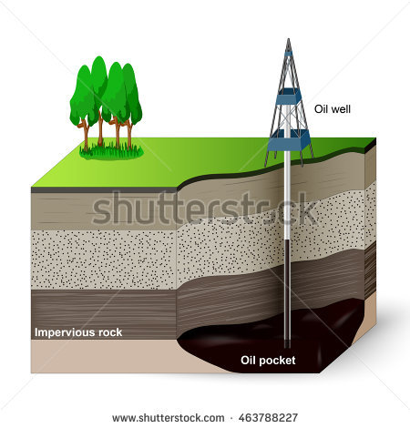

Where do we get our oil from?

Slide 3
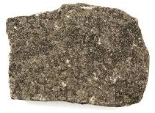
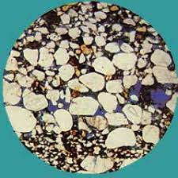
Sedimentary Rocks – Sand Stone
Sand stone
With microscope

Slide 4
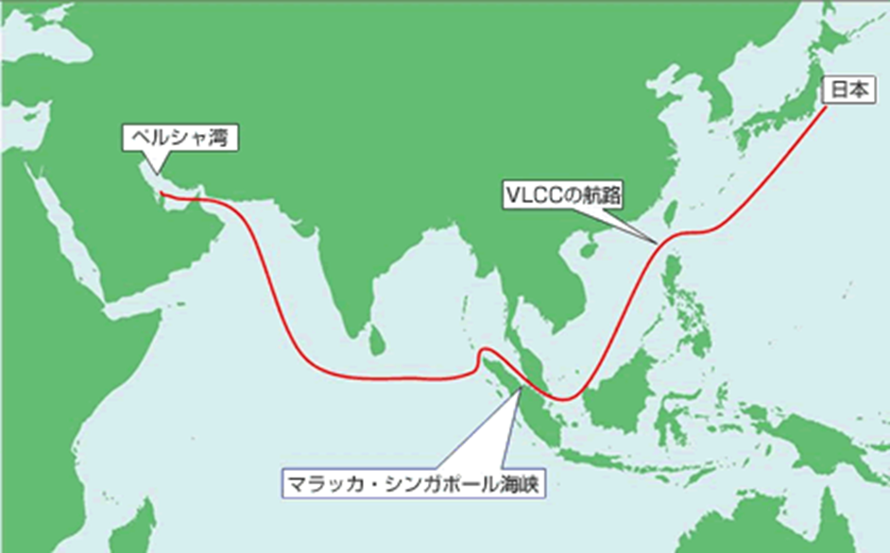
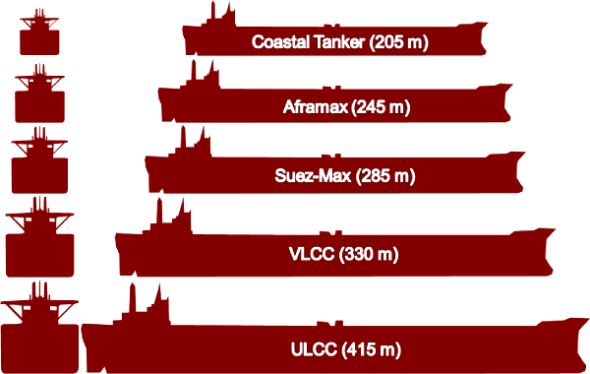
Transportation

Slide 5
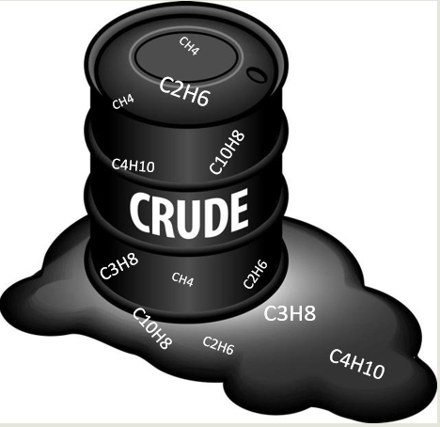
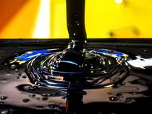

What is crude oil?

Slide 6
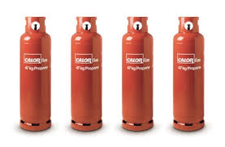

Products from crude oil
Propane (C3H8)
Benzene (C6H6)

Slide 7
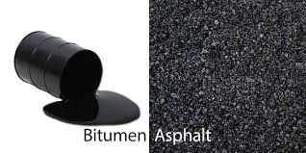
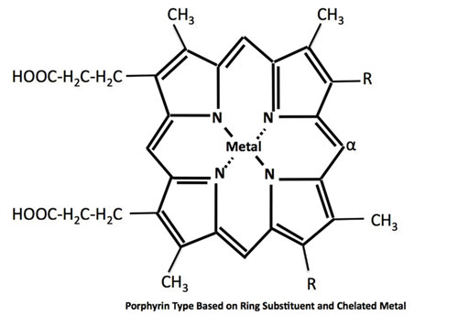
The leftovers – and its uses

Slide 8
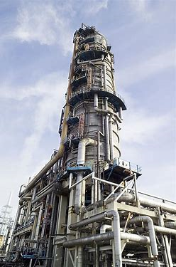
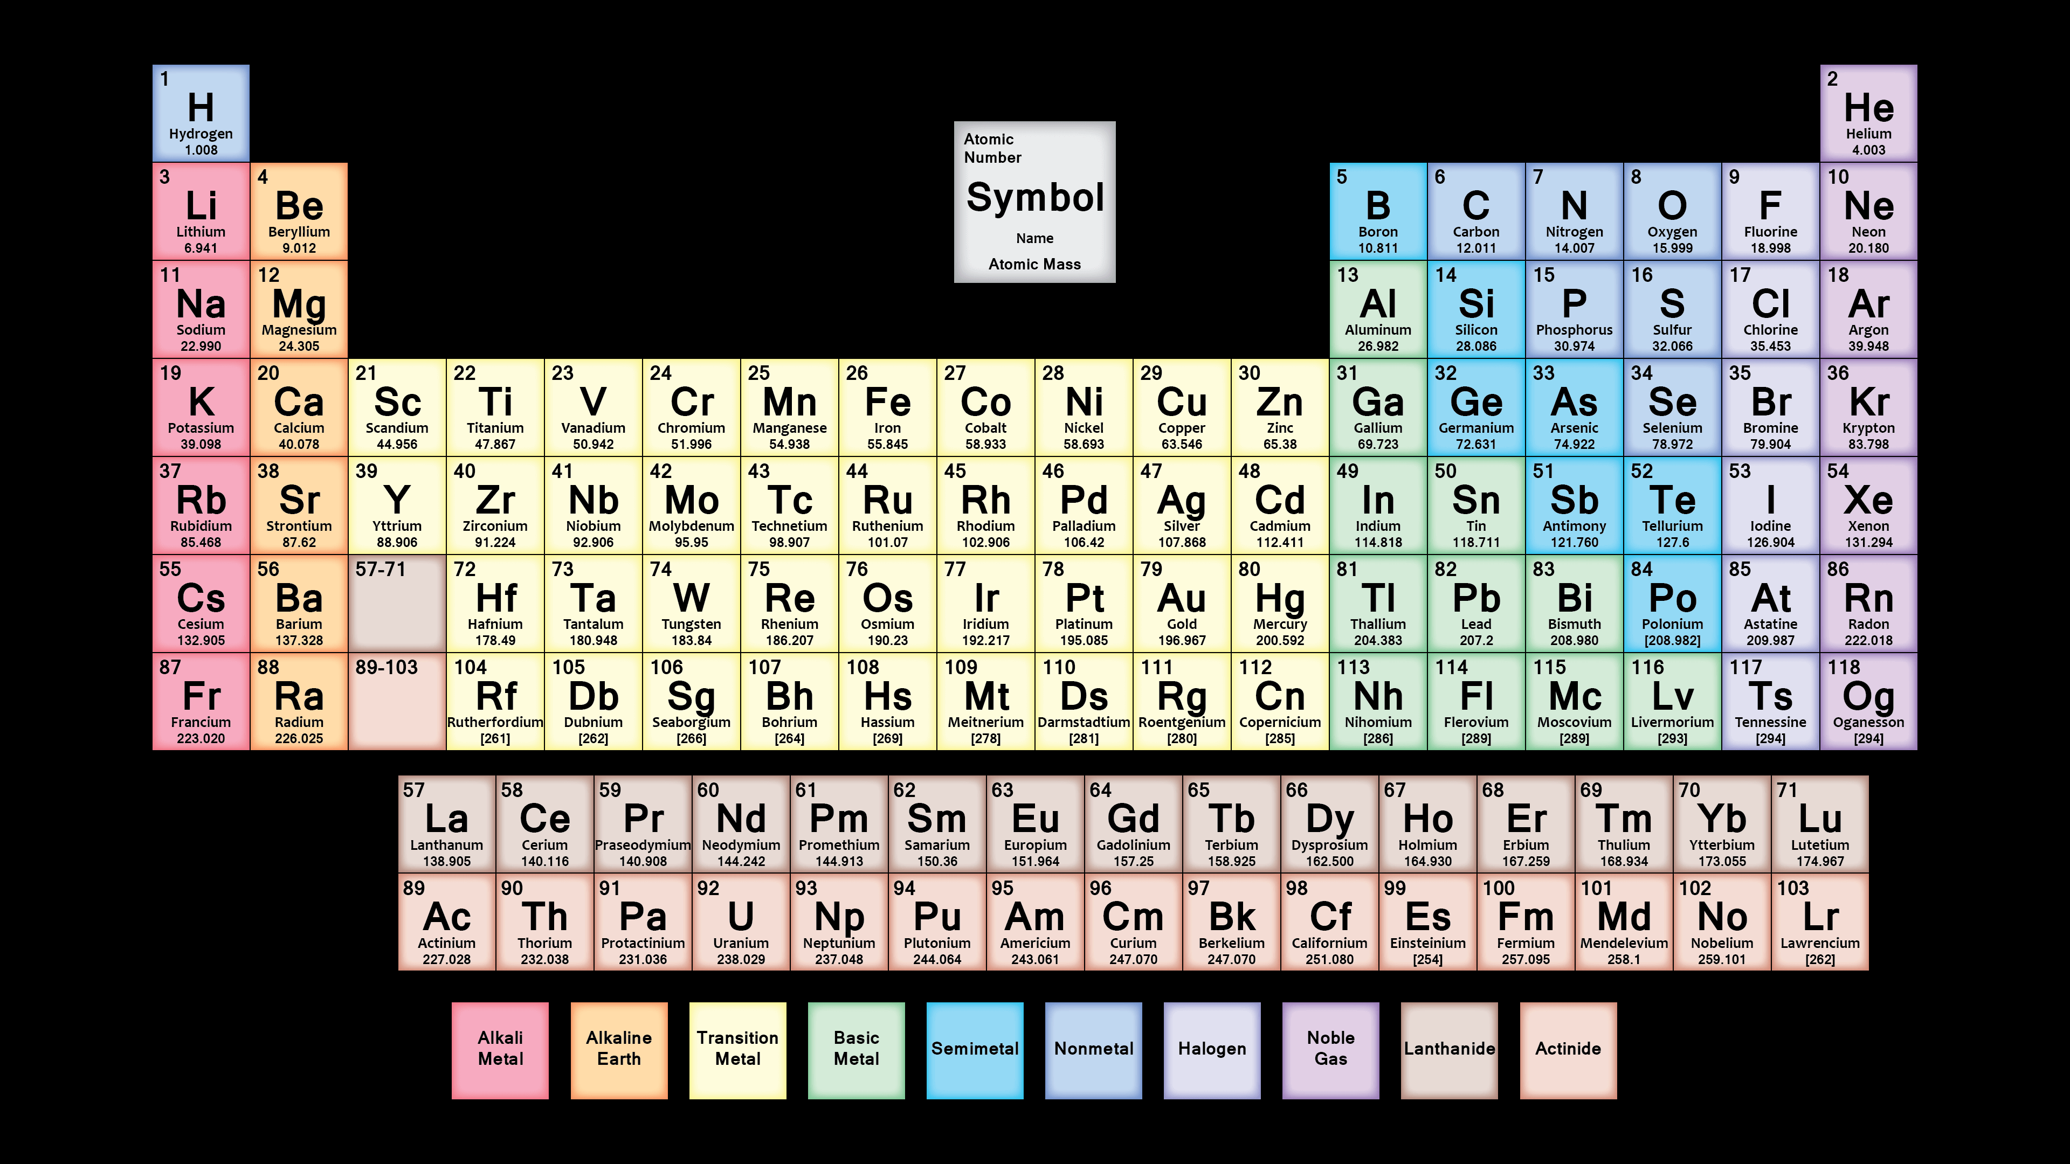
Refining – from crude oil to products
Oil refining tower
Periodic Table

Slide 9
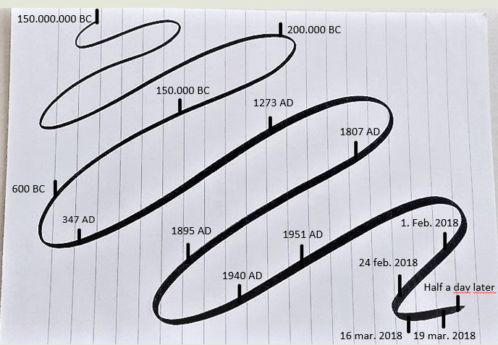
Oils long Journey
Phytoplankton dies and sink to the sea bottom
Oil starts migratin upwards in rock layers
Oil stops migratin and becomes a reservoir
Oil is used for medicin and lightning in Persia
First recording of oil being used for weapons
Streets of London is lit by coal oil
It’s described that the Chinese is drilling for Oil
300.000 t oil is pumbed in South Arabia for Japan
Invention of combustion engine that uses oil
Oil is load in a Oil tanker (ship) heading to Japan
Oil is now part of everyday life in most of the world
The Oil tanker is in Japan and the oil in a refinery
The Charwar Oil field is drilled and pipelines are being laid
The Oil is ready to be used
The Oil is used up

Slide 10
Last Message from Us
“The Stone Age didn’t end for lack of stone,
and the oil age will end long before the world run out of oil”
Sheik Ahmed Zaki Yamani, the Saudi Oil Minister in 1970’s

Slide 11
Thank you for listening

