Slide 1
Note for presentation

Slide 2
Stream of our presentation
1st :Geological part
1.1 Question: oil lakes under grounds ? But, from compressed rock.
1.2 You got oil. Next, How do you transport it ?
1.3 What is crude oil in the first place?
2nd:Chemical structure / molecules
2.1 Oil is constructed by carbon and hydrogen molecules called carbohydrates
2.2 What's carbohydrates? Show examples with chemical structures

Slide 3
Stream of our presentation
3rd How to separate oils/ distillation/ crude oil refining
3.1 the boiling point
3.2 the periodic table of chemical of the element
4th Last message from us

Slide 4
Transportation
VLCC, 330,000KL crude oil unloading
During unloading, injecting inert gas instead of oil
Take off the sea berth with Tugboat(heading to the Singapore Straits )
Emergency practice prescribed by low par a month or three month
Checking lunar age in crowed straits for night cruse
Loading 2 mil barrels of crude oil in Saudi Arabia (consumed a half day in Japan) for 35-40 hours

Slide 5
Geological place to drill oil / the layer of soil

Slide 6
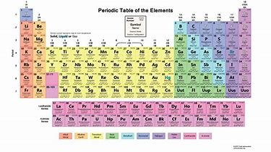

Slide 7
Chemical structure / molecules
Methane: the smallest in carbohydrates CH4
Propane : the most familiar with us/ tapped gas for daily life
gas form C3H8
Benzene : the base of gasoline / petroleum liquid form
C6H6
Bitumen : 95%: carbohydrate 5% other ingredient of asphalt / pavement dense liquid / leftover CxHx-R

Slide 8
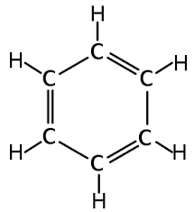
Benzene

Slide 9
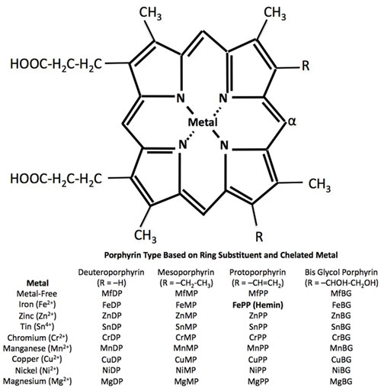
Bitumen

Slide 10
Chemical structure / molecules
The period table
Atomic structure and weight (Neutron /proton / electron)
hydrogen: (N:0 P:1 E:1)
carbon: (N:6 P:6 E:6)
the weight of

Slide 11
How to separate oils/ distillation/ crude oil refining
Burning crude oil at the bottom of the refining tower
Separating by boiling pointing
Image gas, thin liquid and dense oil
Bitumen : ingredient of asphalt / pavement

Slide 12
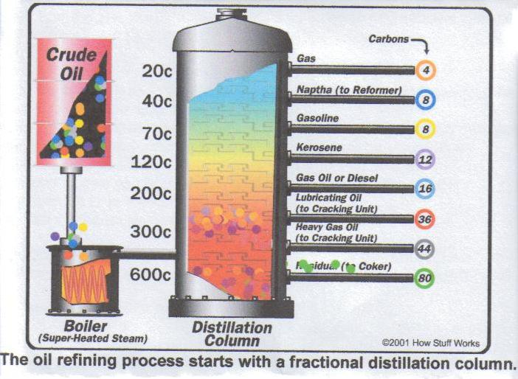

Slide 13
Last Massages
Hikaru
The earth has taken 150 million years to create crude oil since Ancient times.
Many people have dedicated themselves to drilling, to refining and also to transporting oil since we found it in America in 1850s.
But now, we are spending those oil in only one day or half of day.

Slide 14
Last Massages
Sarah
In 2051 we will run out of oil without other ways,
(last coal and fossil souse in 2088)
“The Stone Age didn’t end for lack of stone, and the oil age will end long before the world run out of oil”
Shelk Ahmed Zaki Yamani,the Saudi Oil Minister in 1970’s

