Slide 1
Kruge Leirskole
Sarah Erland, Clemens Hecker, Anne Schäfer, Hikaru Wada

Slide 2
Structure
Where we‘ve been
Weekly program
Differences between week 1 & 2
Lessons learned
Personal reflections

Slide 3
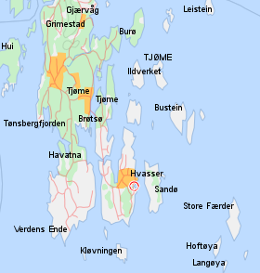
Where We‘ve been
Camp school on Hvasser close to Lilleskagen
Village is known for its tourism during summer
Supervisors: Erik & Paal (Mona „Mom“)
Own harbour with boats & beach
Mandatory time from 10am to 4pm

Slide 4
Where We‘ve been
Camp school on Hvasser close to Lilleskagen
Village is known for its tourism during summer
Supervisors: Erik & Paal (Mona „Mom“)
Own harbour with boats & beach
Mandatory time from 10 to 4

Slide 5
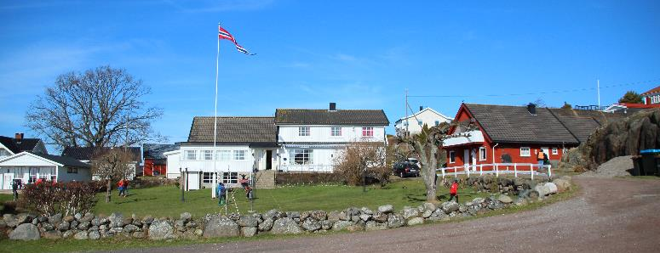
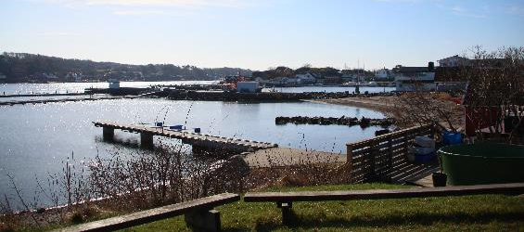
Kruge Leirskole

Slide 6
Weekly Programm
Time | Monday | Tuesday | Wednesday | Thursday | Friday
8.00 | - | Morning bath | Morning bath | Morning bath | Morning bath
8.30 | - | Inf. todays programm | Inf. todays programm | Inf. todays programm | Inf. todays programm
10.00 | Preparing for arrival | Walk around Sandøya | Fishing + Aquarium | Vikings day | Cleaning + Final exam
12.00 | Arrival | Lunch | Lunch | Lunch | Departure
13.00 | Welcome & Briefing | Walk around Sandøya | Fishing + Aquarium | Vikings day | Student cleaning
16.00 | Freetime | Freetime | Freetime | Freetime | -
18.00 | Dinner | Dinner | Dinner | Farewell party | -

Slide 7
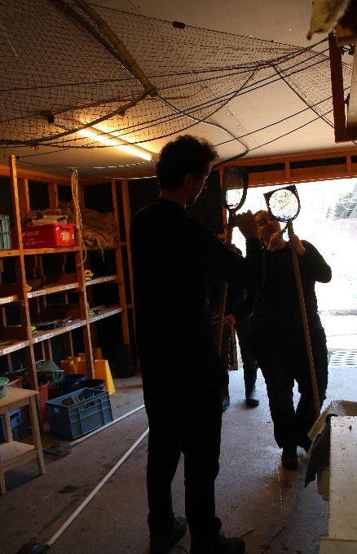
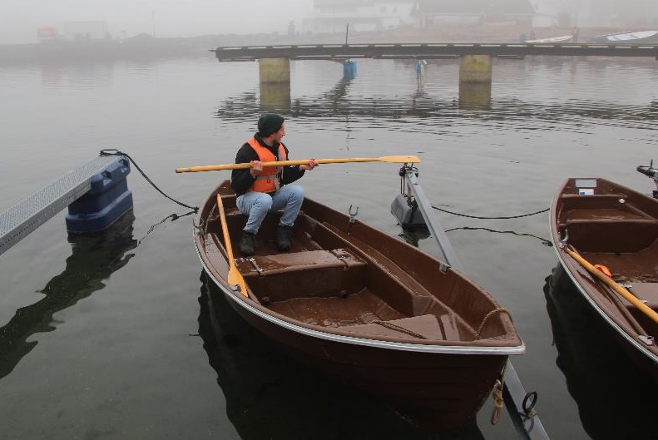
Monday – Preparing & Welcome

Slide 8
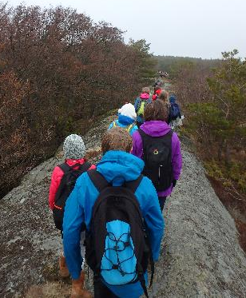
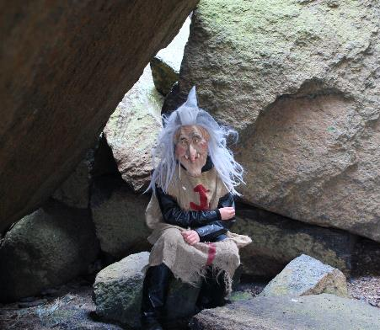
Tuesday – Walk & Talk

Slide 9
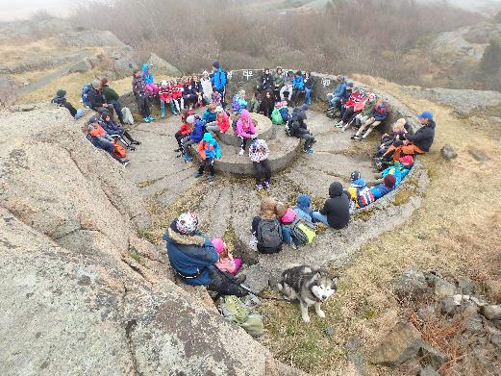
Tuesday – Walk & Talk

Slide 10
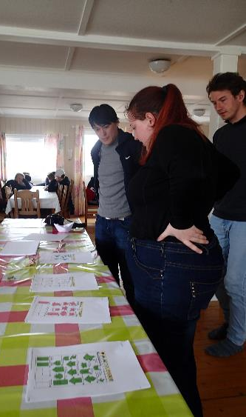
Tuesday – Walk & Talk

Slide 11
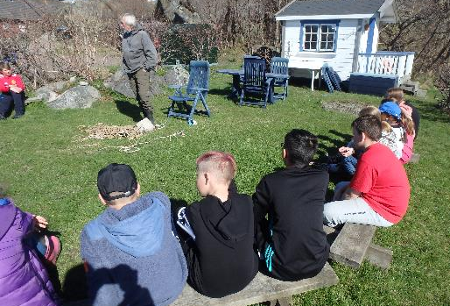
Wednesday – Knotting & Aquarium

Slide 12
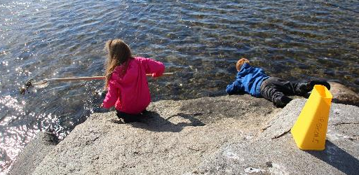
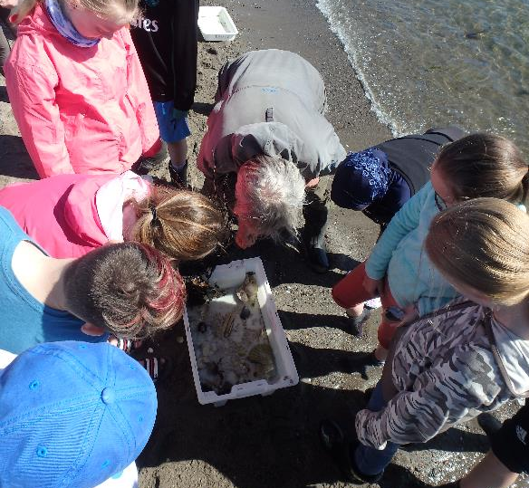
Wednesday – Aquarium

Slide 13
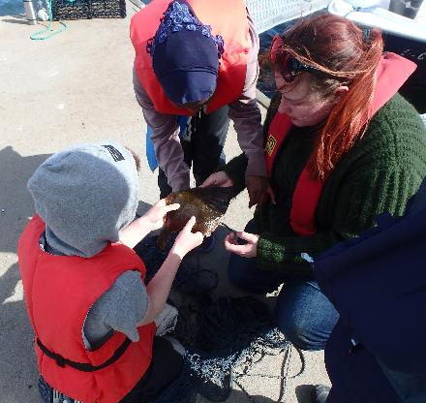
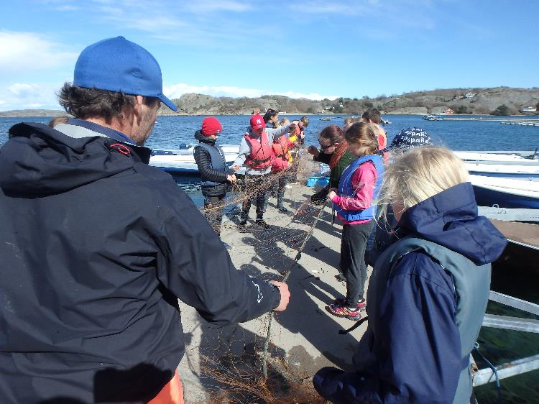
Wednesday - Fishing

Slide 14
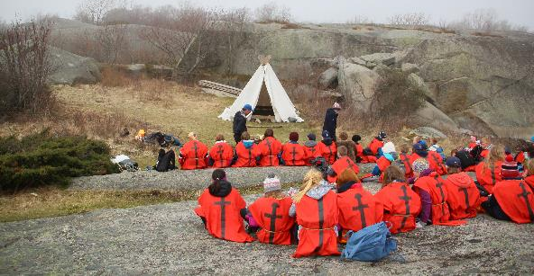
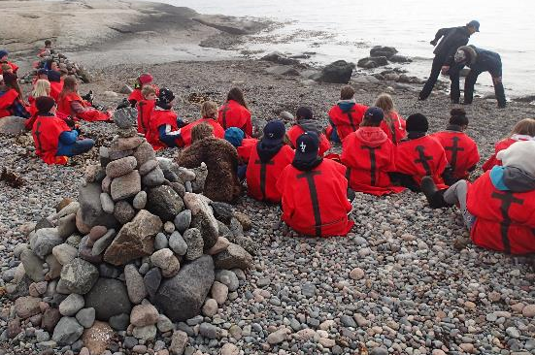
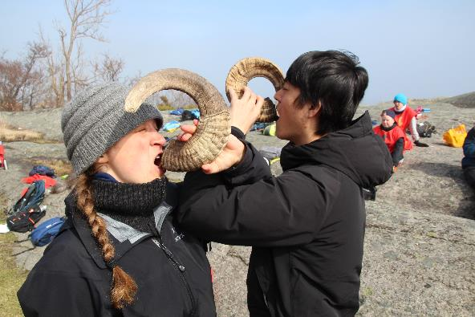
Thursday – Viking day

Slide 15
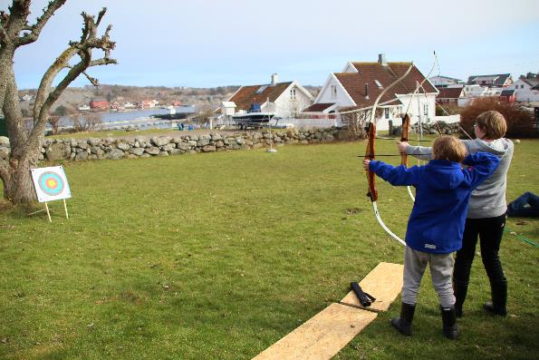
Thursday – Viking day

Slide 16
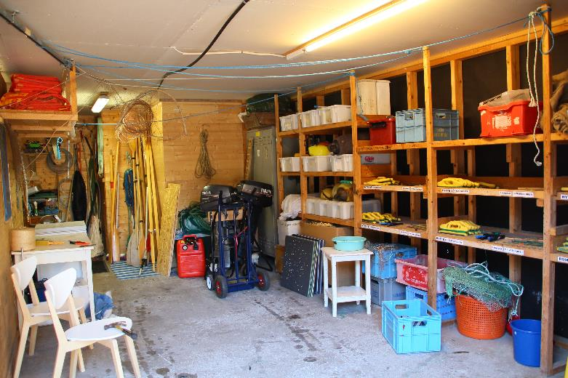
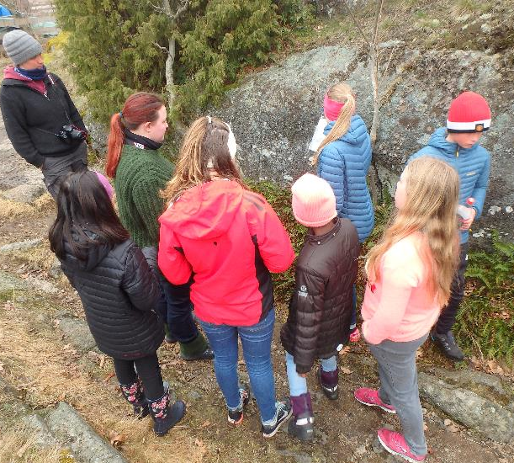
Friday – Cleaning & Final “Exam”

Slide 17
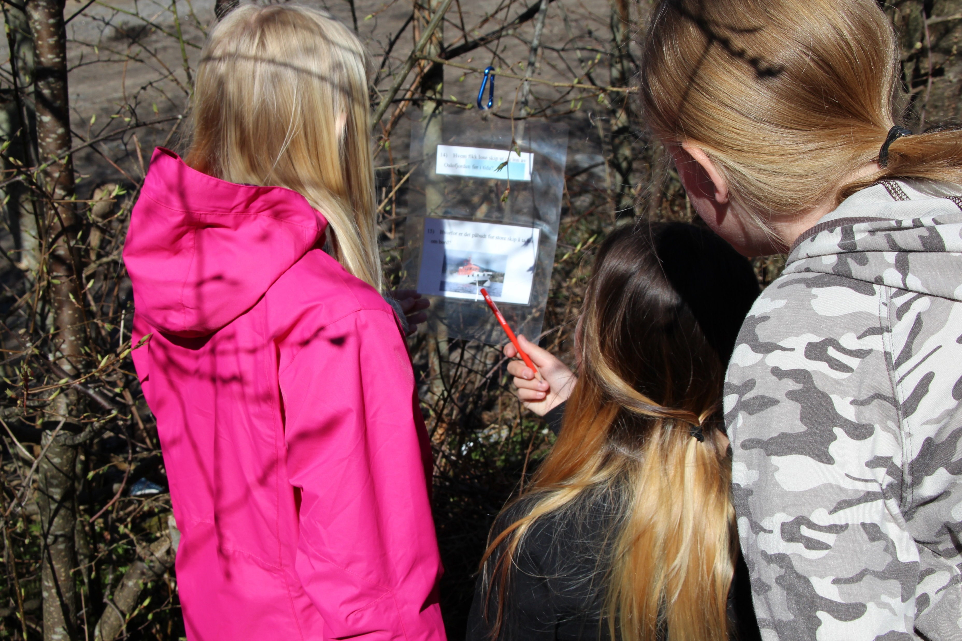
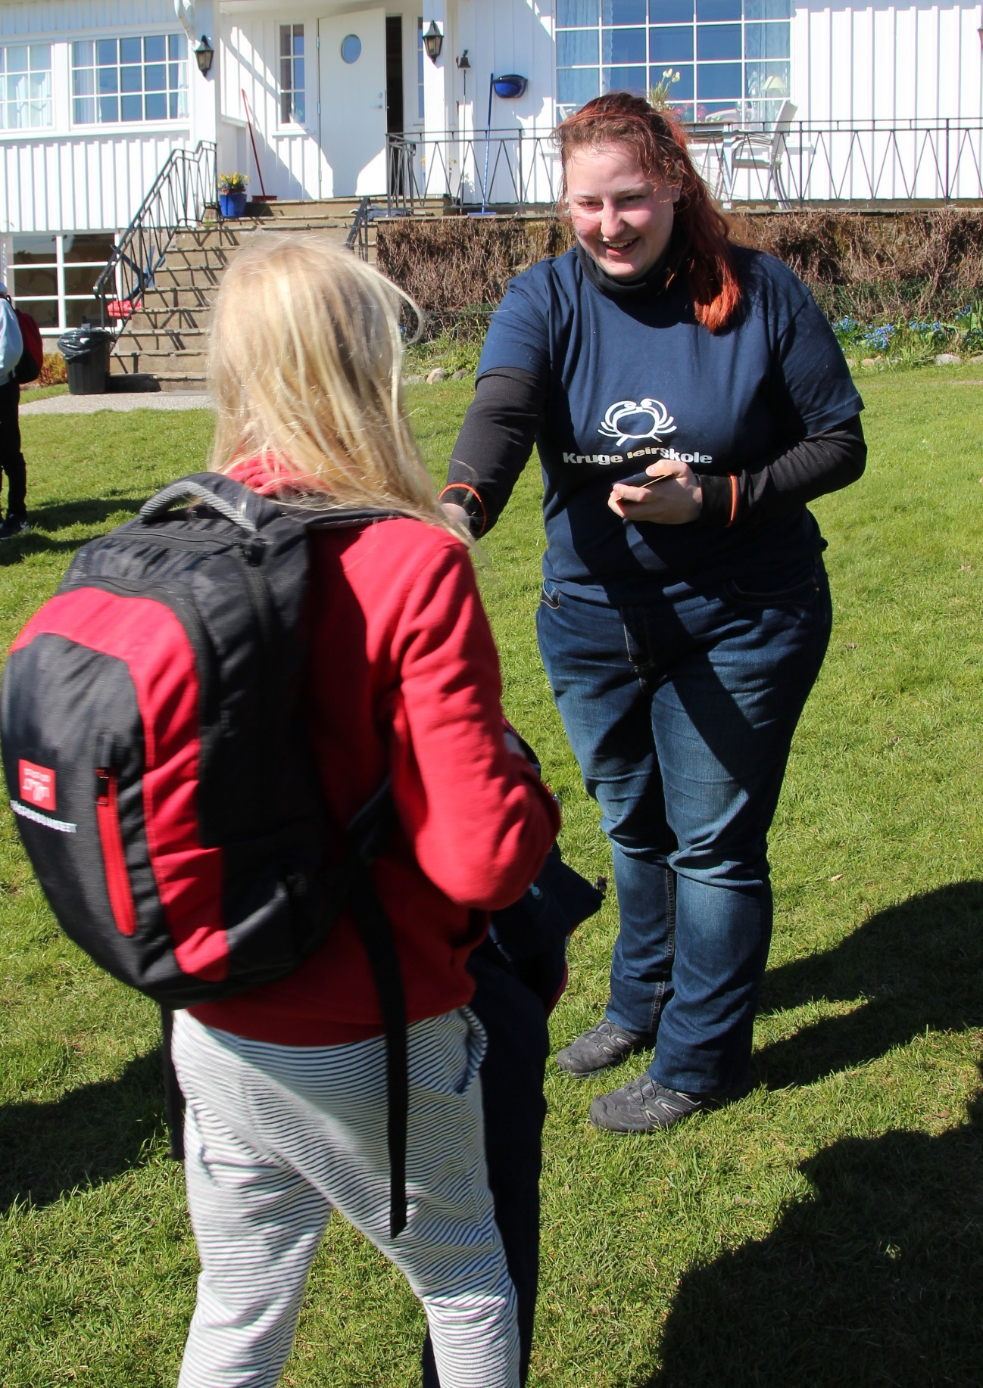
Friday – Cleaning & Final “Exam”

Slide 18
Differences between week 1 & 2
Kruge Teacher
New parts
Children
Weather
Parts excluded
Prepara-tion
Teachers

Slide 19
Lessons learned
Experiencial learning
Nature science
History
Physical education
Social science
Handcraft
Norwegian
Risky play
Curious play
Estimating their abilities
Coyote teaching
Communication & Teamwork

Slide 20
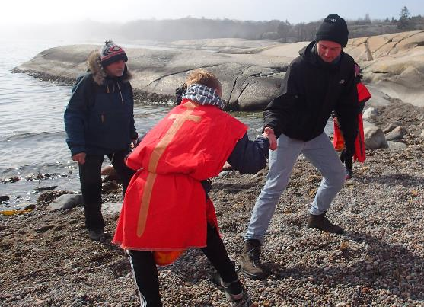
Personal reflections - Clemens
Connecting knowledge with outdoor activities
Diversity in programm
Children get easily bored
Dealing with special kids
Got more patient
Children are eager to learn
Language barrier between children and teachers

Slide 21
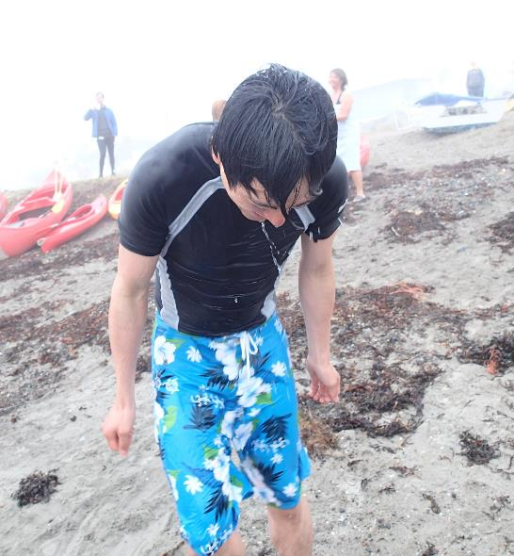
Personal reflections - Hikaru
Comparison between Japanese school trips and Norwegian school trips
More flexible
Following their couriousness
Much more free time
Small feedback and reflections for children
Worry about safety for kids

Slide 22
Personal reflections - Anne
How to manage a camp school?
Possibilities for us to engage and participate in activities
More potential to go deeper into details
Prepare my own special topic (with activities)
Similar to camp schools in Germany

Slide 23
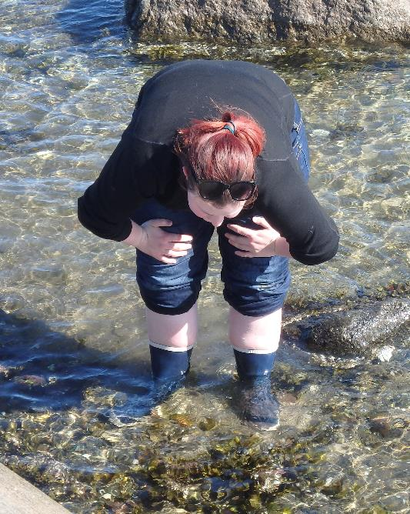
Personal reflections - Sarah
Is Campschool all fun and play or school?
How to a assess how much information to give
How to experience nature on childrens level
Reflections on oneself
When to intervene

Slide 24
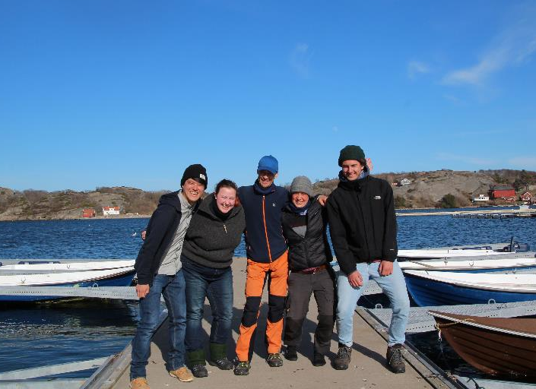
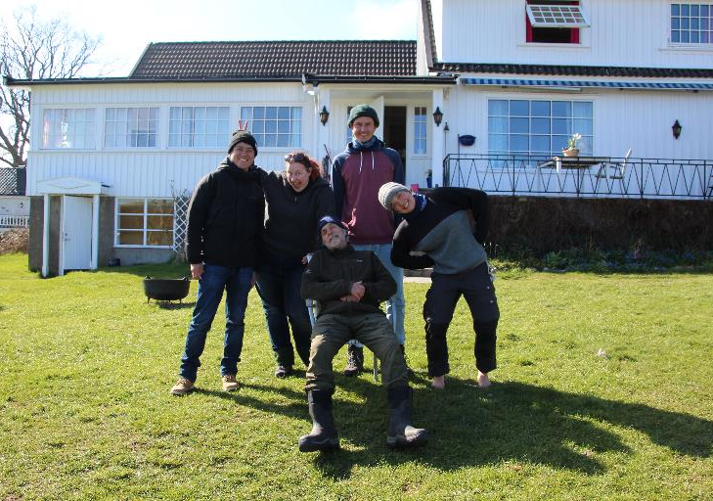
Thank you for your Attention!

