Slide 1
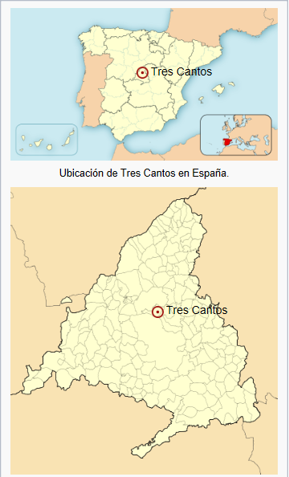
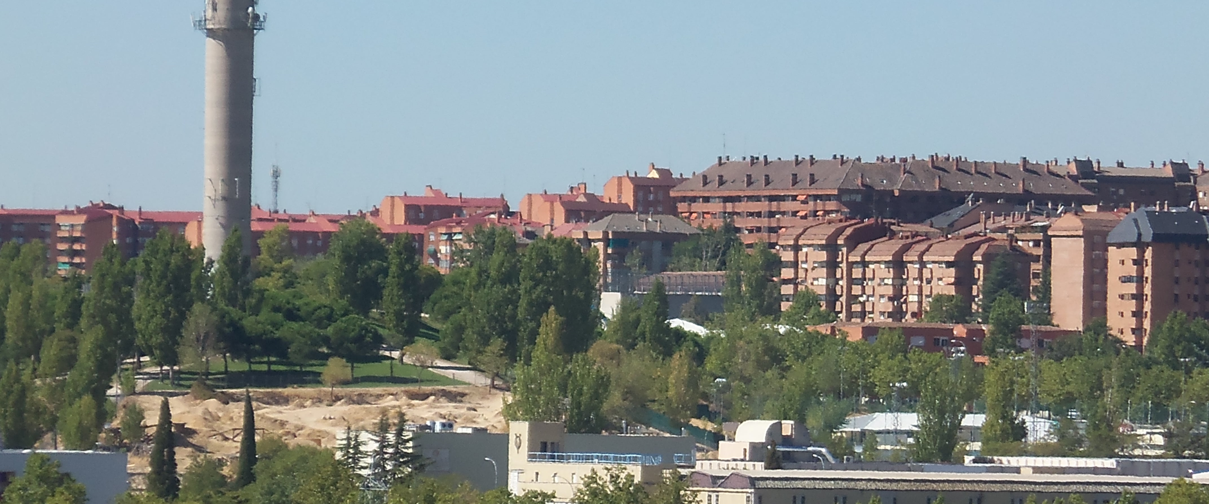
Tres Cantos
20 km far from Madrid | Located in the north | Close to the mountains

Slide 2
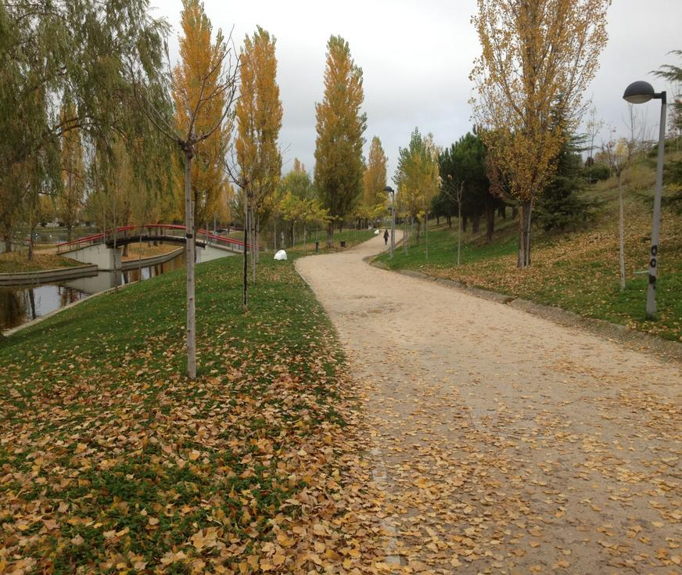
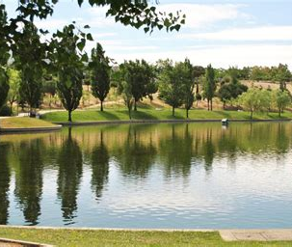
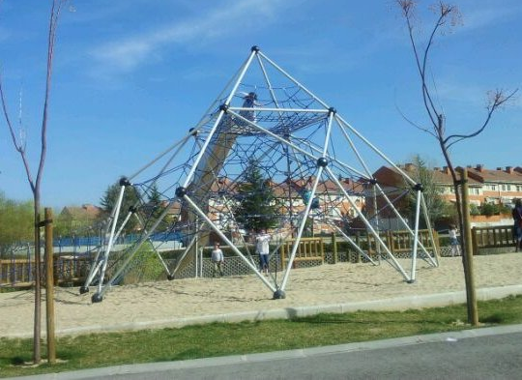
PARQUE CENTRAL
Lake | Kids friendly | Green Areas | Vegetation

