Slide 1
OIL PROJECT

Slide 2
WHAT WE KNOW ABOUT OIL?
Oil is non-renewable energy source and it’s a fossil fuels
We need oil for everything
SPAIN: We have oil industry in Burgos, Tarragona, Valencia and Galicia. But it’s not a big industry
IRELAND: There is a lot of Oil off of the Coast of Cork, approximately 1 Billion barrels.

Slide 3
WHAT WE WANT TO KNOW?

Slide 4
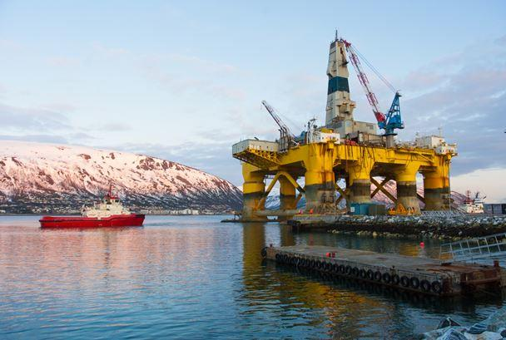
Why are the prices different around the world?
How it is produced?
Enviromental impact
OIL
How it influences in political and economical system?
What's gonna happen when it's over?
Different uses

Slide 5
Refining
(gasoline)
What is oil?
Crudo - Chemistry
Where and how drilled and refined?
Enviromental climate change
OIL
Pollution
Personal consumer
Politics around producing oil
Economy national and internacional

