Slide 1
Horten Natursenter
SETTING
PRACTICE AIMS
CURRICULUM
TYPICAL DAY FOR A CHILD VISITING
PLACEMENT THROUGH OUR EYES
PERSONAL TAKE-AWAYS

Slide 2
SETTING

Slide 3
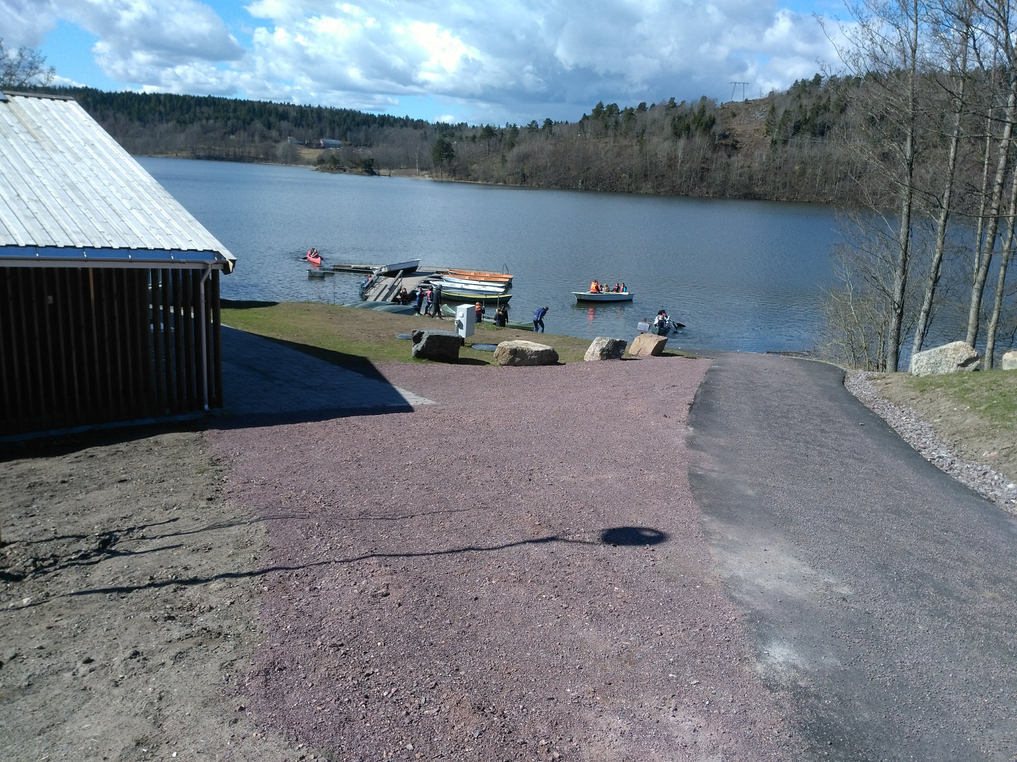

Slide 4
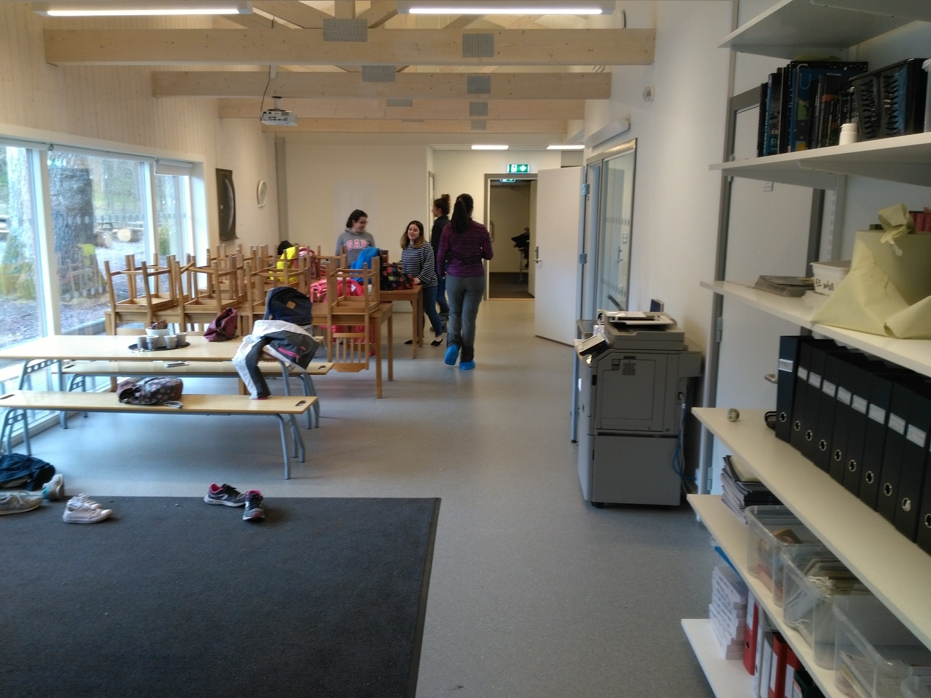

Slide 5
Teachers
Andreas: Young children (1-4 grades)
Hege: middle school (5-10)
Gunn: high school-college
Stine: assistant

Slide 6
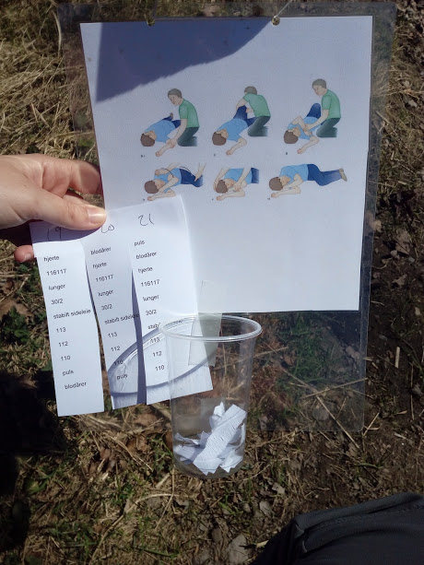
Practice Aims
Re-learn how to play in nature
Teach outdoor skills
Team work through competition and games
Combining what is taught in school and showing practical uses

Slide 7
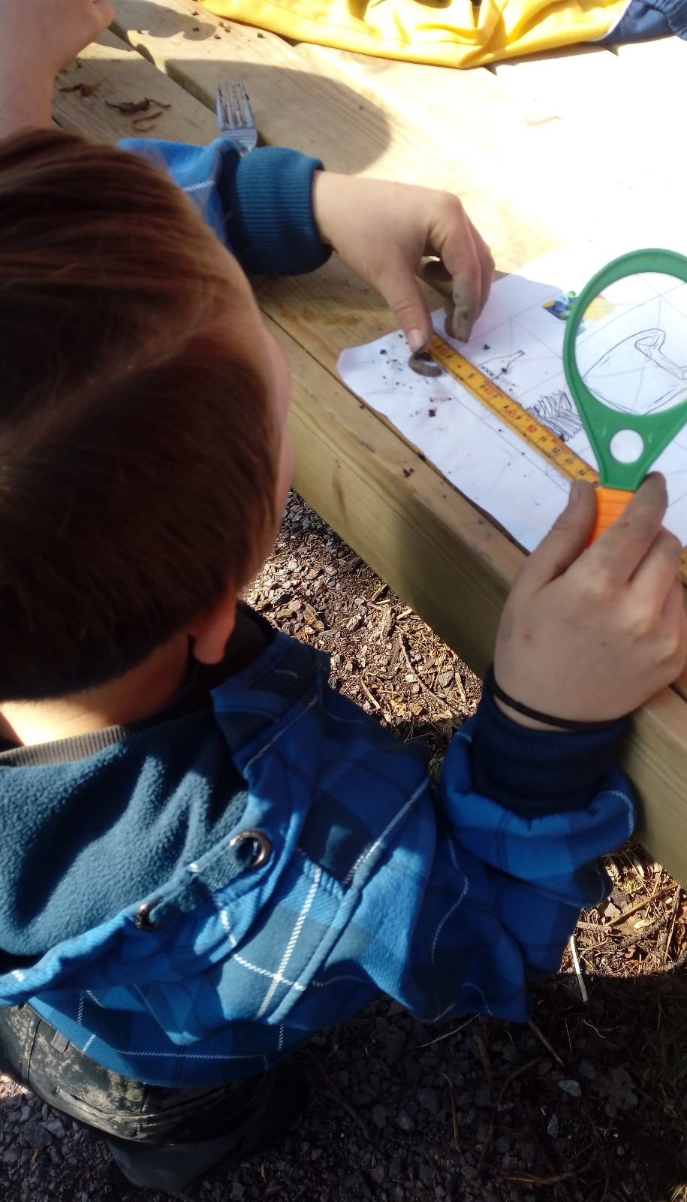
curriculum
Following the Norwegian Curriculum
Activities based on what kids are studying at school at that time
Good communication between teachers and Natursenter teachers.

Slide 8
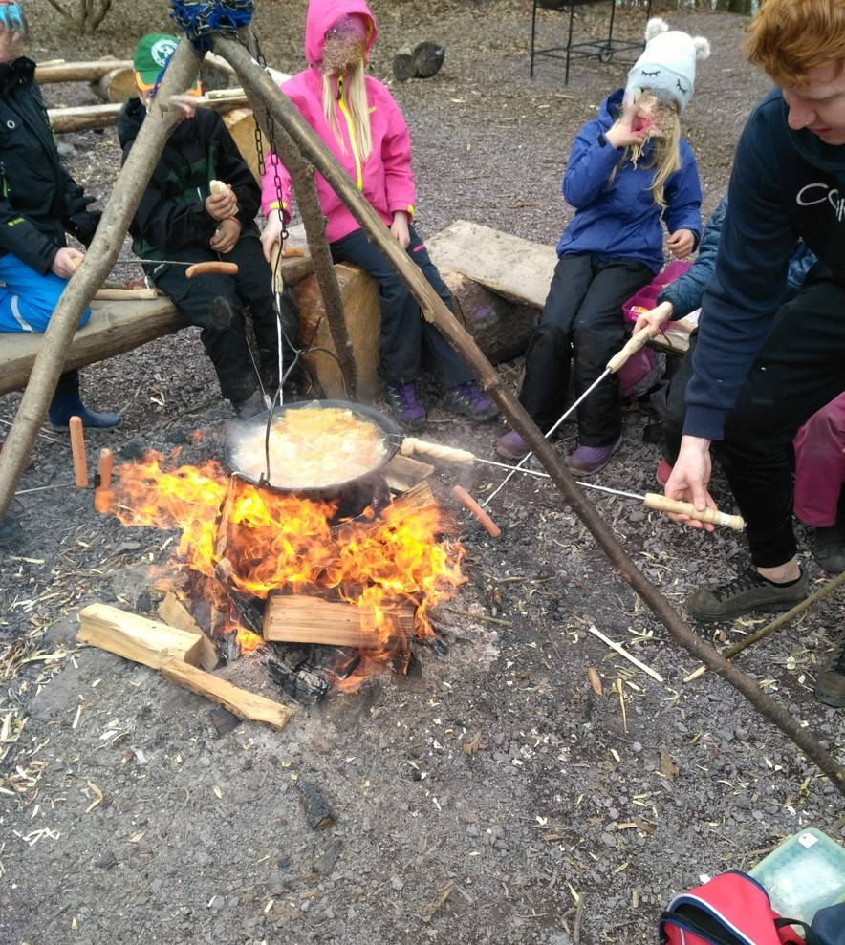
Typical Day for a visitor

Slide 9
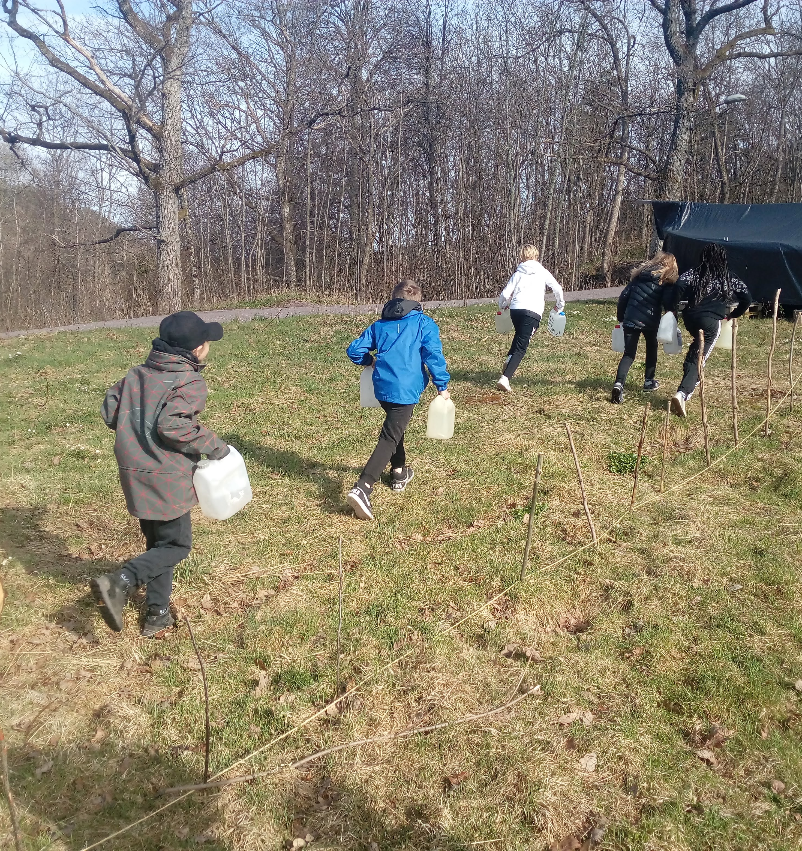
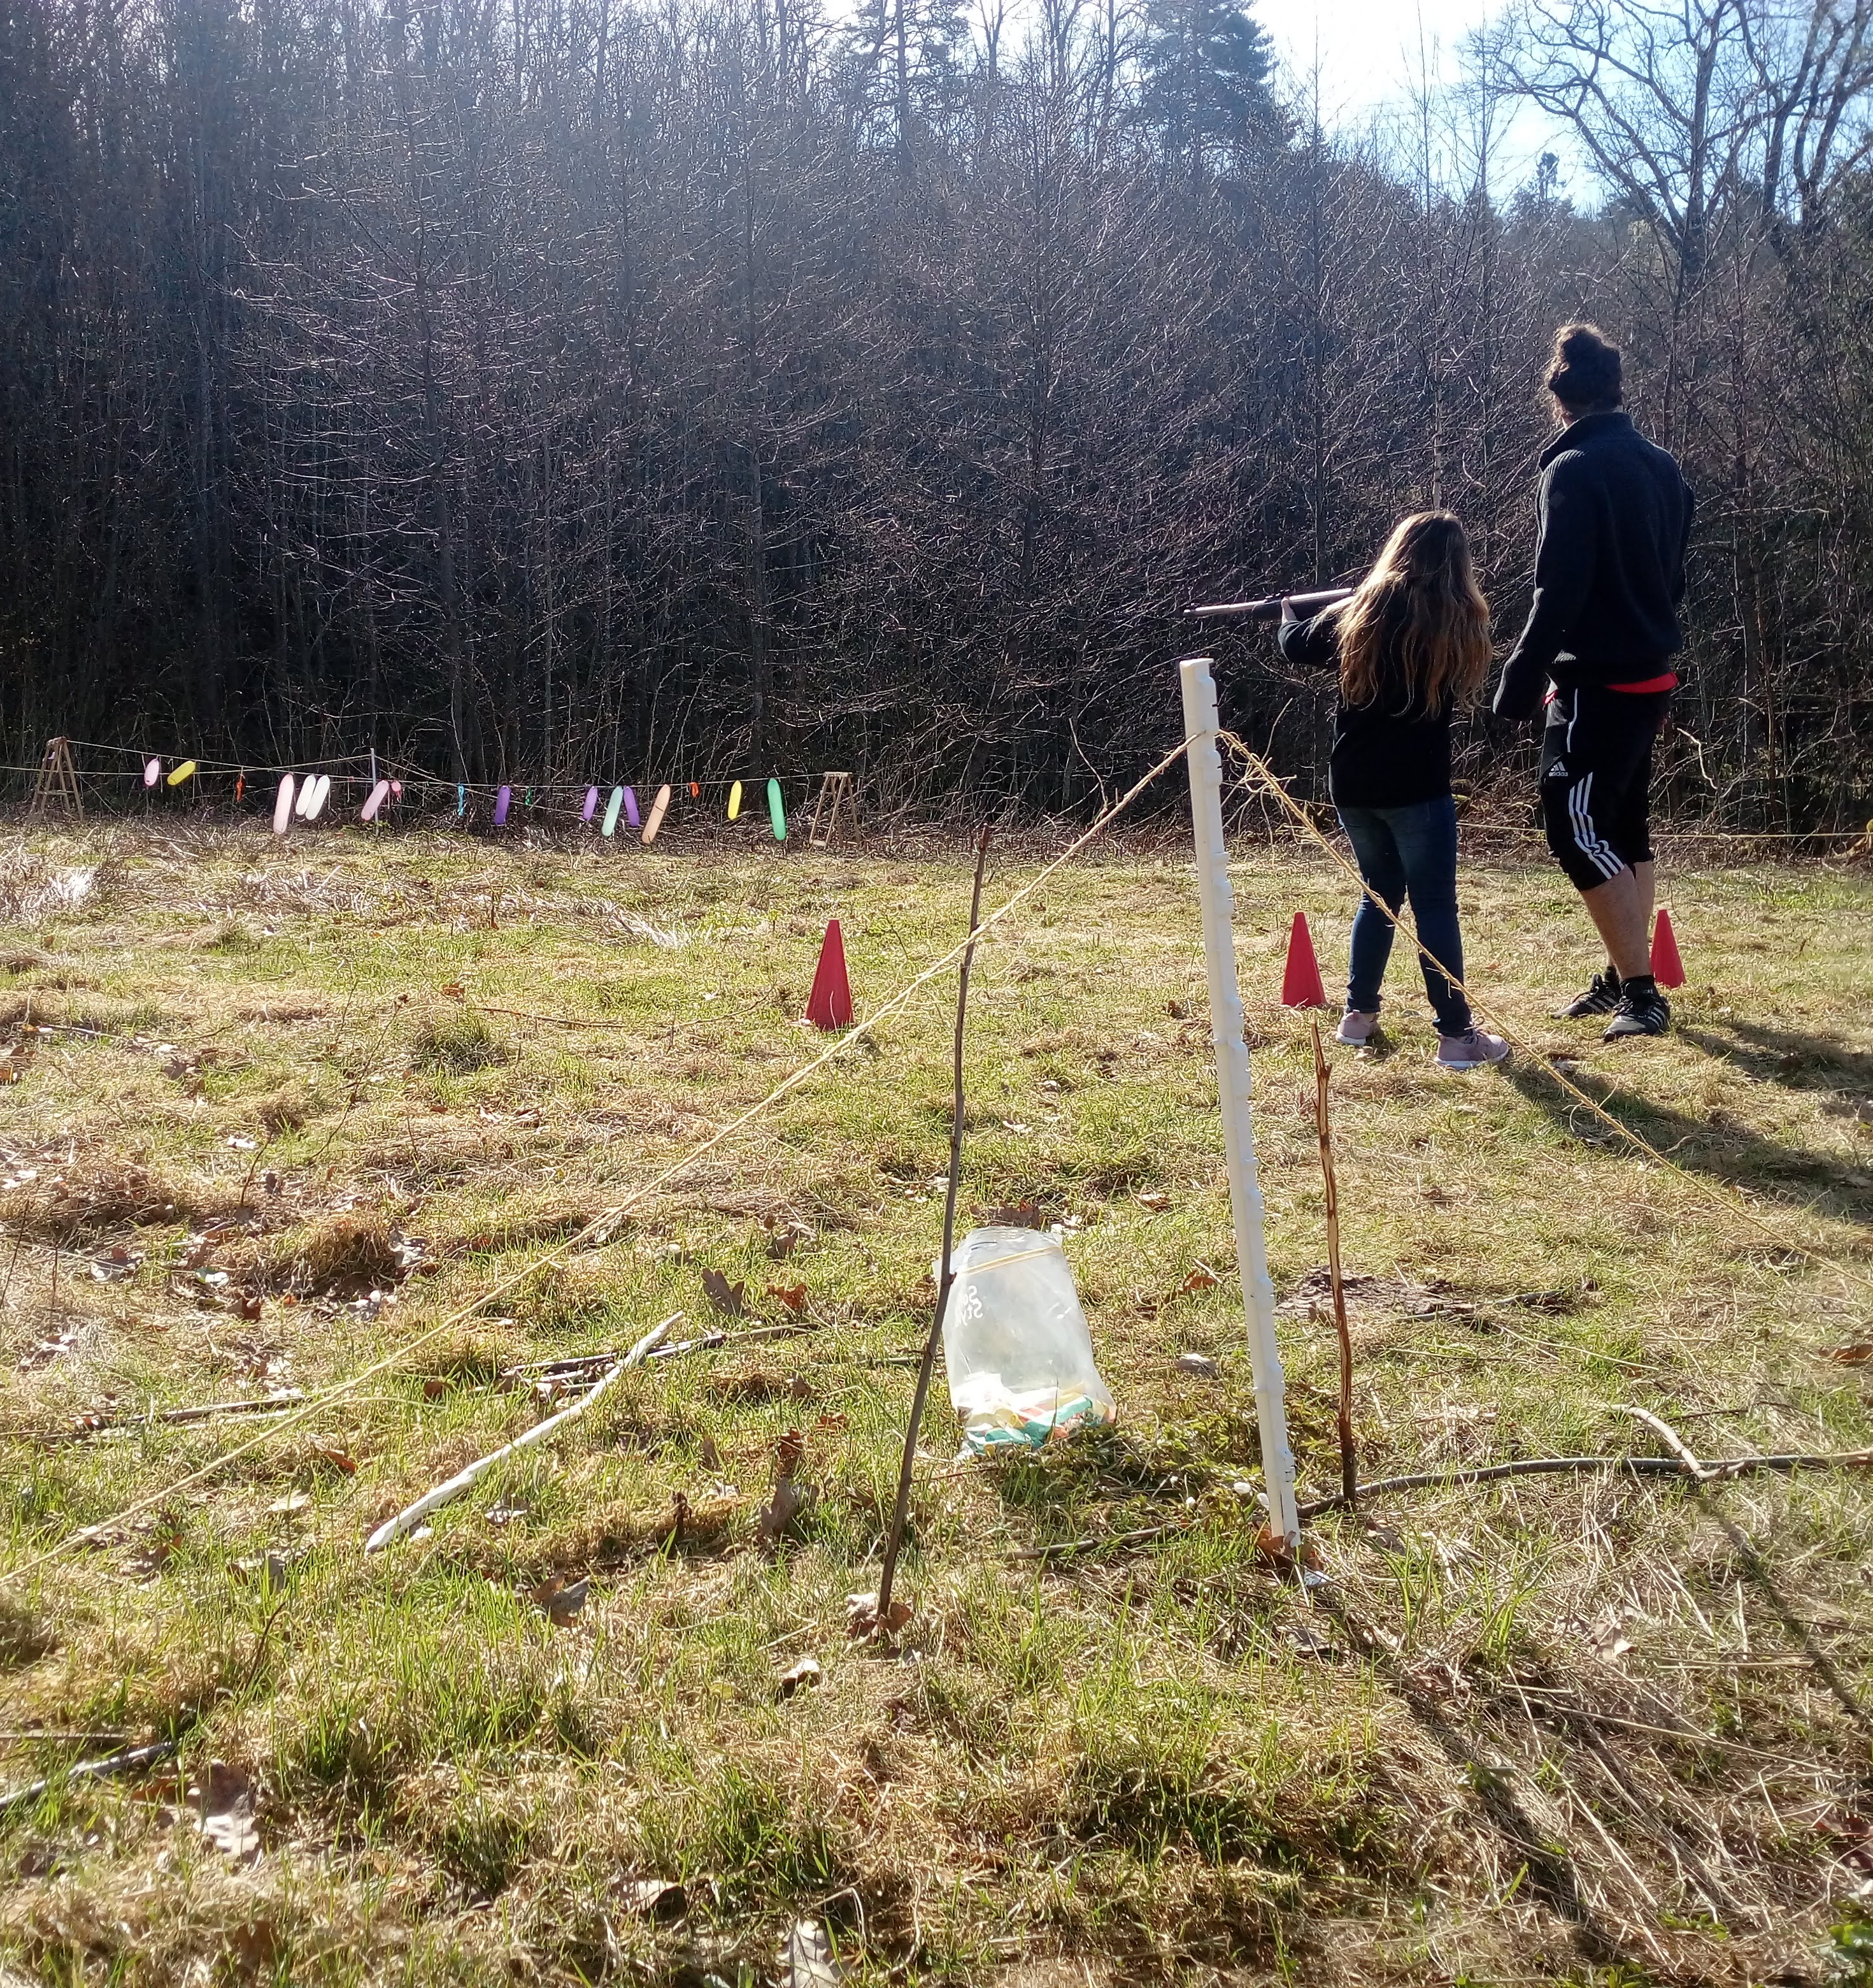

Slide 10
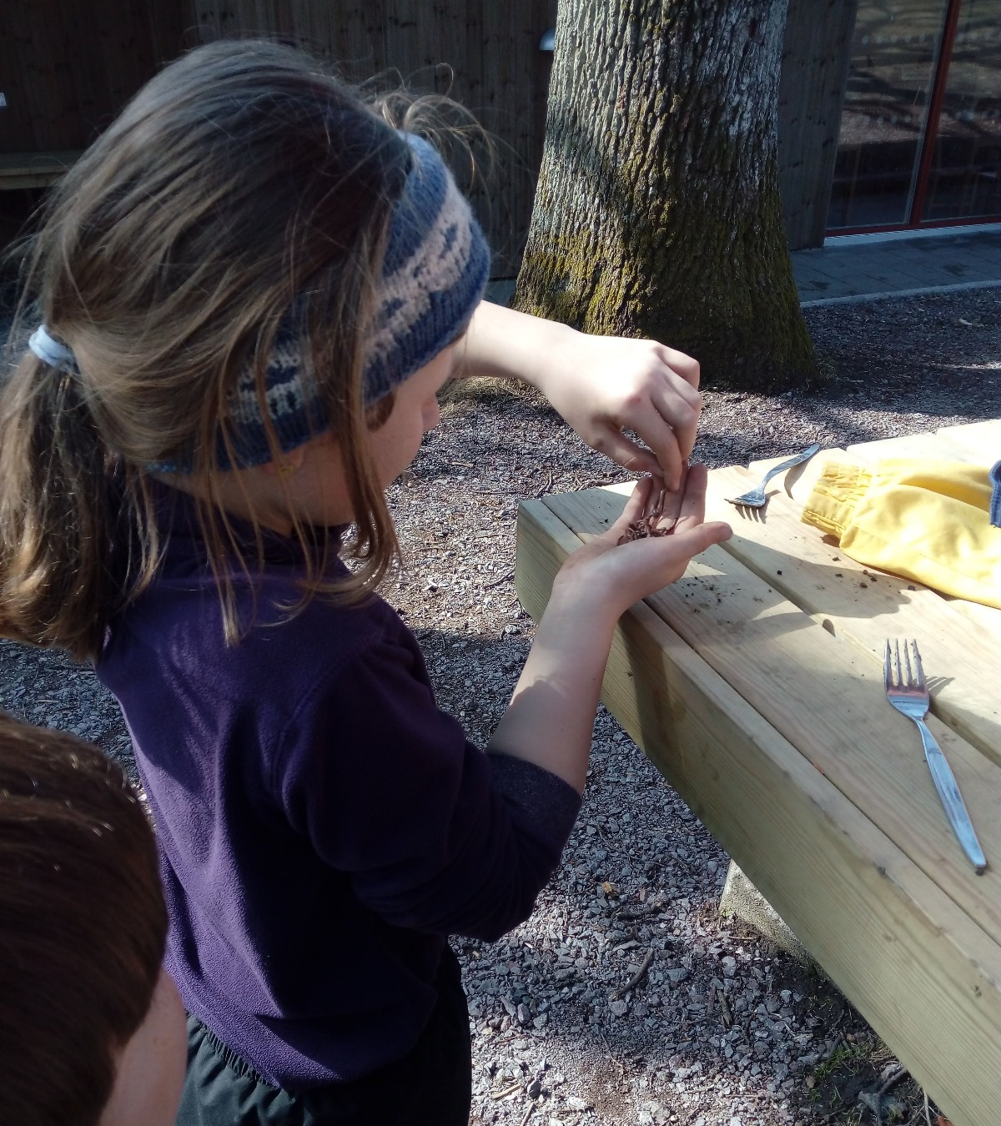
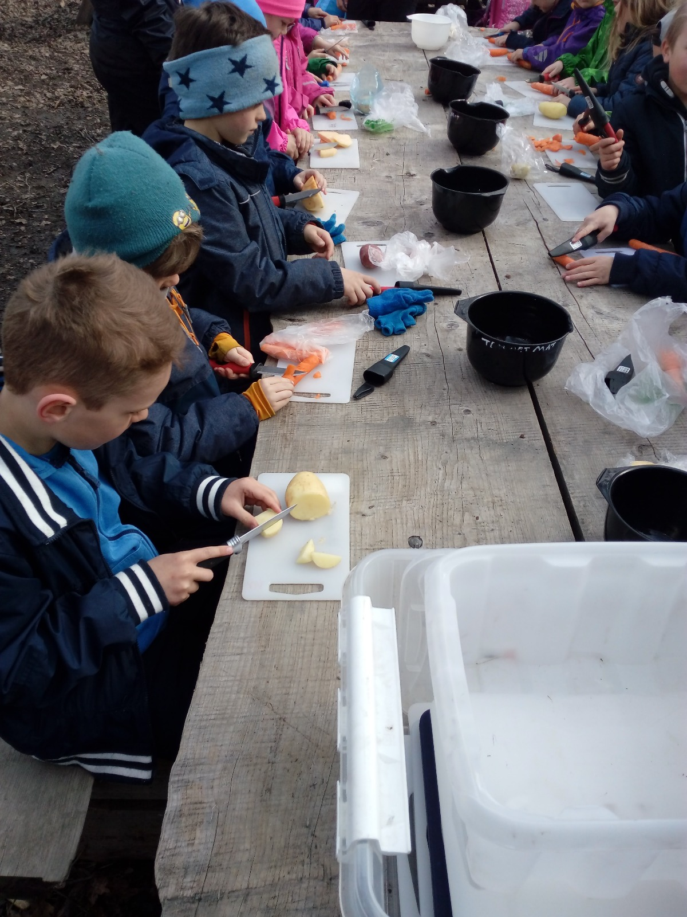

Slide 11
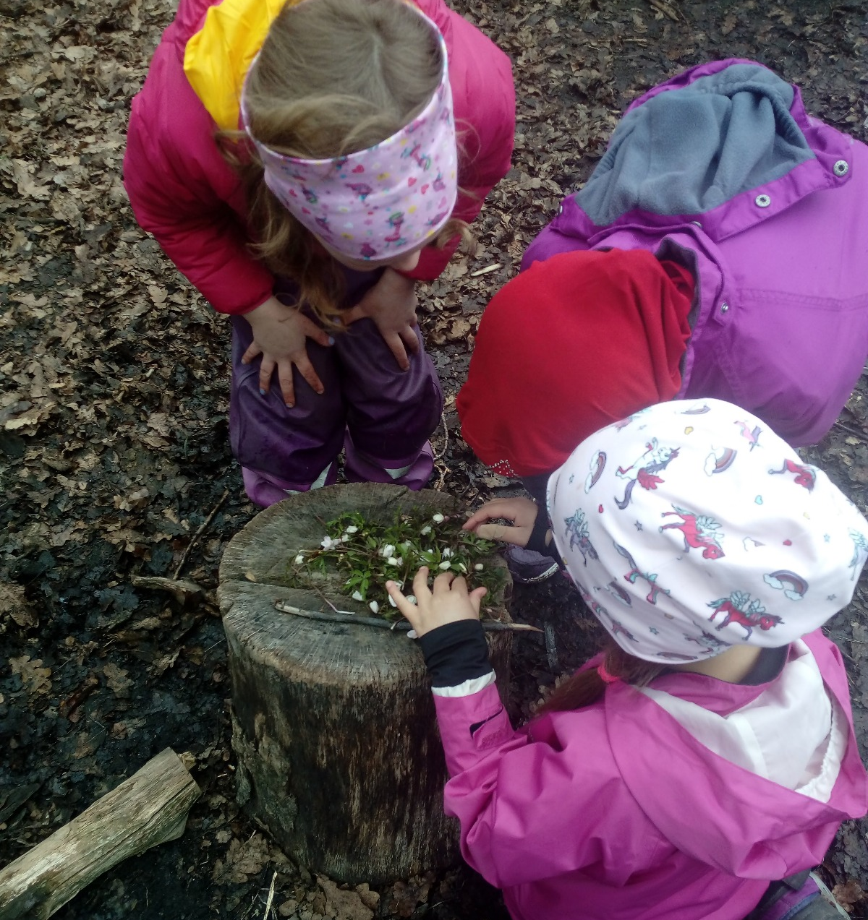
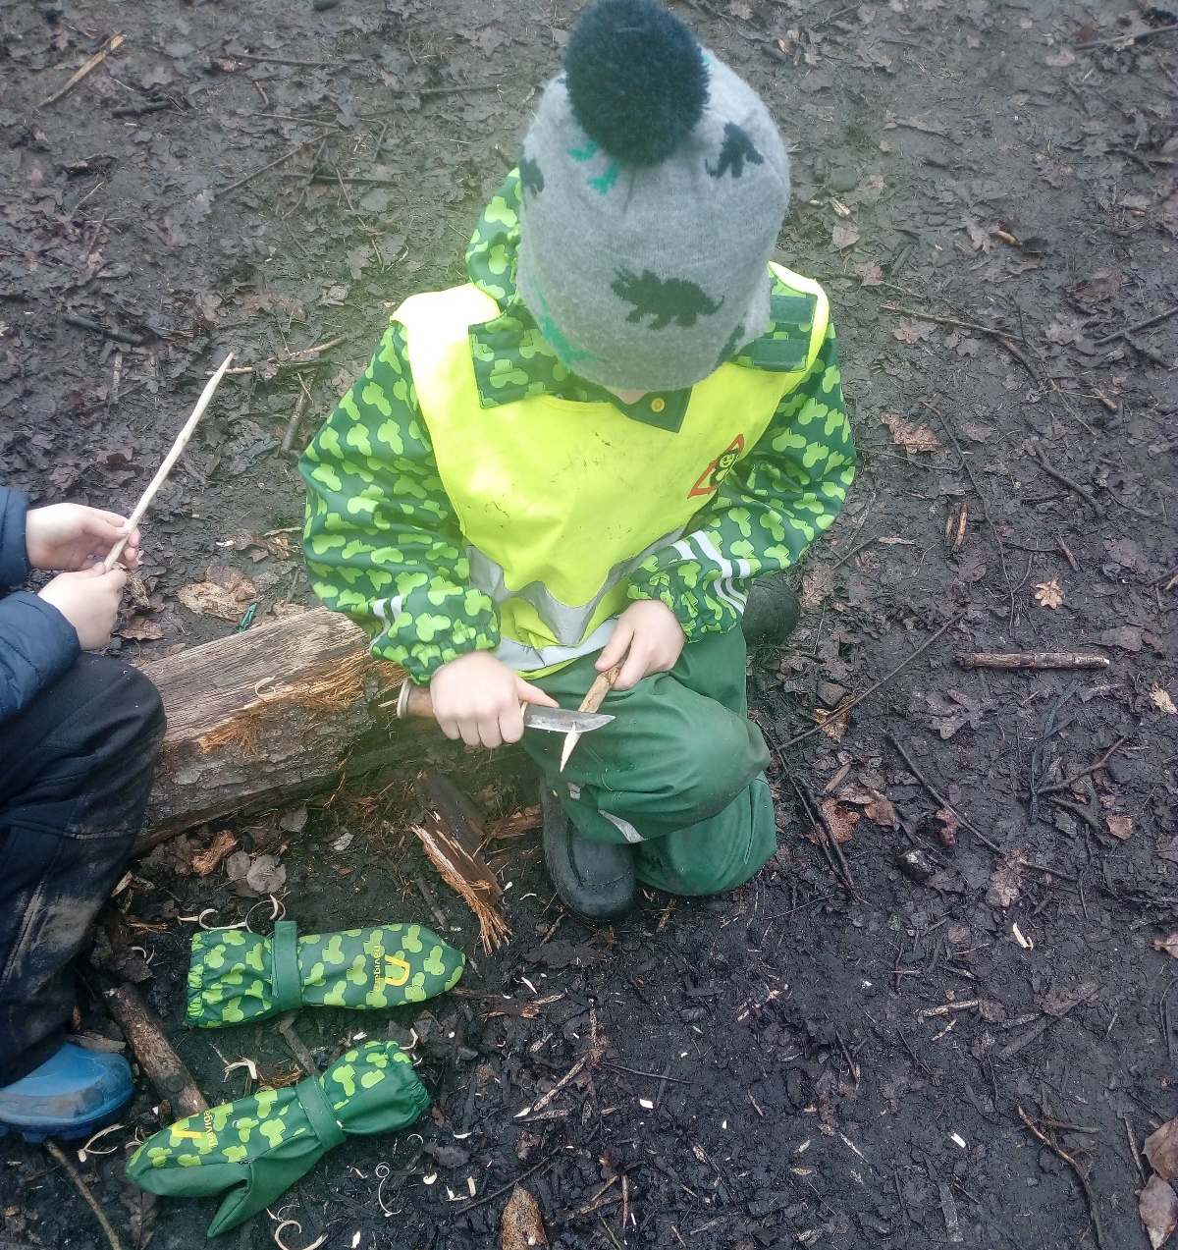

Slide 12
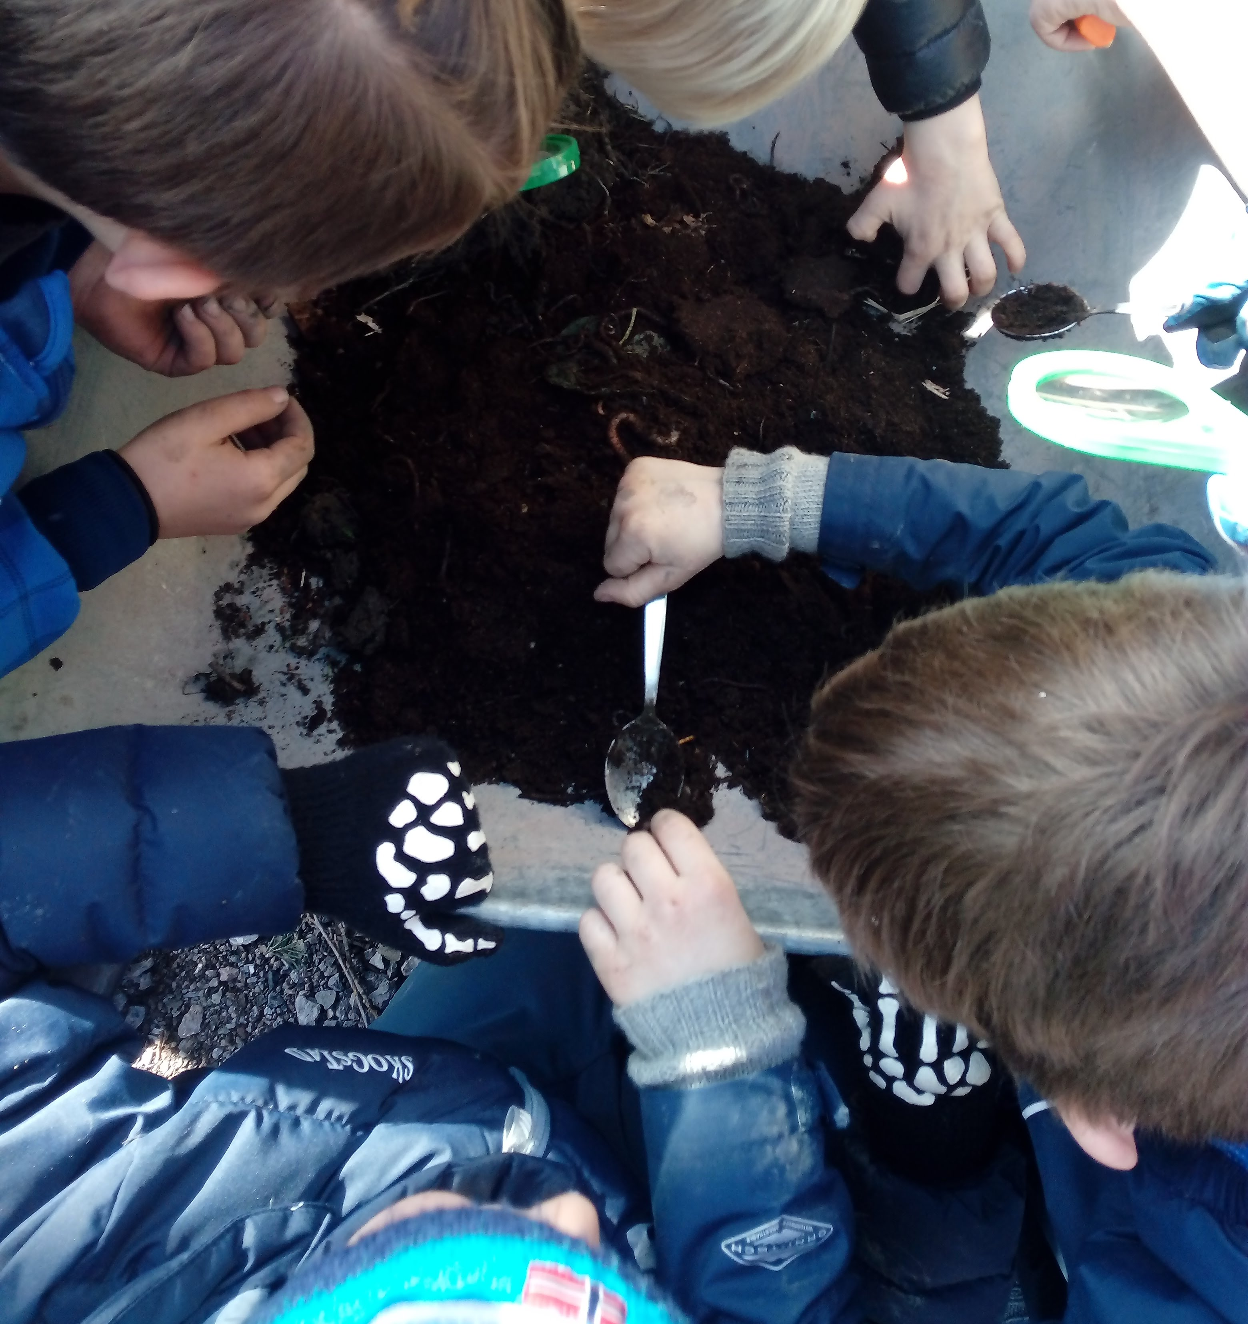
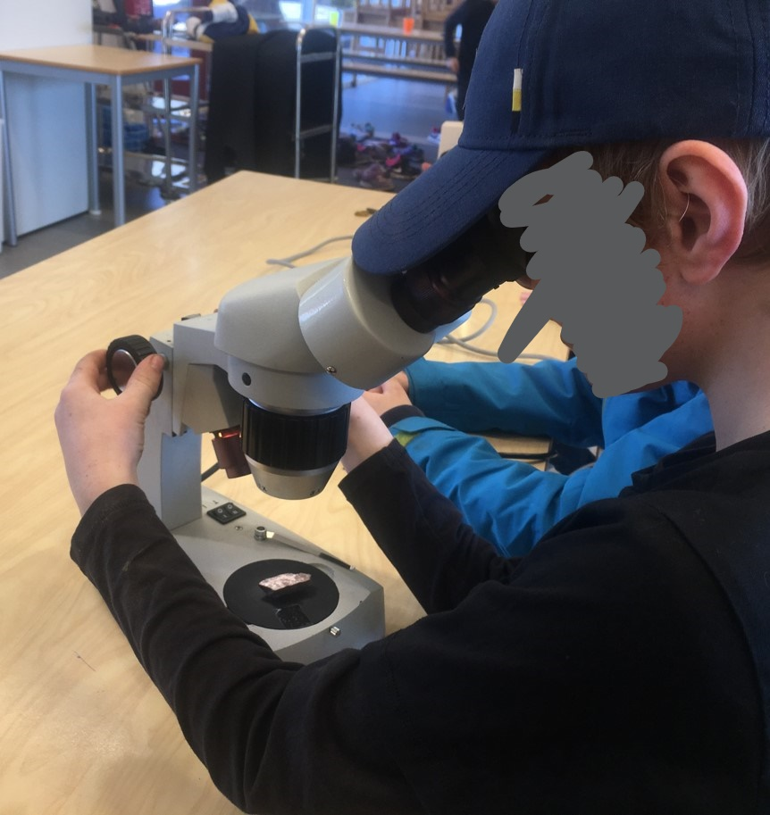

Slide 13
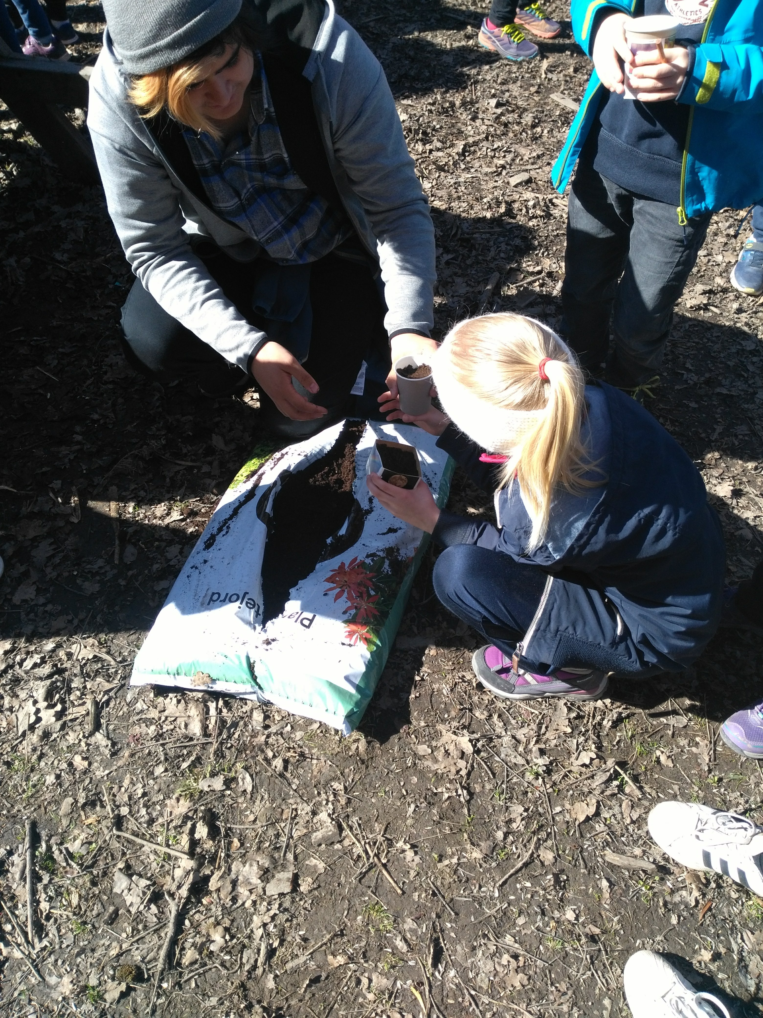
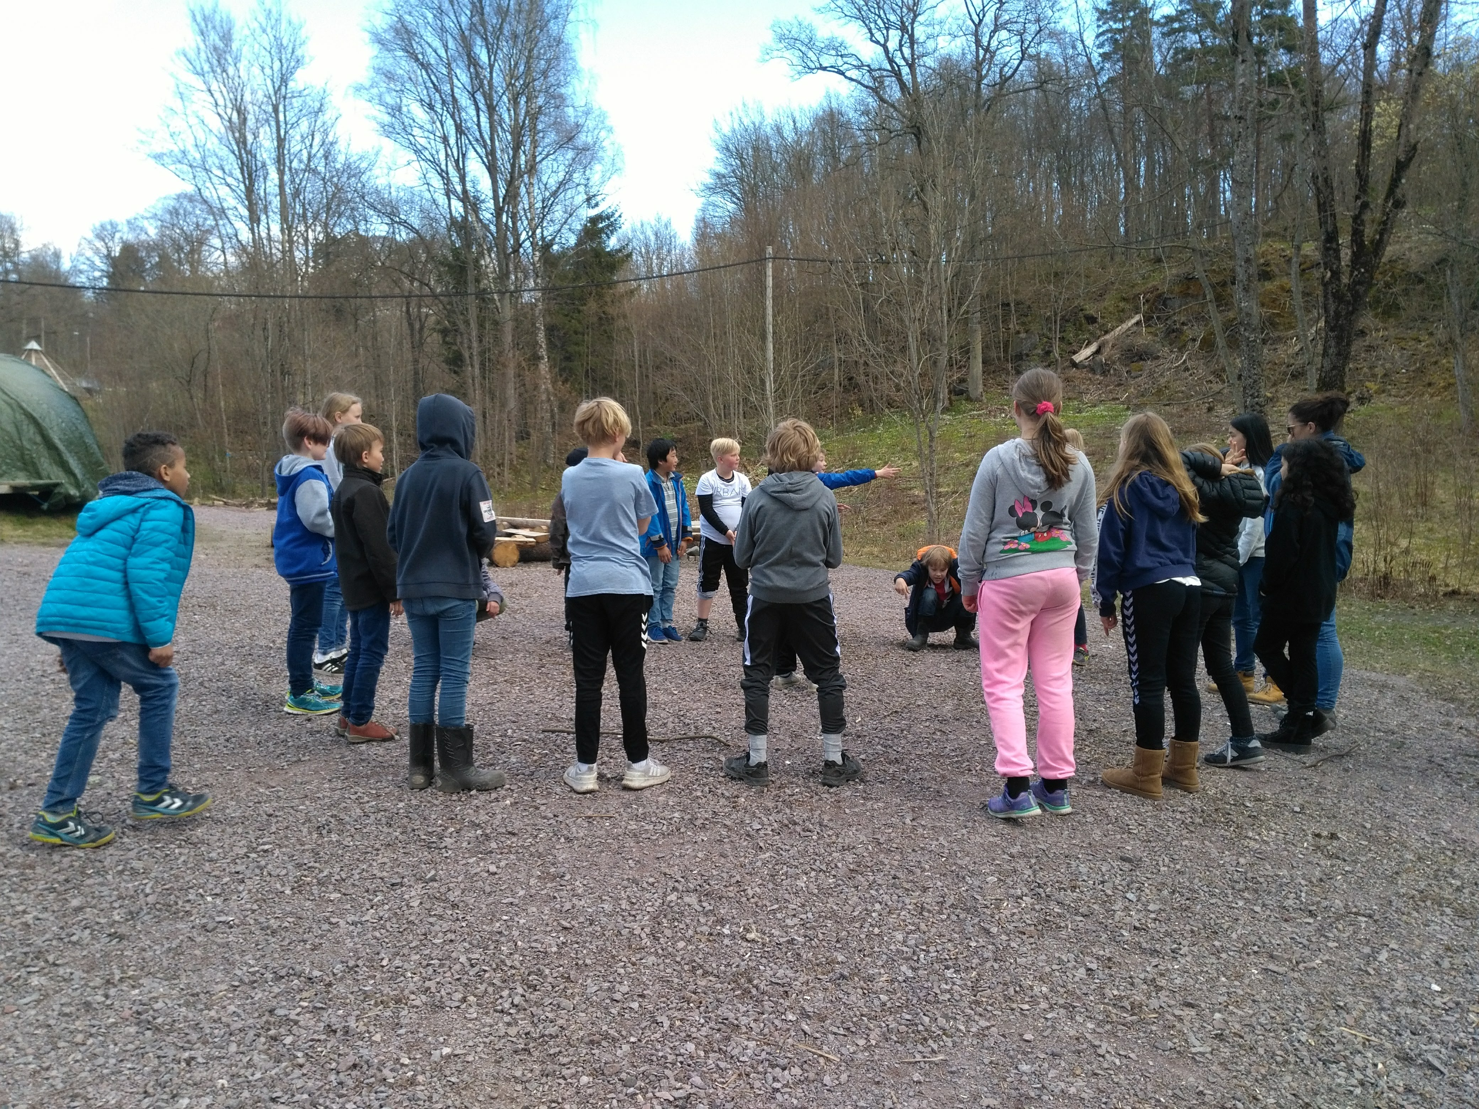

Slide 14
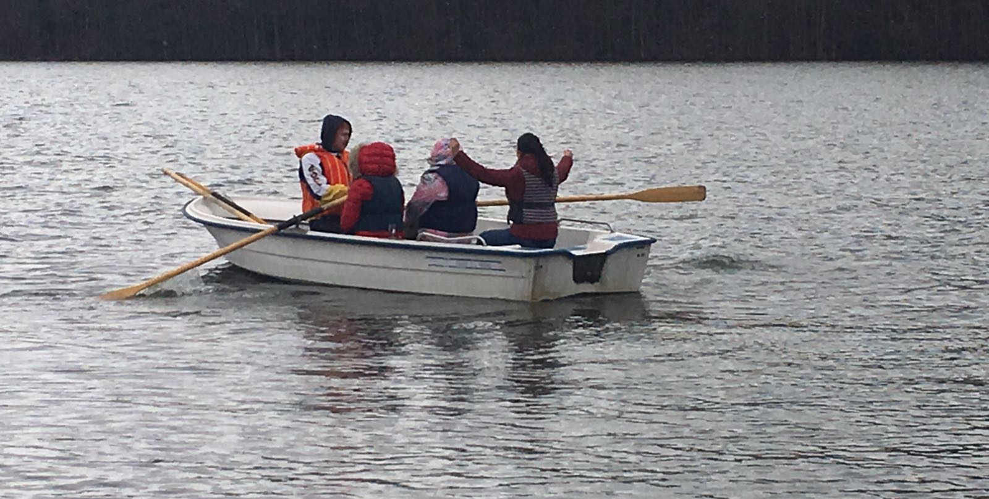
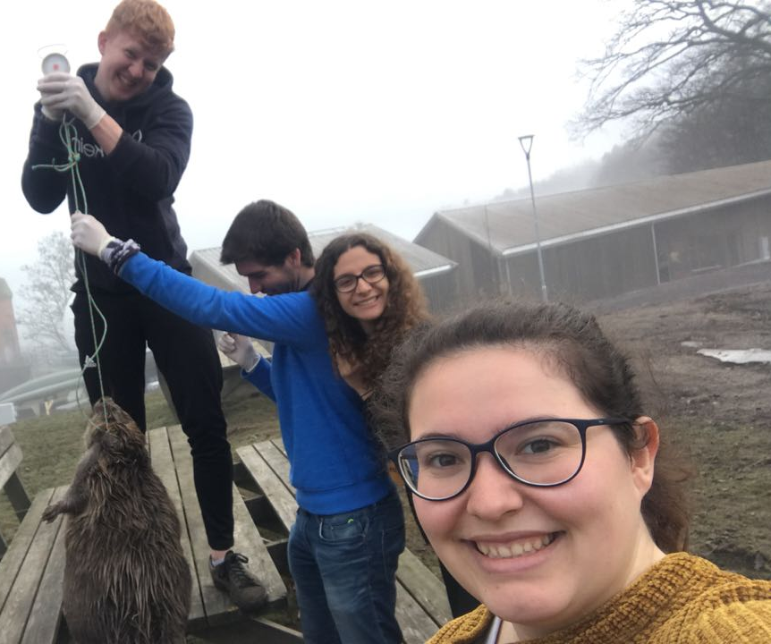
PLACEMENT THROUGH OUR EYES

Slide 15
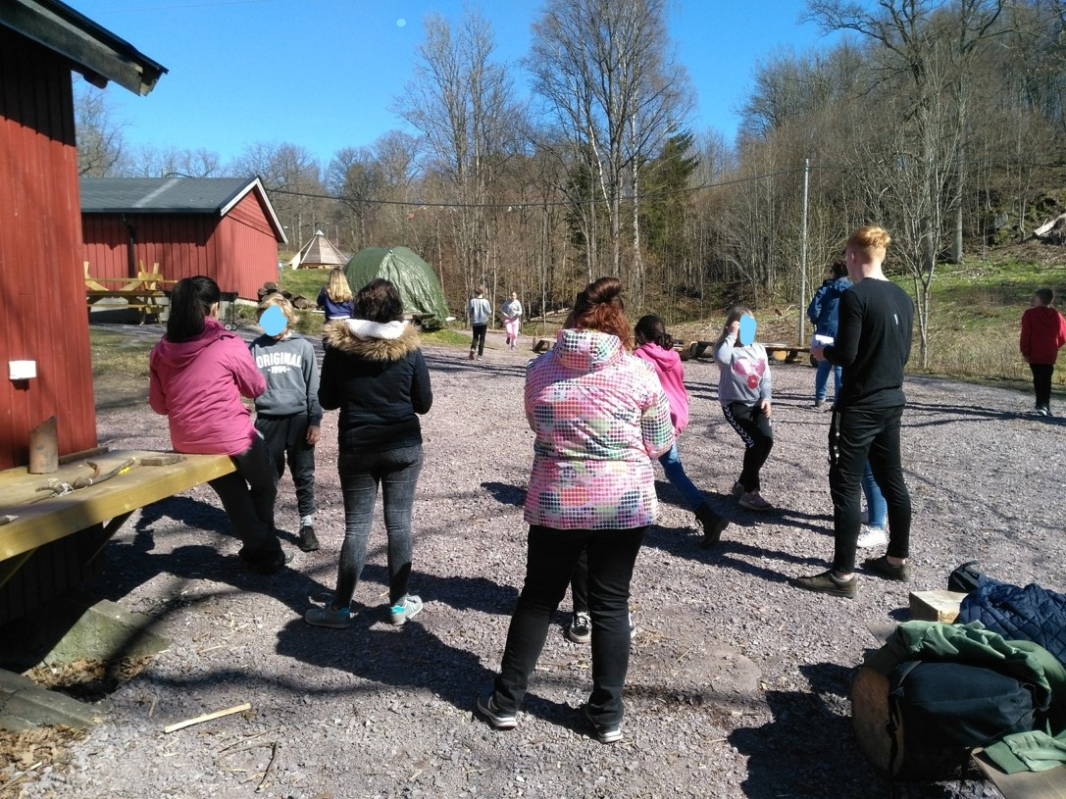
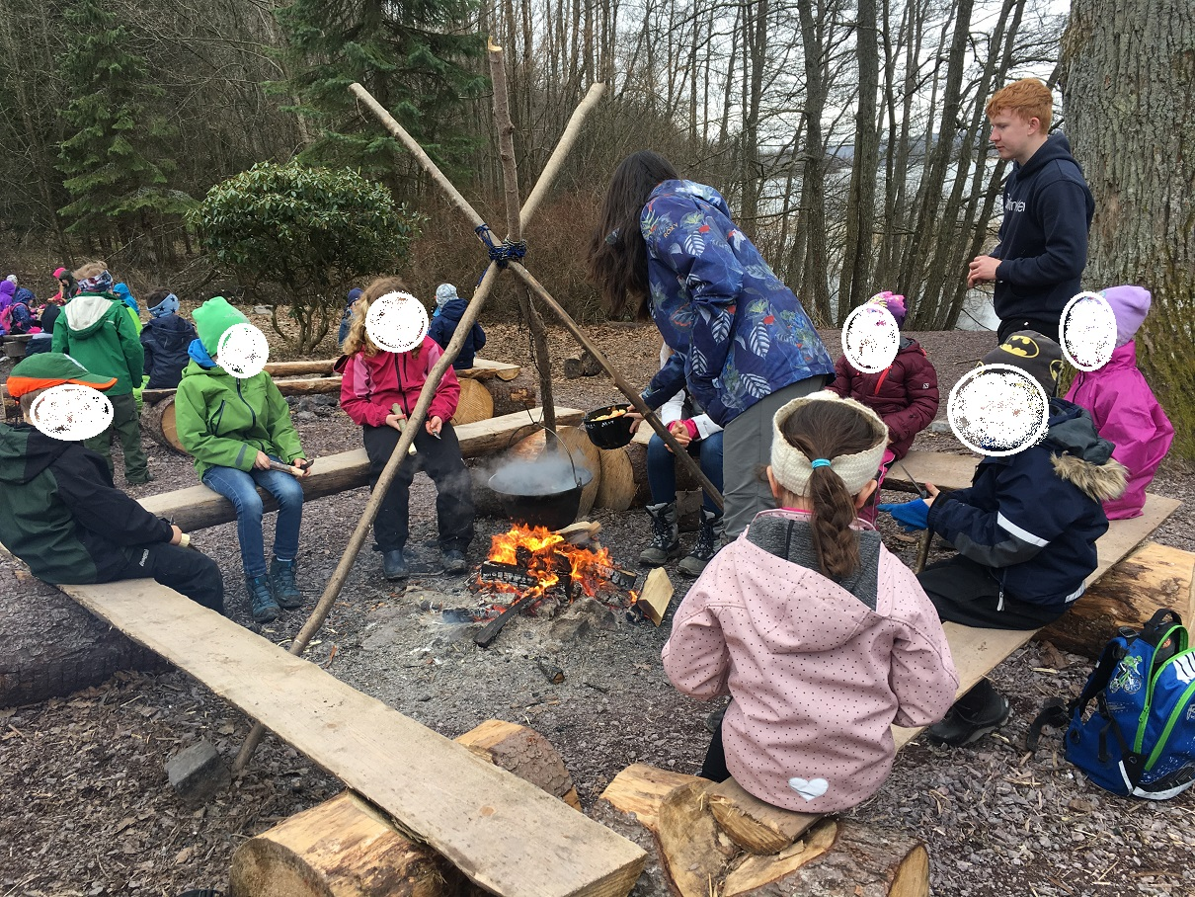

Slide 16
Personal take-aways
Organization doesn’t mean everything
Lack of language
Self-management
Take advantage of the unexpected

Slide 17
Horten Natursenter
Promote their posibilities and centre.
Schools
Accept or deny the offer and tells the centre what they’re working on
Horten Natursenter
Prepare activities

Slide 18
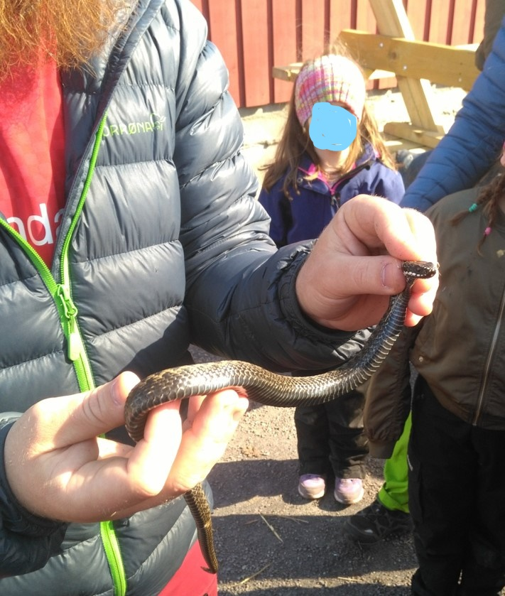
Take advantage of the unexpected

Slide 19
Cultural Heritage
Materials
Family
Nature
Teachers / ratio

