Slide 1
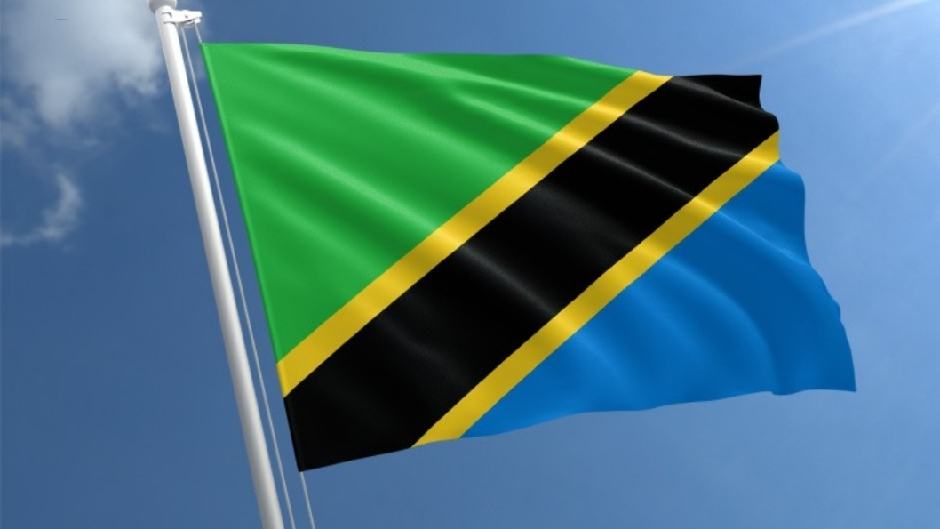


Tanzania

Slide 2
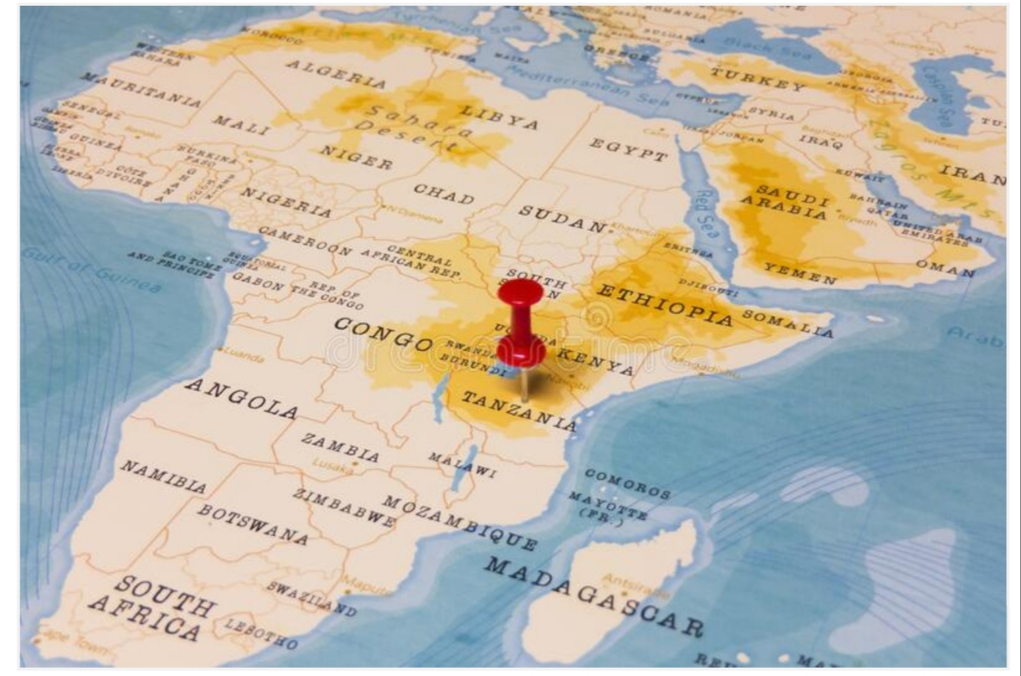
Tanzania is located in East Africa

Slide 3

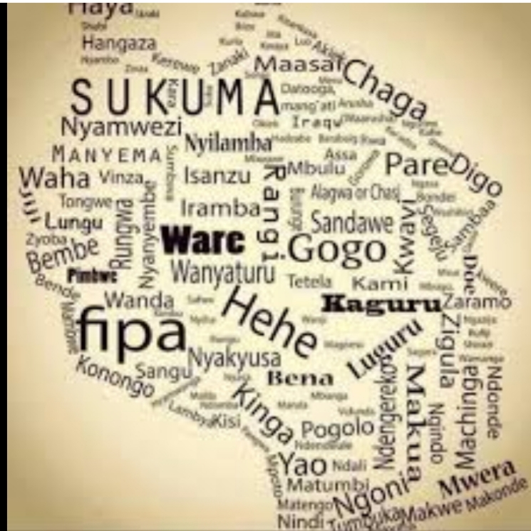
Tanzinia has over 120 different tribes and languages
z

Slide 4
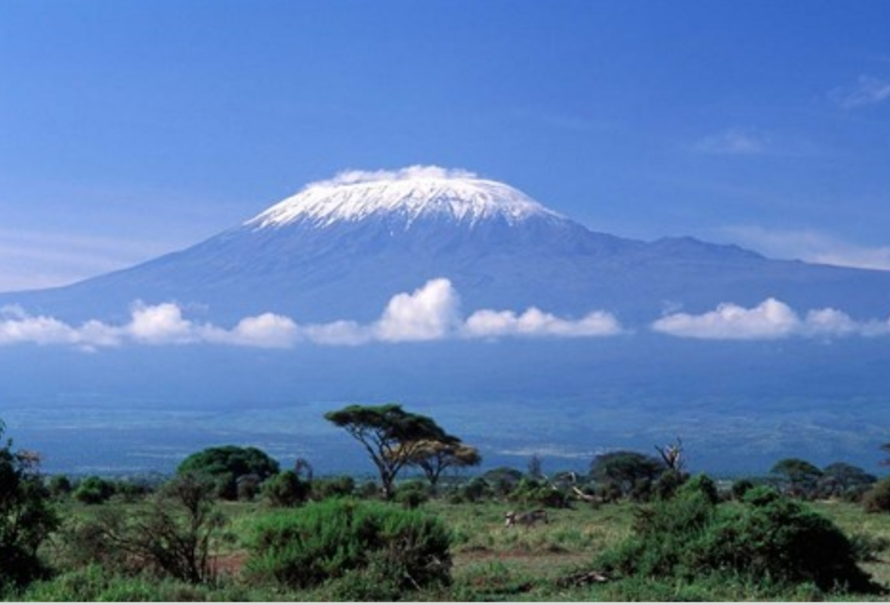
Mt Kilimanjaro is the higest mountain in Africa.

Slide 5
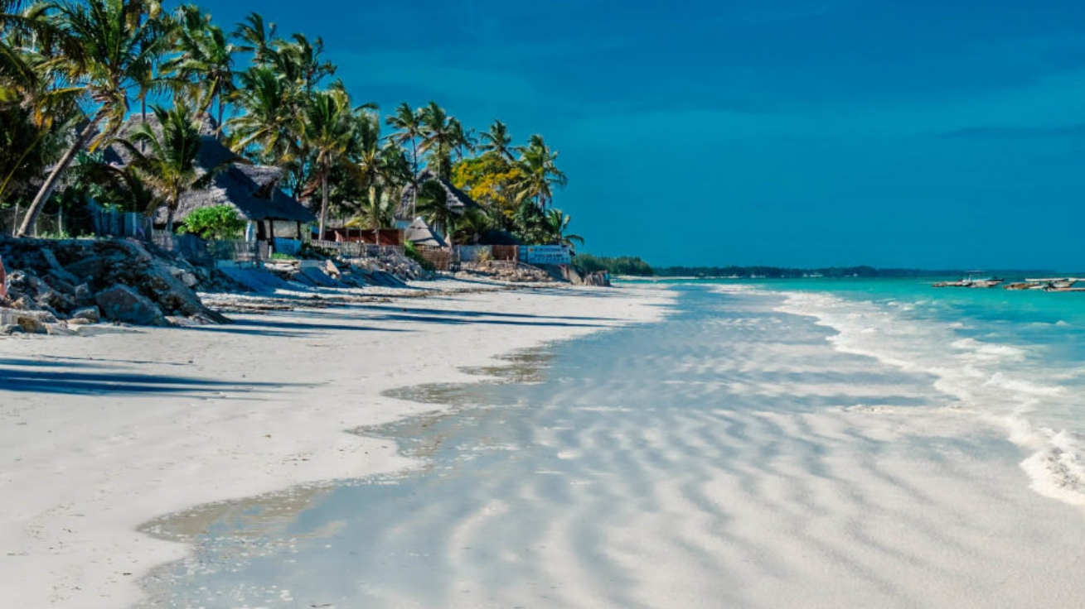
Zanzibar island
There is Pemba and mafia island

Slide 6
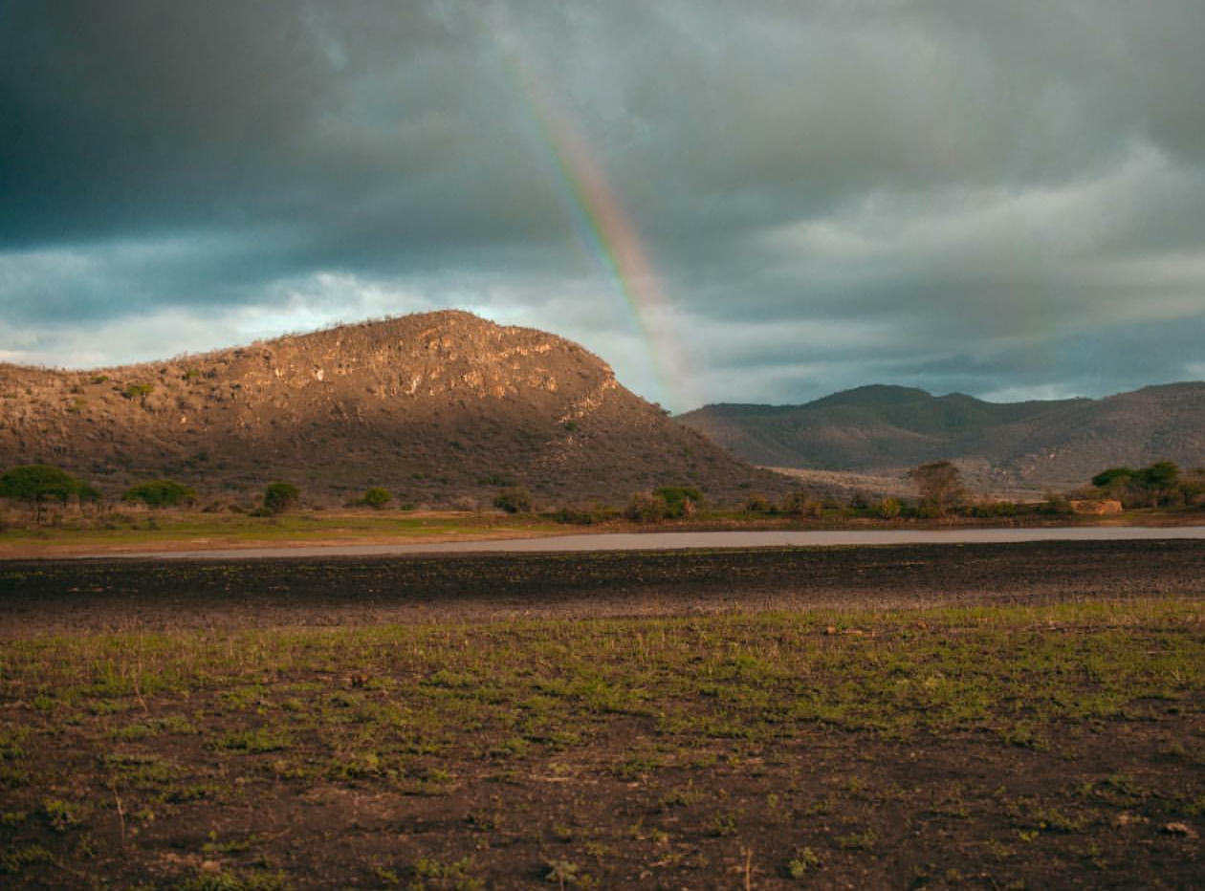
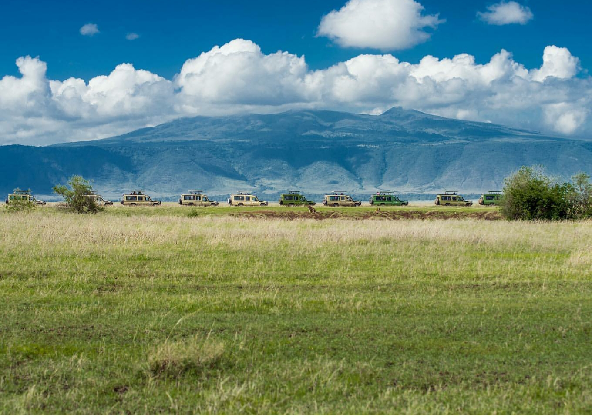
Landscape in Tanzania
z
Ngorongro cr

Slide 7
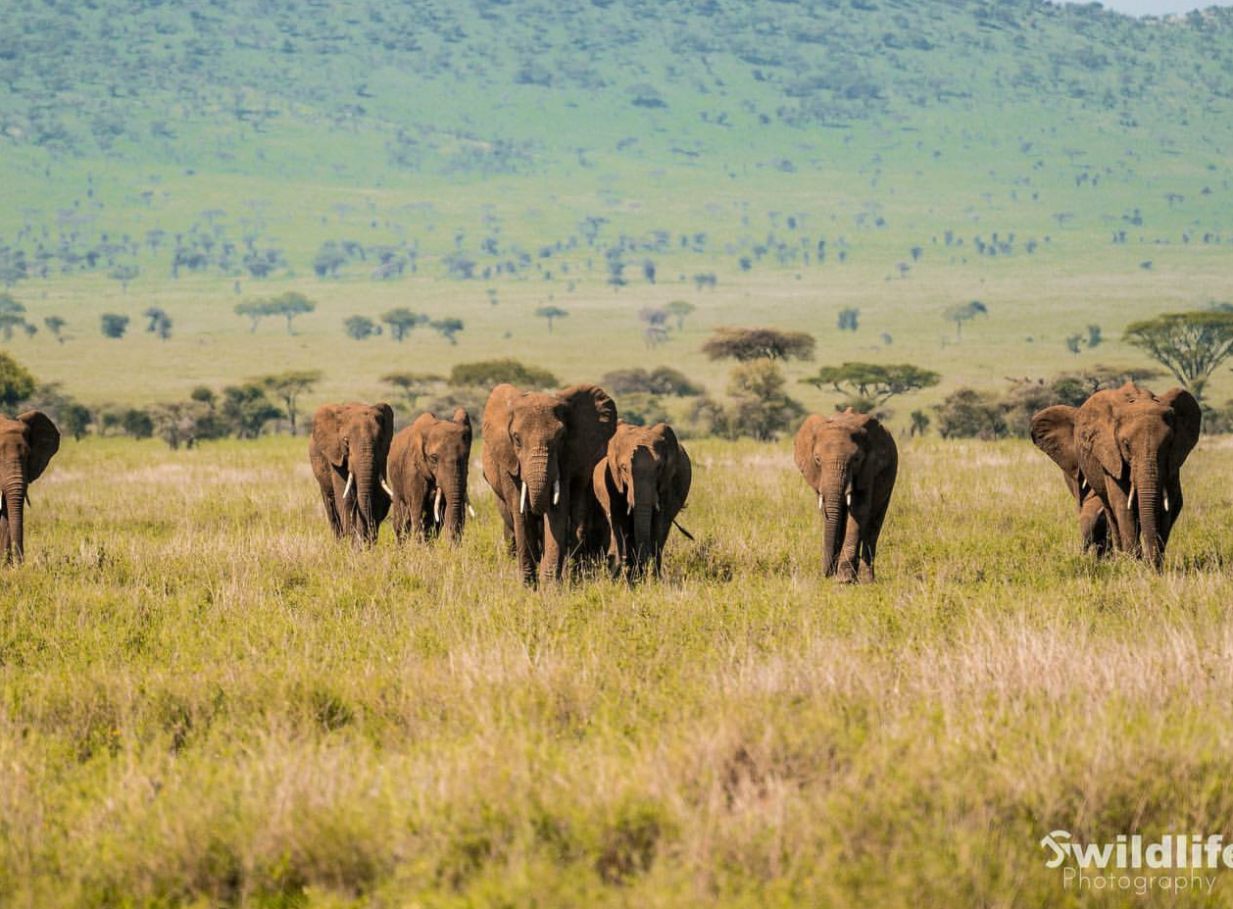
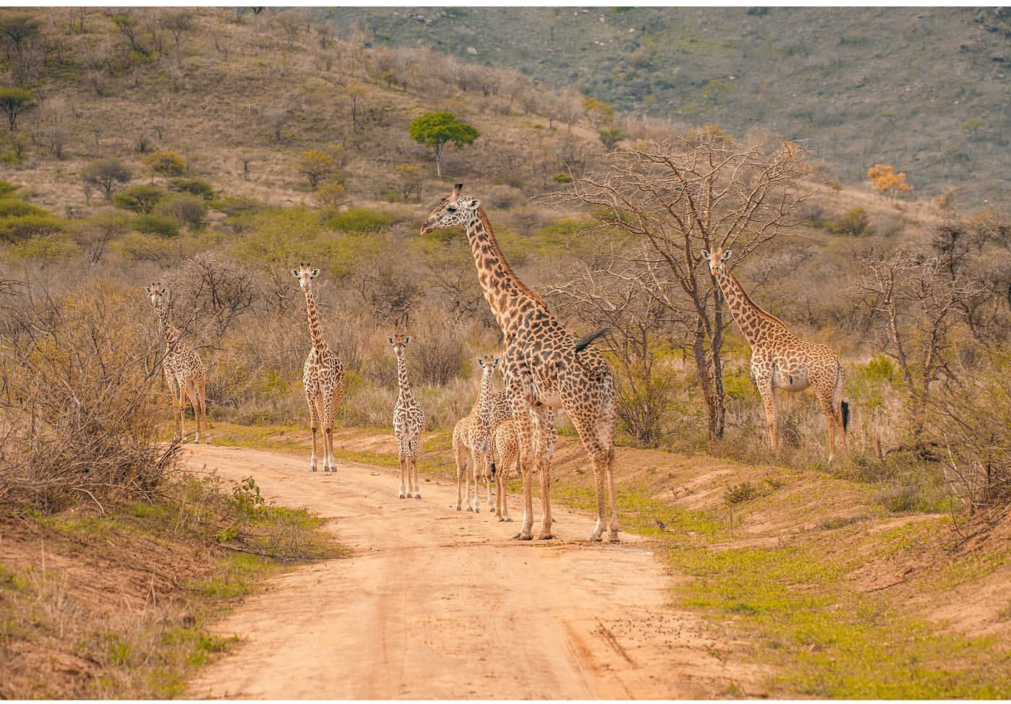
Affordance for learing about wildlife.
z
he country has designated 25% of its land to wildlife sanctuaries and national parks. It’s among the highest in the world, and the total area is greater than the size of Germany.

Slide 8
he country has designated 25% of its land to wildlife sanctuaries and national parks. It’s among the highest in the world, and the total area is greater than the size of Germany.

